Slide 1

IIoT Go to Market Strategy
Steve Gallagher | April 2017

Slide 2

In the “Almost Interesting” category…
Reside in Chapel Hill, NC
Home town is Montreal, grew up in Toronto
…and yes, like you, I HATE Celine Dion!
Moved to USA (Chicago) Jan 1, 1997
Married, two daughters (One Canadian, One American)
US Citizenship in 2008, dual passports now…
UNC Tar Heels, Montreal Canadians, NFL Panthers
I do not know, nor am I related, to this dude….

Slide 3
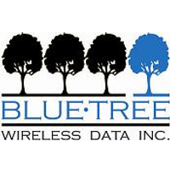



“Pre” Red Lion Timeline
Wireless Carrier Sales
($247m)
Seamless Mobility
Wi-Fi / Bluetooth
(1999)
Acquired by Spectris
for $76m
Industrial Cellular
Gateways
1987
2001
2003
2006
Oct
2007
Oct
2011
Sales
Training
Company
Acquired by Sixnet
for $21m
Sales
Prouct Operations
Management
(30m handsets shipped /
$4.2B)
Bluetooth
Access Point
start-up

Slide 4
Red Lion Timeline
Aug 2015
VP Sales IIoT,
Mr. Miller starts…
Andreas
Berz starts
2014
2015
April
2016
Oct
2016
2017
2012
Colin
Geis starts
Ready to make IIoT sales!
VP Sales
Cellular Team
( 2 USA, 3 Can, 3 SE)
VP Sales
Integrated
Red Lion and cellular channels
New strategy:
Time & Territory
ISS
Rep firms
Core Red Lion focus

Slide 5
“Size of the Prize”
Industrial Cellular Gateway Market Size- 2017
Global
Regional (est.)
IIoT
RLC
Share
<1%
Served
Available
Market
(Industrial Cellular
Gateways)
$545,000,000
1.4M units
$390 ASP
$250,000,000 Americas
$147,000,000 EMEA
$142,000,000 ASIA
Total Available Market
Fixed Cellular
Network Gateways
$754,000,000
3.7M units
$203 ASP
Source: Source: Berg Insight – The Global M2M/IoT Terminal Market 2016

Slide 6
IIoT Go-To-Market Plan
What
are we selling?
Who
are the end users?
When
should we start selling?
IIoT
GTM Plan
Why
do end customers
want this?
How
do we go to market?
Where
does Red Lion fit?

Slide 7
IIoT Go-To-Market Plan – Where
What
are we selling?
Who
are the end customers?
IIoT
GTM Plan
Why
do end customers
want this?
How
do we go to market?
Where
does Red Lion fit?

Slide 8
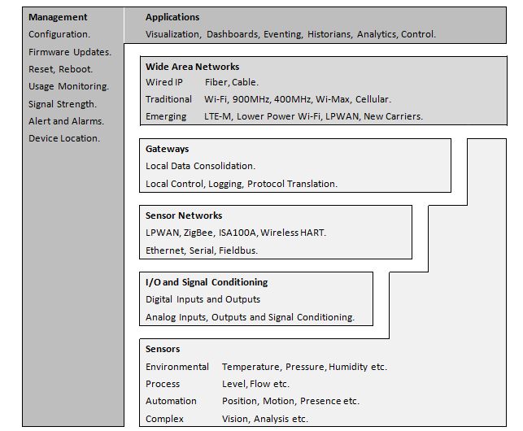
IIoT Stack – Where is RLC today?
Software, necessary infrastructure and platform support.
Networks that provide the link to the software
Hardware

Slide 9
IIoT Go-To-Market Plan - What
What
are we selling?
IIoT
GTM Plan

Slide 10


IIoT GTM – Value Proposition
Red Lion is the hardware, one piece of an IIoT solution that enables secure delivery data to the cloud.
Cloud Integration Strategy
We are cloud agnostic and will support the customer’s platform choice
Not a proprietary cloud strategy
Edge Computing
Capability
Application execution now down to the device level
Allows the ability to process data locally to prevent data deluge from the field to the enterprise level
Migrate from Automation to IIoT
Its more than protocol conversion. Demand is for secure delivery of sensor, asset and device data to the enterprise cloud
Leading with IIoT will enable Industrial cellular sales (and DSP etc.…)
Migrate from Product to Solution Orientation
Customers are looking for solutions the address the entire IIoT system
Vertical based solutions are central to current thinking as our GTM strategy evolves

Slide 11








Integrated Cloud Partnerships
RAMQTT
  Pre-Configured Profiles on RAM®
  Plug-and-Play
  ~2 minute setup*
SDK Agents
  Platform engineers integrate into Red Lion hardware
  Can provide custom features (protocol conversion, etc.)
  Customer must install agent onto RAM hardware

Slide 12
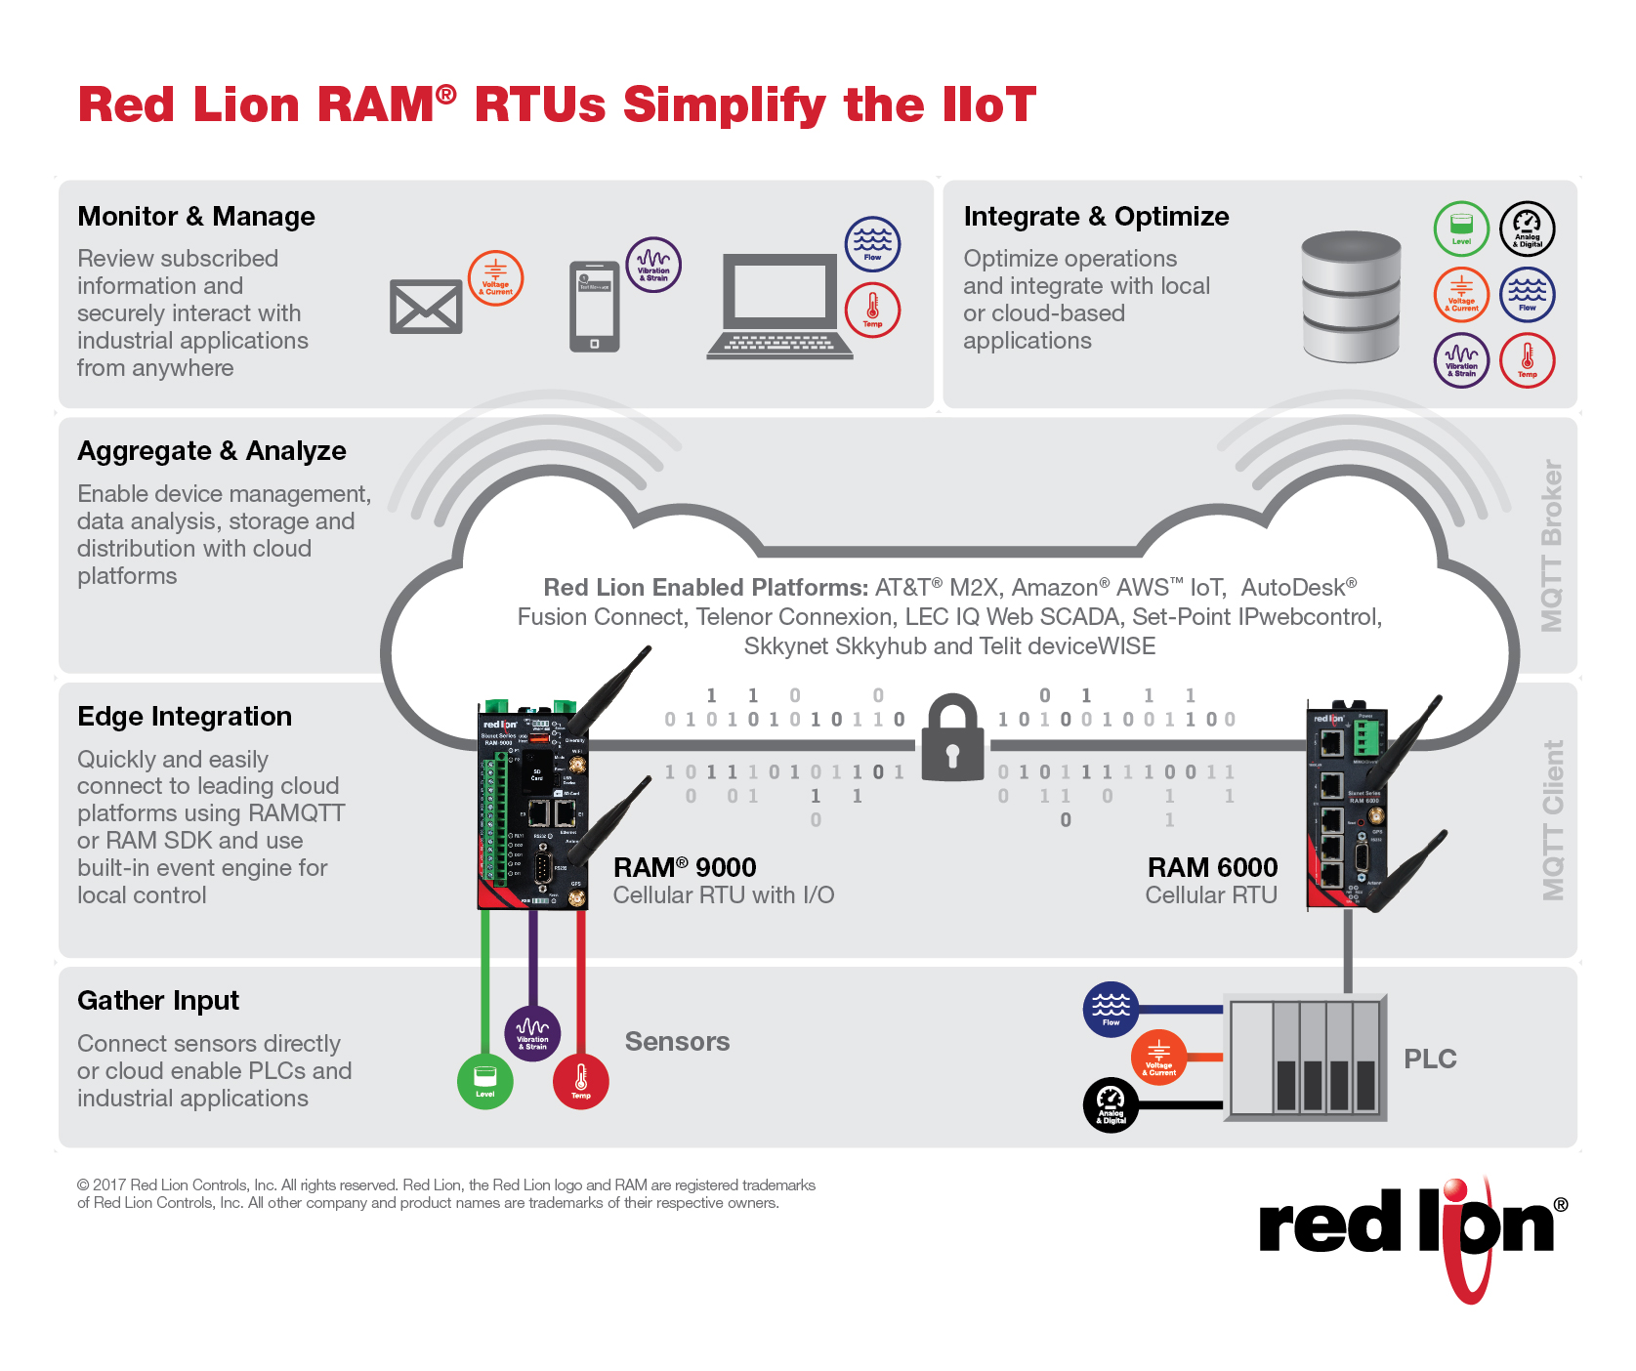
Red Lion RAM® RTUs Simplify the IIoT

Slide 13
We Sell Hardware
Today, we do not…
  Resell cloud platform services
  Resell carrier data plans
  Encourage our distribution partners to become resellers of cloud platforms or sales enablement software
  Participate in any referral, commission or revenue sharing programs with our ecosystem partners
…Tomorrow?

Slide 14
IIoT Go-To-Market Plan - Who
Who
are the end users?
IIoT
GTM Plan

Slide 15
Who are the End-Users?
Two key things to look for…
A clustered asset model whereby for most industrial applications, multiple devices are within reach of an industrial gateway. We see gateways as a key bridge between device networks and the various applications to which the data will be passed
We also believe that most IIoT applications types will follow the overlay or legacy application, and that gateways will be essential for talking to existing assets to obtain data.
So……Look for end users that have a combination of a large base of disconnected assets, and long hardware replacement cycles. Our gateways are the prime means for integrating these legacy assets.
Note: machine builders / OEM’s may be a great “end user” target for us, however hardware needs to evolve…

Slide 16
IIoT Go-To-Market Plan - Why
IIoT
GTM Plan
Why
do end customers
want this?

Slide 17
Evolution of the Gateway
Yesterday
Protocol Conversion
Simple network interface
Now
Primary enabler of sensor to cloud integration
Primary enabler of remote access for assets that may be distant, or previously not integrated
Primary enabler of edge computing
Cloud is the driver, whereby gateway is a means to the cloud

Slide 18
IIoT Go-To-Market Plan – How/Where
IIoT
GTM Plan
How
do we go to market?
Where
can we reach them?

Slide 19
Path to revenue is a “Partner Play”
Cloud
Platform
Providers
Cellular
Carriers
Red Lion
System
Integrators
Application
Platform
Providers
Distribution
Partners

Slide 20
IIoT GTM PLAN – It’s Play Time
Business Development Partner Focus
Business Development Tactics
Carriers
Deep with fortune 1000 / Ccustomers initiate discussions
Vertical focused
Resources in place and committed to the space
Bundled offers utilizing our hardware
Joint event participation and lead sharing
Technical and Value proposition training
Reseller / SI introductions
IIoT centric System Integrators
Calling on IoT verticals on the OT side, developing relationships and delivering solutions. Built for stitching together solutions from multiple vendors to solve OT problems.
Distributors/Integrators like LEC and Set Point Controls
Integration Partners of Cloud Platform Partners
Vertical and geographically based
Joint event participation and lead sharing
Cloud Platform
partners
Key to success within this channel is not to sell/promote the platform, but to co-sell new IIoT opportunities developed through the channel itself
Gain access to their SI ecosystem
Training on Red Lion IIoT ready products
Joint event participation and lead sharing
Red Lion
Distribution channels
Small subset capable / will embrace IIoT
Leading with our IIoT story will drive cellular revenue
Product Training of SAM’s & distributors
On boarding sales enablement partners
All procurement and/or revenue recognition via regions

Slide 21
Path to Revenue – Bundled Programs
US Cellular
W/WW bundle using iQWebScada cloud platform
AT&T
Remote Monitoring and Connected Factory bundled offers in development, using M2X cloud platform.
Verizon
Condition Based Monitoring (remote monitoring of industrial assets) bundled offer using Fusion Connect cloud platform
June 2017
July 2017
June 2017
May 2017
LEC
W/WW bundle
using iQWebScada
cloud platform

Slide 22
IIoT Go-To-Market Plan - When
When
should we start selling?
IIoT
GTM Plan
NOW!

Slide 23
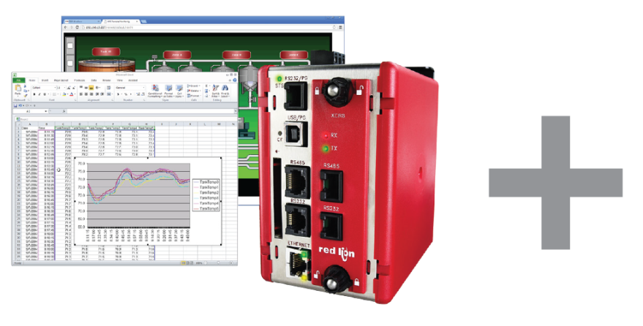
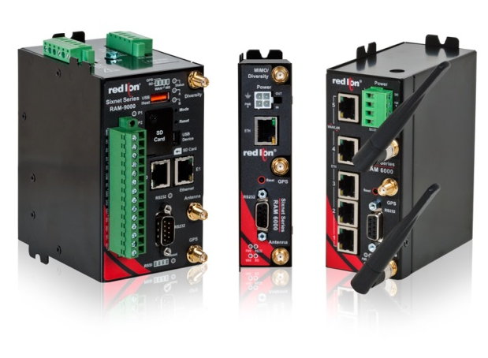
The Combined IIoT Solution!
Data Station Plus Protocol Conversion
Support for over 300 industrial protocols
Data logging and built-in web server
Remote machine access/configuration
Alarm and event notification
Email and SMS messaging
Productivity and reporting tools
RAM® Industrial Cellular RTUs
  Secure communication to the Cloud
  4G LTE multi-carrier support
  Real-time access to mission-critical data
  Powerful built-in event engine
  RS-232, RS-485 and Ethernet ports
  Digital and analog I/O

Slide 24
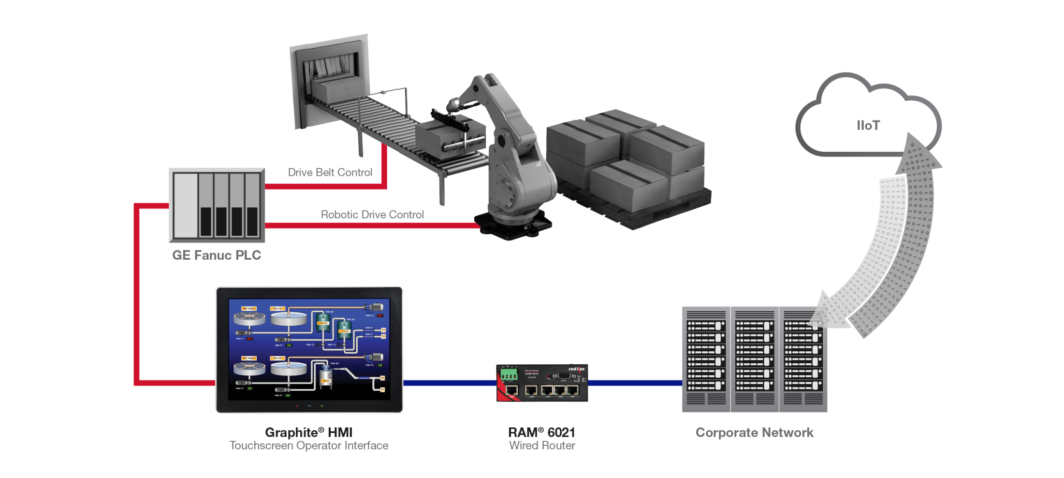

Connected Factory: Wired

Slide 25
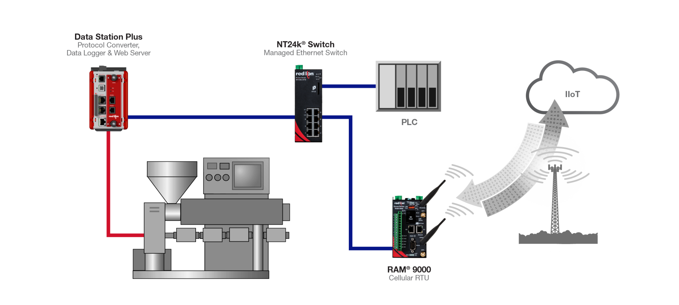
Connected Factory: Wireless

Slide 26

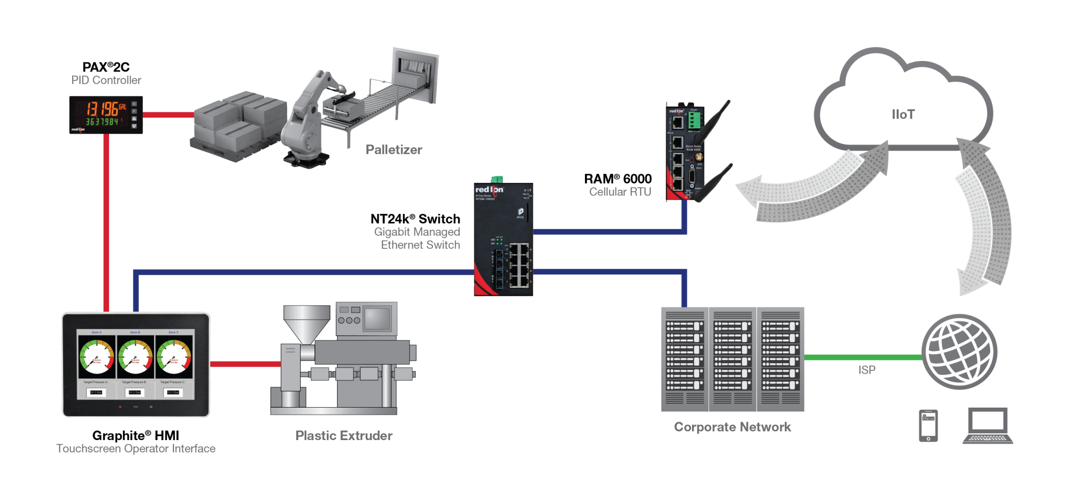



Slide 27
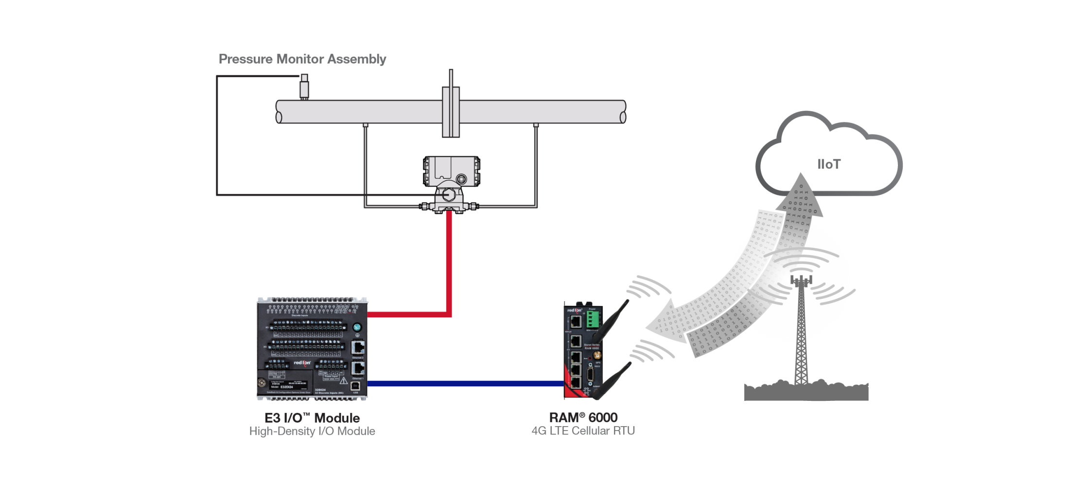
Remote Monitoring

Slide 28
Questions?

