Slide 1
Indication
Workshop 2013

Slide 2
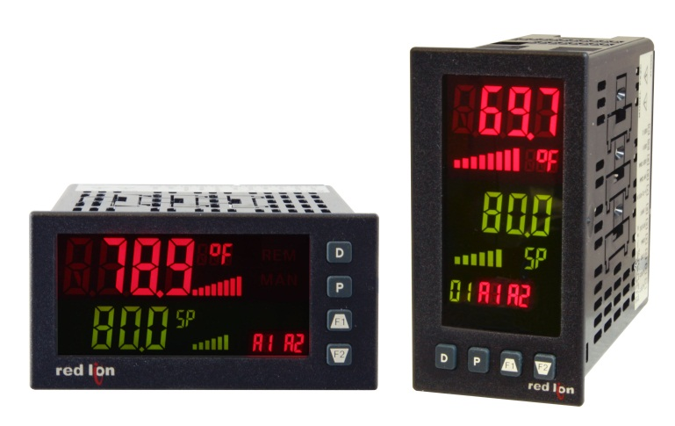
Indication Goals
PAX2 Series Update
Expanding Our Range

Slide 3
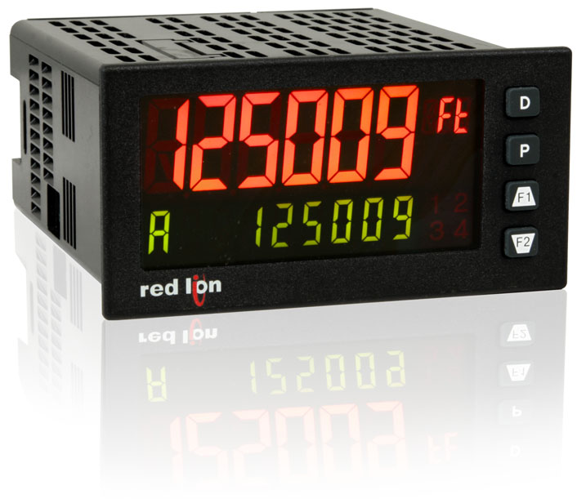
PAX2 Series

Slide 4



PAX2 Series
UL Listed
  PAX2A
  PAX2D
  PAX2S
  PAX2C

Slide 5
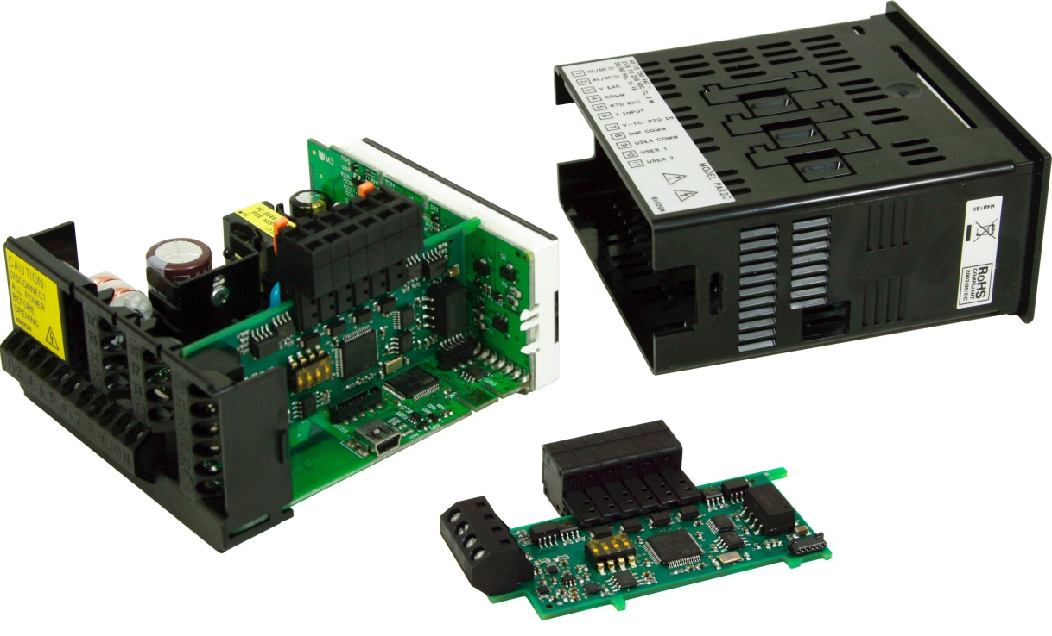
Update on FlexBus

Slide 6
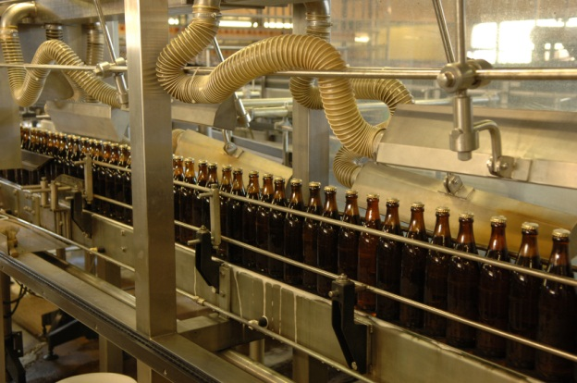


Expanding Our Range

Slide 7

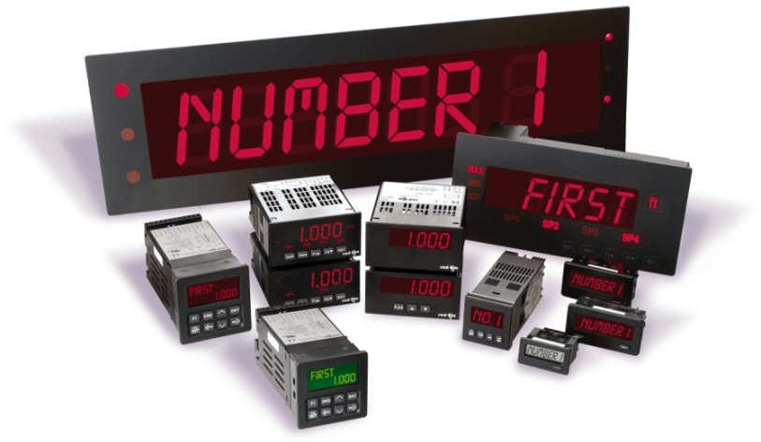
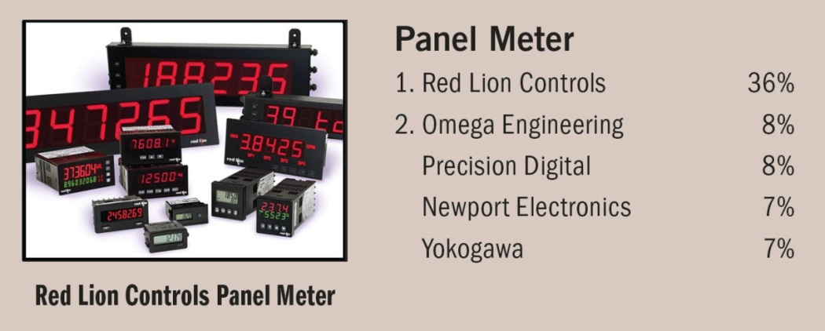
The Brand Is Ours

Slide 8
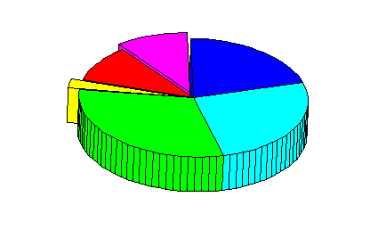
Panel Meter Numbers
Digital Meters
Analog Meters
Signal Conditioners
Sensors
Accessories
???

Slide 9
Panel Meter Numbers
Digital Meters
Analog Meters
Signal Conditioners
Sensors
Accessories
PID Controllers

Slide 10
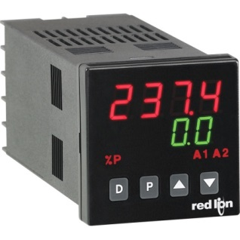
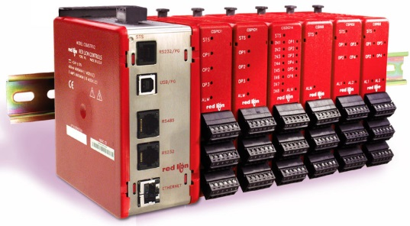
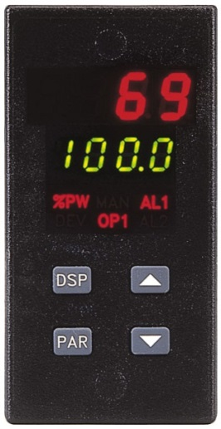
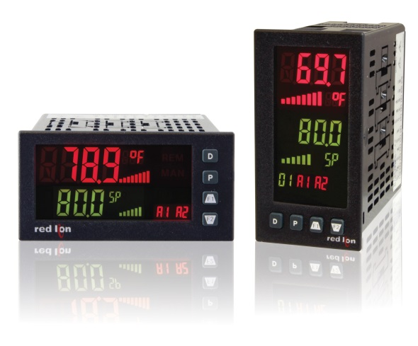
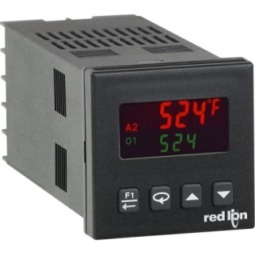
Our Current Products

Slide 11
Temperature Control Market
Charts are representative only

Slide 12
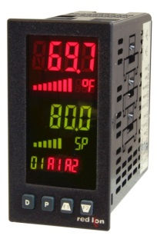
What’s Missing?
Charts are representative only

Slide 13
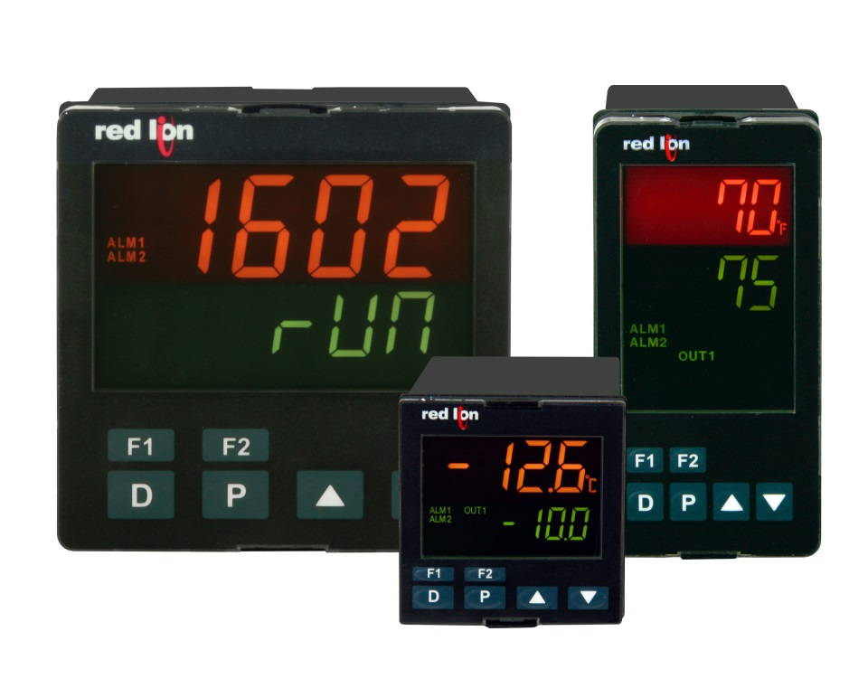
Introducing PXU Series
Our New Low Cost Controllers
1/16, 1/8 and 1/4 DIN Models

Slide 14
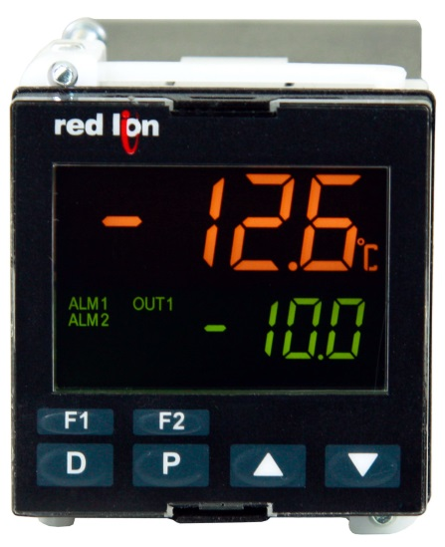
PXU Features
Our New Low Cost Controllers
Full PID Control
Universal Input - TC, RTD, 0 – 10 VDC, and 0 -20 mA (0 -50 mA)
On demand auto-tuning
PC or front panel programming
1 Inch shorter depth
Initial offering AC powered
Custom overlay capability
UL Listed, 61010-1, Process Control Equipment

Slide 15
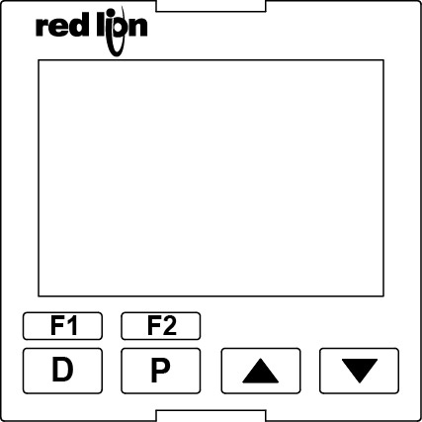
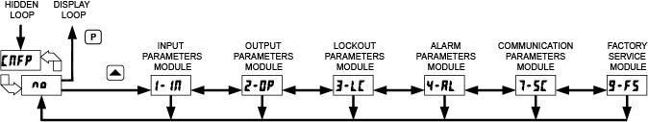
Most Important
Look and feel, both product and programming

Slide 16
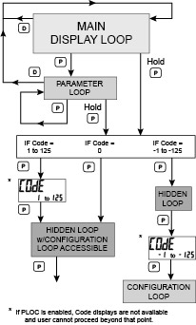
Programming Loops
Red Lion Programming

Slide 17

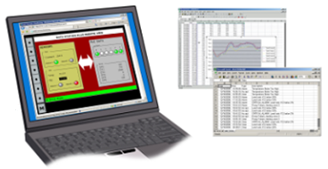
RAM LTE for remote access
Graphite HMI with local I/O
105TX for local network
Dedicated PID controller with display
Laptop for remote monitoring and control
E2 I/O for remote I/O

Slide 18
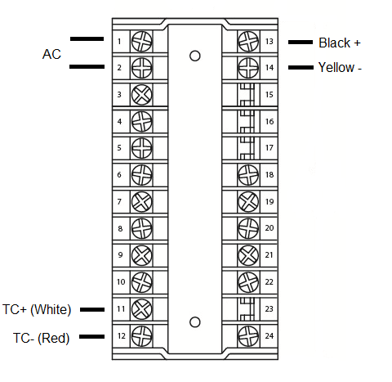
Hands-on
Wiring the controller

Slide 19
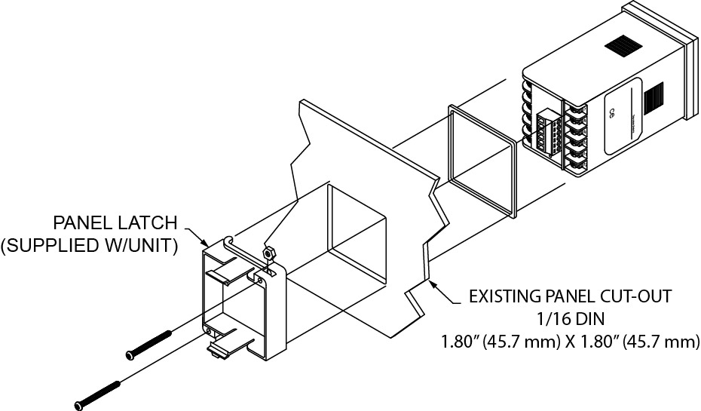
Let’s Try One
Installing the controller

Slide 20
Programming Overview
Configuration Loop

Slide 21
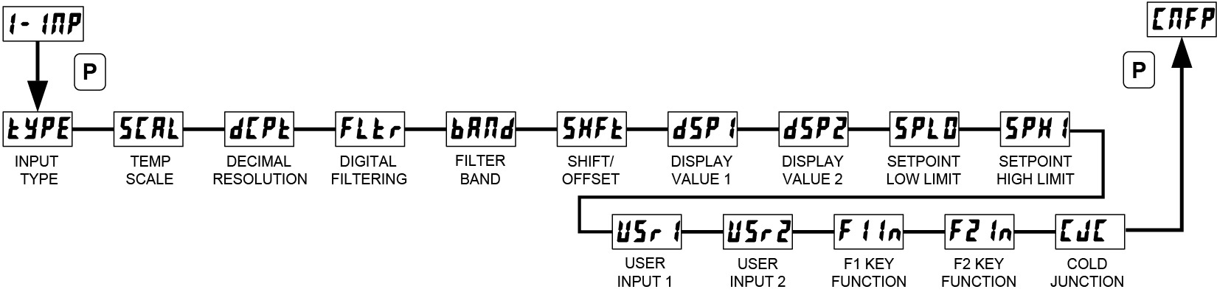
Module 1 – Input Parameters
Parameter Display Selection
Input Type tyPE tc -J
Temperature Scale SCAL ˚F
Decimal Resolution dCPt 0
Digital Filtering FLtr 8
Input Filter Band bANd 1

Slide 22
Module 1 – Input Parameters
Parameter Display Selection
Shift/Offset SHFt 0
Display Value PT 1 dSP1 0.0
Display Value PT 2 dSP2 100.0
Setpoint Low Limit SPLO -148
Setpoint High Limit SPHI 2192

Slide 23
Module 1 – Input Parameters
Parameter Display Selection
User Inputs USr1 or USr2 NONE
Function Keys FIIn or F2In NONE
Cold Junction CJC ON

Slide 24
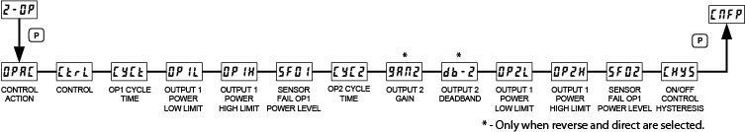
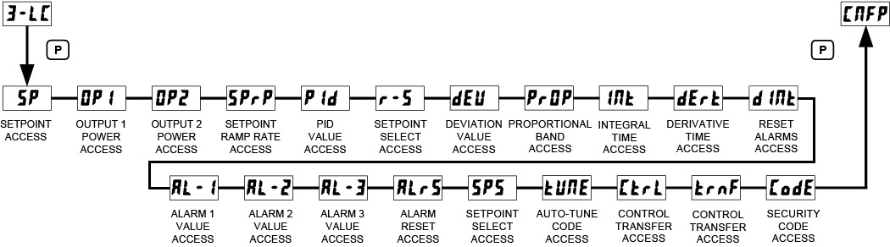
Additional Modules
Module 2 – Output Parameters
Module 3 – Lockout Parameters

Slide 25
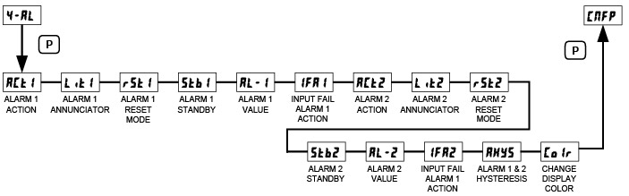
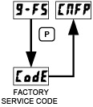
Additional Modules
Module 4 – Alarms Parameters
Module 9 – Factory Service Operations

Slide 26
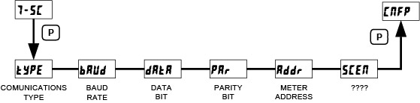
Serial Communication
Module 7 – Serial Communication Parameters
Comms Type – Modbus RTU
Baud Rate – 38.4K
Address 247

Slide 27

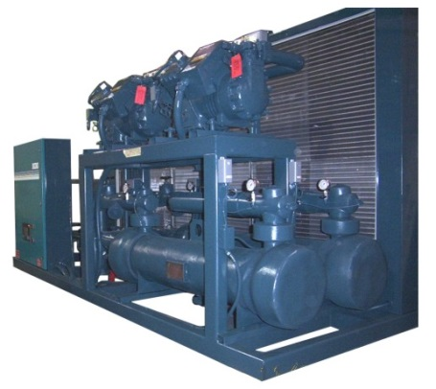
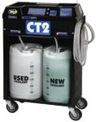
Process Applications
Chemical Pumps
Cooling Controls
Automotive Fluids

Slide 28
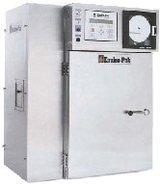
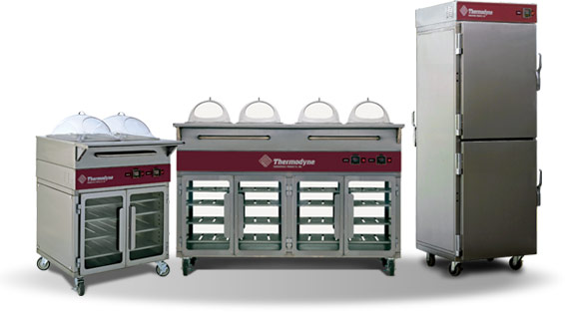
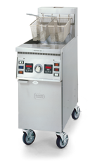
Temperature Applications
Ovens and Smokers
Food Warmers
Fryers and Grills

Slide 29

Still in operation and application to PID control

Slide 30

Complete Offering
Charts are representative only

Slide 31
Thank You

