Slide 1
Interface
Workshop 2013

Slide 2
G3 Series – Review

Slide 3

Hardware

Slide 4
Hardware
Launched in 2003
  Started with the G303
Range filled out slowly
Sales slow to develop
  Technology was too early
2005 Sales explodes
  Realized technology and …

Slide 5

Crimson Software

Slide 6

Crimson
Crimson 2.0 launched 2003
  Great “hang time” – was seven years old when replaced
Crimson 3.0 launched 2010
  Better user interface
  More efficient tag handling
  Better colors and fills
  Undo function
  Master slides and widgets
  En masse formatting
  Debug tools
  Crimson 3.0 still going strong

Slide 7
Crimson’s Critical Features
The Big Three
Protocol conversion
Data logging
Web server

Slide 8
Crimson’s Critical Features
User programs
Not to mention…
Custom & data web pages
FTP Host
Email support
Security manager
SMS text message support
Easy animation
SQL Sync
FTP client

Slide 9
Forum Threads (PLCS.net)
In response to a customer trying to decide between Maple Systems, C-More Panel or an EZ Automation HMI…
  “I'll be the first to suggest Red Lion's G3 or G3 Kadet HMI over any of those.”
In response to a customer struggling with an AB HMI…
  “…toss the PV300 (or sell it on ebay) and buy a G304K from Red Lion. Then your HMI limitations all but go away and the performance and capability and reliability will go up (dramatically).
In response to someone struggling with AB software…
  “Install Studio in a separate VM, and restore an archived copy of the application to that, then try to edit… Then throw it all out, and switch to Red Lion.”

Slide 10
Customer Sentiment
Customer’s statement about the DSP to Jeremy Howell…
  “…the Data Station Plus could cure world hunger if it was given a chance. You really don’t charge enough for them.”

Slide 11

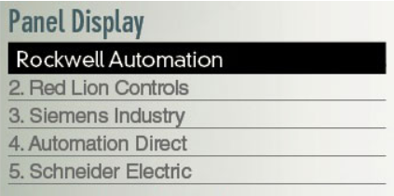
G3’s Brand
Survey says...
Thanks to your efforts!

Slide 12
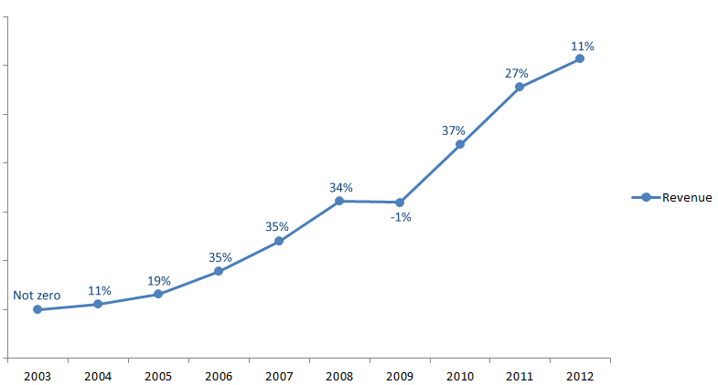
Revenue Growth
Thanks again!
Over 500% growth

Slide 13
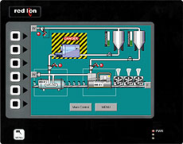
Is There Room for Improvement?
The negative comments
Has a big bezel/buttons I don’t want
The overlay is lumpy
Some models have low resolution
CF cards are limited; old technology
Battery replacement requires disassembly
Those mounting studs are tedious
Temperature ratings aren’t sufficient
The looks that only a mother could love

Slide 14

What if we could…
Reduce the mounting space
Eliminate the nasty buttons
Provide better touchscreen feel
Improve display resolutions
Move to SD cards
Make it look sexy

Slide 15
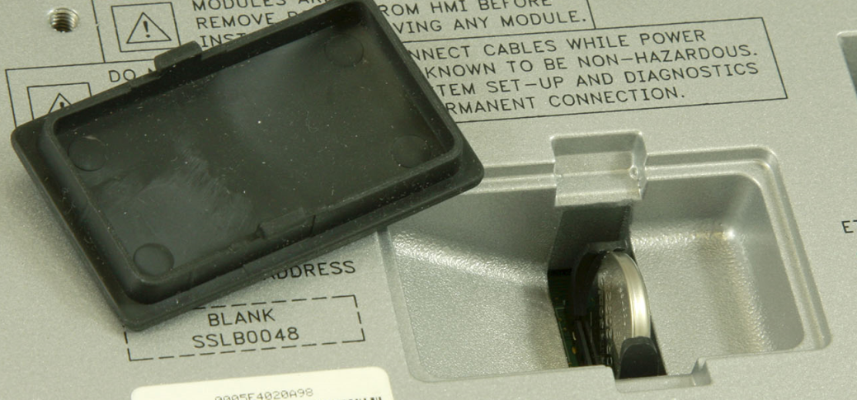
What if we could…
Offer easier battery replacement, without disassembly

Slide 16
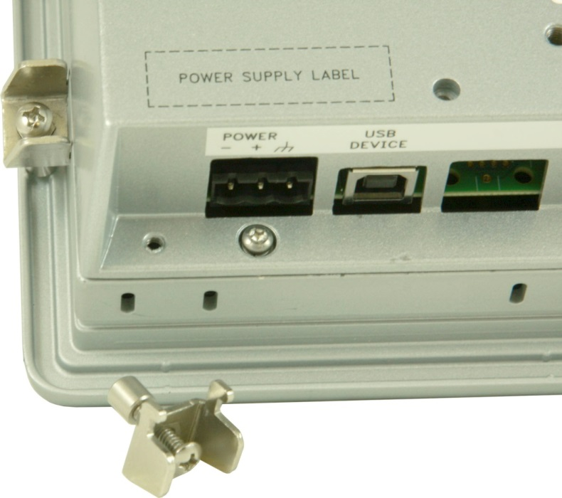
What if we could…
Use easy-to-install mounting clips

Slide 17
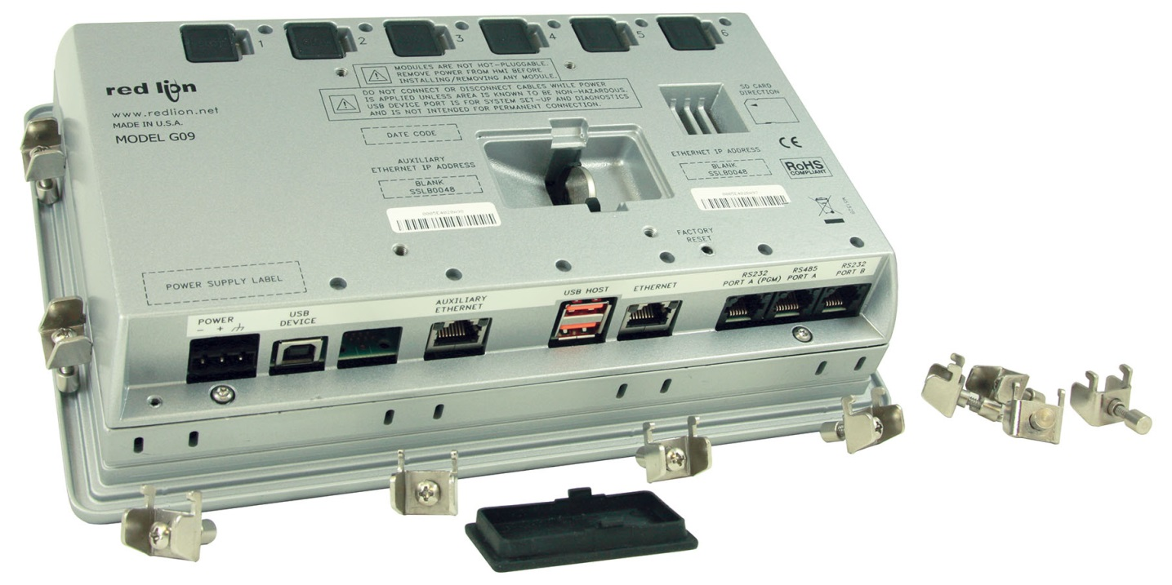
What if we could…
Give you a package that offers all of these?

Slide 18
Graphite Series HMI

Slide 19


What if we could…
Remove all the obstacles!

Slide 20
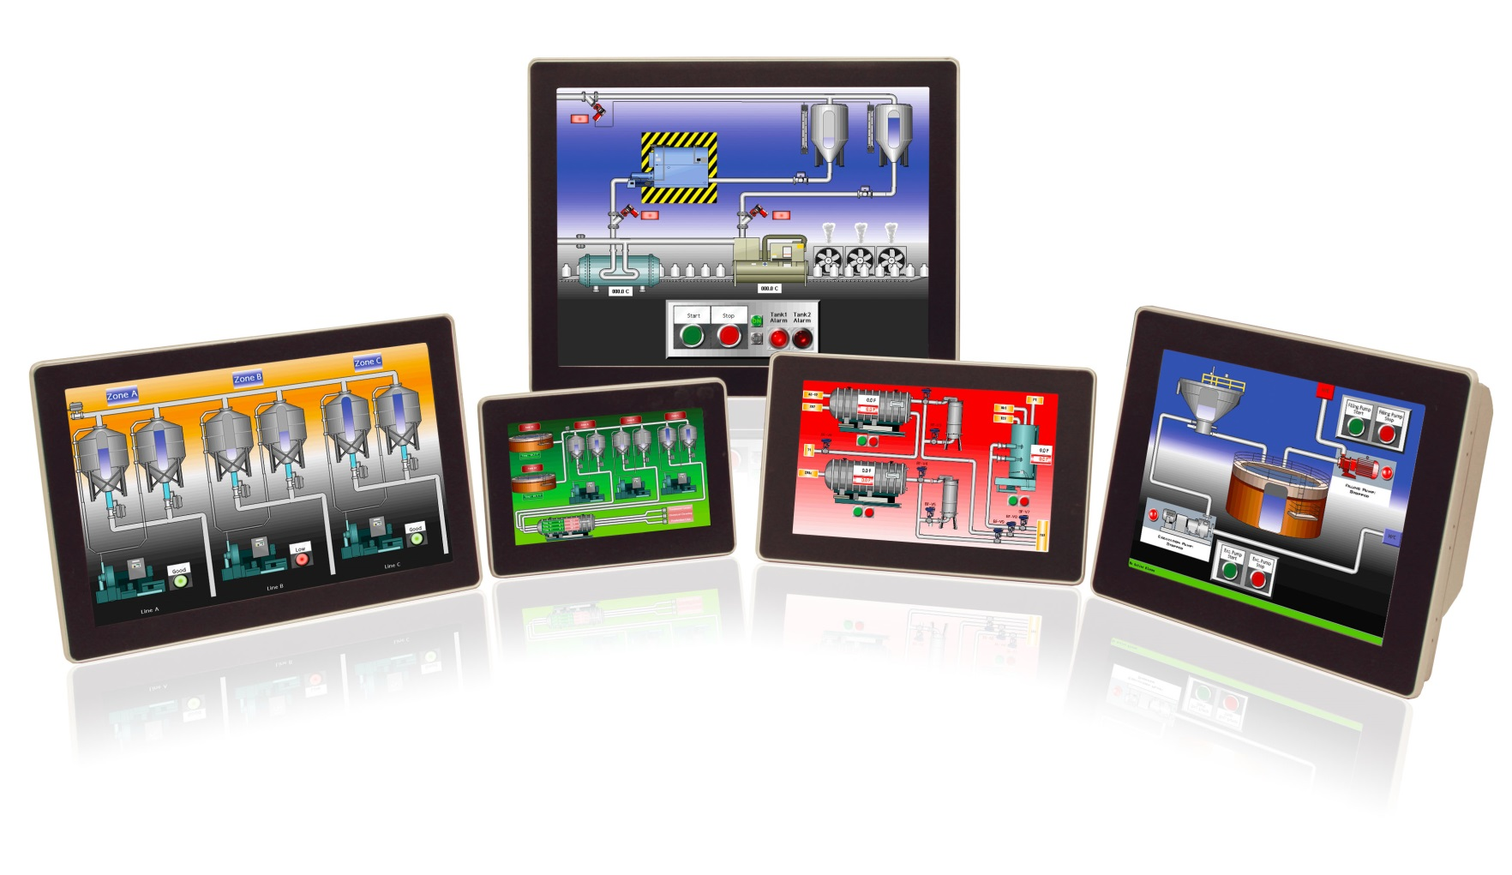
The Graphite Series

Slide 21
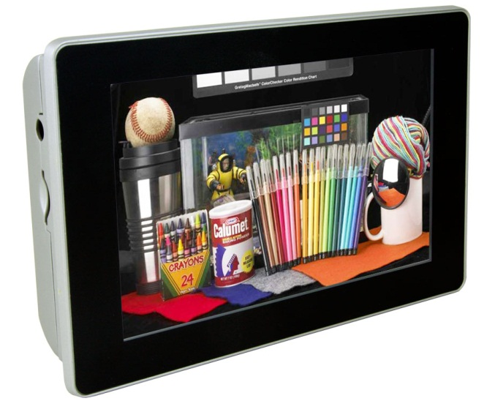
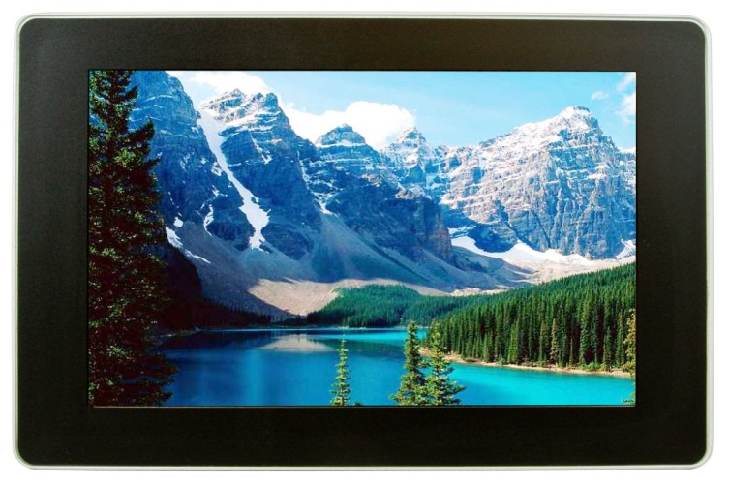
Sleek Appearance
Wolf-whistles appreciated

Slide 22
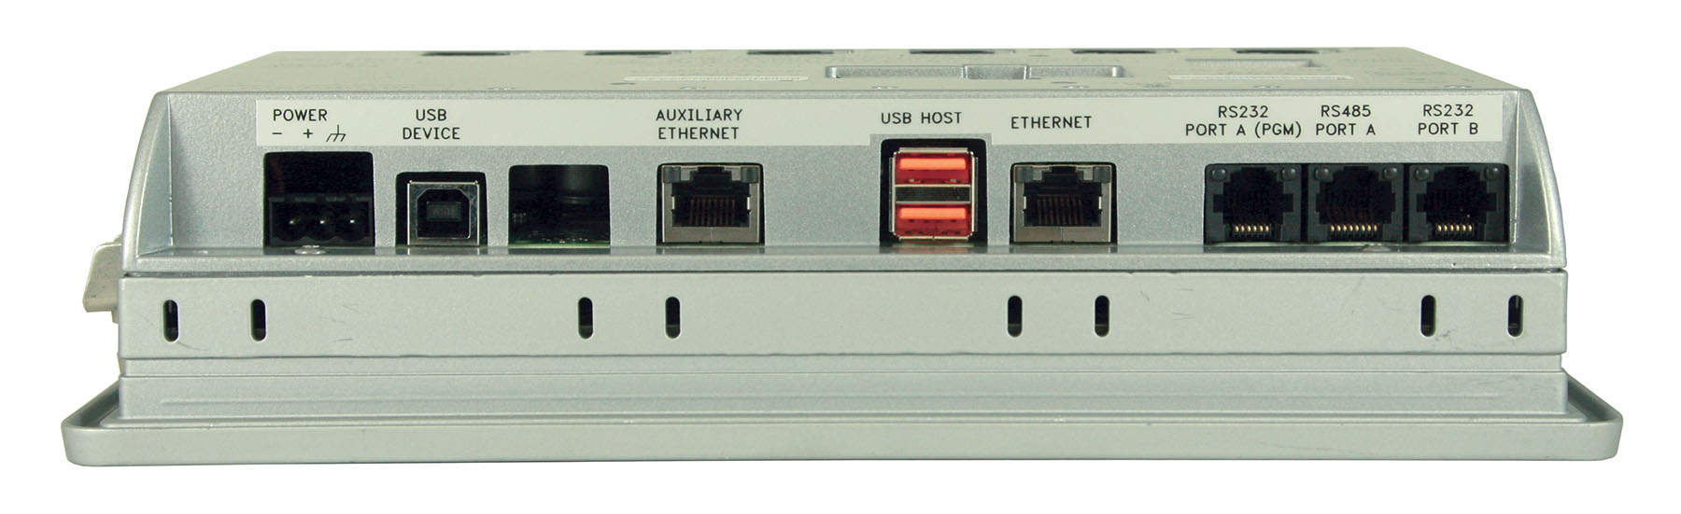
Not Just a Pretty Face
Extremely Functional With Rugged Construction

Slide 23

Graphite Models
7" Display Models, Wide Screen
  Indoor, WVGA (800 x 480)
  Outdoor, WVGA (800 x480)
9" Display Model, Wide Screen
  Indoor, WVGA (800 x 480)
10" Display Models
  Indoor, VGA (640 x 480)
  Outdoor, VGA (640 x 480)
  High Resolution, SVGA (800 x 600)
12" Display Model, Wide Screen
  Indoor, WXGA (1280 x 800)
15" Display Models
  Indoor, XGA (1024 x 768)

Slide 24
Graphite Facts
Power – Currently 24 VDC, 12 VDC models to come
Temperature – Currently 0 to 50˚, working towards -20 to 60˚
Cast aluminum construction with NEMA 4X front panel
Reduced footprint and easier to install
Complete serial port isolation
Agency approvals will come; UL Listed, UL Hazardous, ATEX, ABS – others will be considered
Crimson 3 compatible
Price TBD

Slide 25
So What Do You Think?
The Graphite Series

Slide 26
Seeing is Believing
Don’t just discuss our features/benefits
  Everyone has “Ethernet”
  Everyone has “data logging”
  Everyone has “remote access”
Everyone says their software is easy
  We’ve got to show them

Slide 27
Cheat Sheet
PXU Modbus Registers

Slide 28


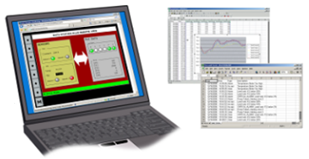

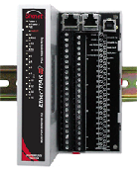
RAM LTE for remote access
105TX for local network
Dedicated PID controller with display
Graphite HMI with local I/O
Laptop for remote monitoring and control
E2 I/O for remote I/O

Slide 29
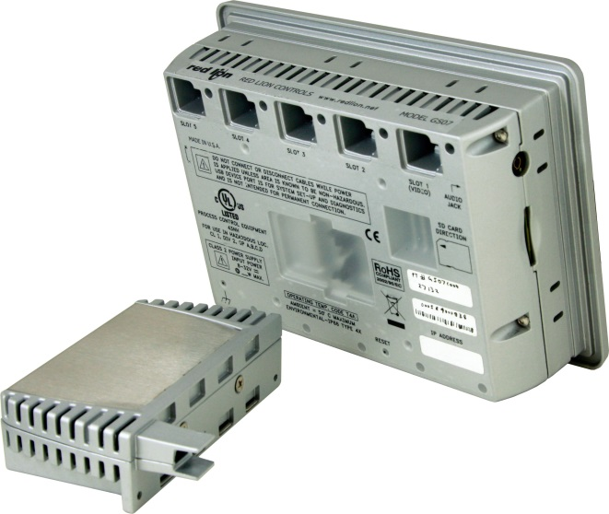
That’s not all
Don’t forget the I/O capability
Eight versions of PID Modules
Four Output Analog Module
Six Input RTD Module
Eight Input TC Module
Eight Input DC Current Module
Eight Input DC Voltage Module
Eight Input, Six Output Digital Module
Four Input Universal Module

Slide 30
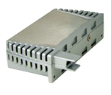
Module Facts
Temperature - -40 to 75˚ C
Operates on proprietary USB connections
All modules program with Crimson 3
Modules run independent of HMIs
Note: modules are not hot-swappable!
Universal module is completely isolated (inputs, power and core)
PID modules have universal inputs; TCs, RTDs, 0 – 10 VDC and process signals

Slide 31
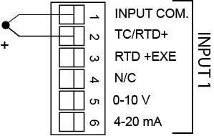
4 Input Universal Module
Thermocouple Wiring
Red –
White

Slide 32
192.168.1.2 Switch
10007
E2 ring 10033

Slide 33
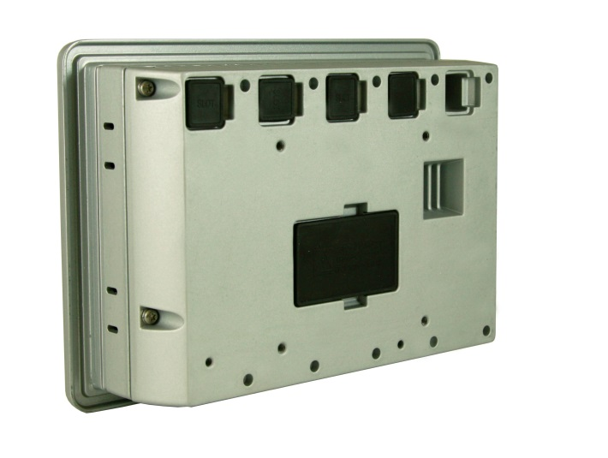
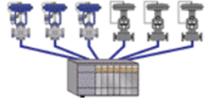
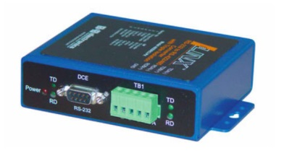

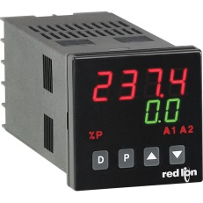
Graphite’s Value
Digital I/O
Protocol Converter
Analog Signals
PID Control

Slide 34
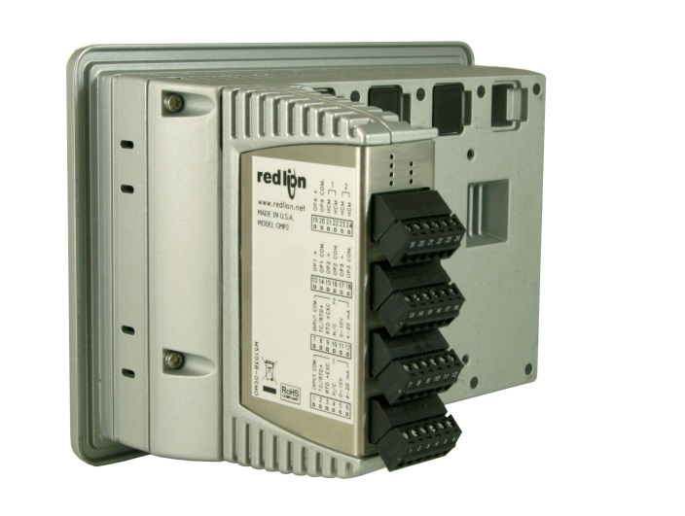
Graphite’s Value
Protocol Converter
Analog Signals
PID Control

Slide 35
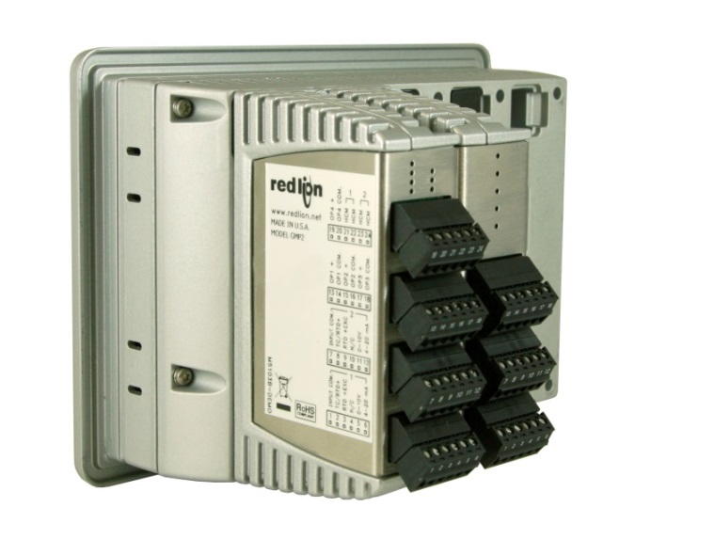
Graphite’s Value
Protocol Converter
PID Control

Slide 36
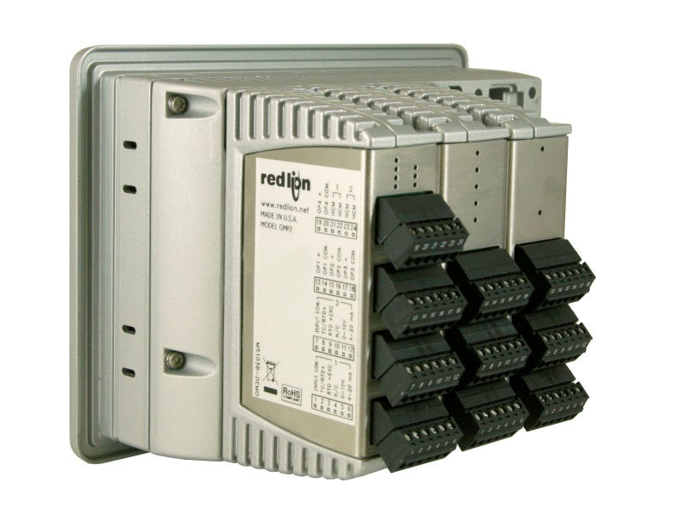
Graphite’s Value
Protocol Converter

Slide 37
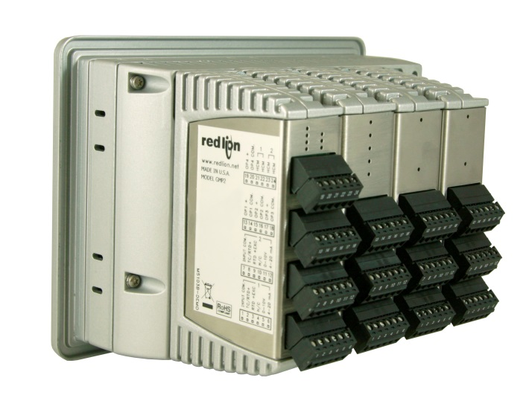
Graphite’s Value
Overall reduction in installation costs
Saves space
Removes system complexity
Single configuration
Single source supplier
Single source tech support

Slide 38
Graphite’s Critical Features
The big three?
Protocol conversion
Data logging
Web server

Slide 39
Graphite’s Critical Features
The big three FOUR!
Protocol conversion
Data logging
Web server
Module Capability

Slide 40





Competition

Slide 41
Competitive Comparison

Slide 42
So Now, What Do You Think?
The Graphite Series
Sleek, Rugged and Flexible

Slide 43
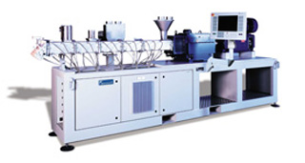
Applications
Extrusion

Slide 44


Applications
Oh hell, sell it everywhere you see a panel!

Slide 45
What Should You Do Now?
Remember the products are NOT released yet
G3 HMIs are not going to be discontinued anytime soon, so…
List all the opportunities that you have lost to the competition
Think about any fresh opportunities
Visit these opportunities first to maximize your sales, but be careful not to set expectations
Visit existing customer after the above opportunities are completed

Slide 46
But above all..
…have fun selling something they ain’t got!
Sleek, Rugged and Flexible
The Graphite Series

Slide 47
Thank You

