Slide 1
RTU & IO
Workshop 2013
Notes:
Introduction

Slide 2
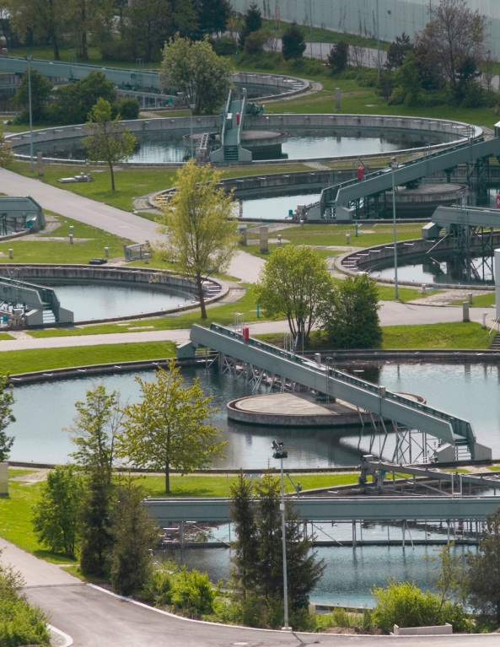
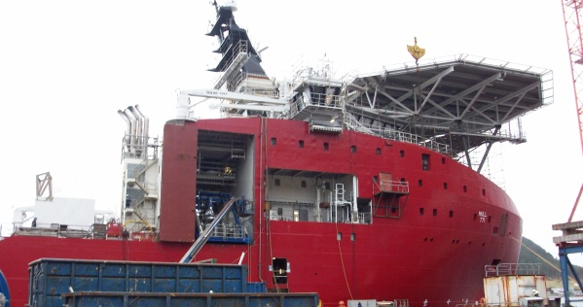
Remote Monitoring and Control in the Most Extreme Environments
Notes:
(Applications from left to right; top to bottom)
A variety of applications. Up to the imagination of integrator.
Water & Wastewater
-Used in many lift stations
-Tank Monitoring
-Water Treatment
-Wastewater
Oil and Gas wellhead
-Wellhead gas and oil measurement and monitoring
-Pumpjack optimization
-Pipeline and distribution monitoring
-Off-shore platform monitoring
-150deg
Maritime
-Offshore oil rigs
-Automating sea fairing construction vessels
Solar Tracking and Demand Response
-Used in the system that won PG&E the award for smart grid in 2012
--Micro solar power plants
--Auto-Demand response applications, Keeping the building at certain usage
Segway: Why can we be used in all these applications?

Slide 3
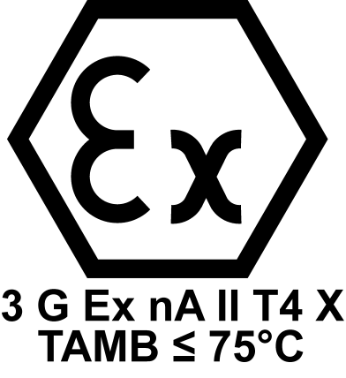
Certified to Perform
ATEX
Notes:
Pic: HAZ LOC
-UL class 1 Div II
-ATEX – More stringent than UL
Pic: DNV and ABS – Do you get call for this?
-Vibration
-Compliance
Pic: Extreme Temps
-40 to 75 degC
Segway: What are these products?

Slide 4
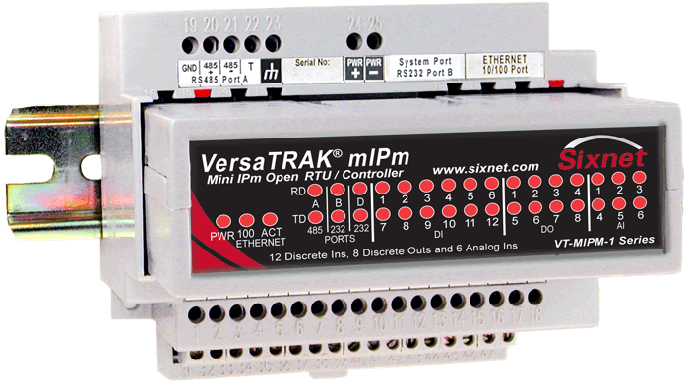
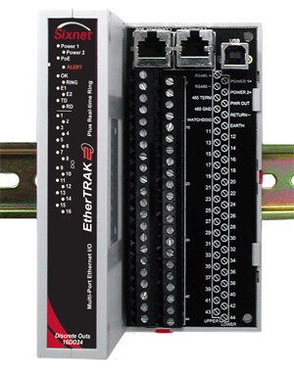
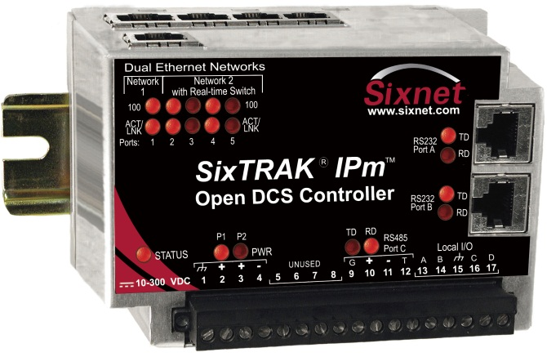
RTU & I/O product line
Notes:
RTUs with and without on-board I/O
- Pass-out 2 RTUs so they can see it in their hands
I/O modules
- Over 17 models of I/O types and mixtures
- Stand alone.

Slide 5
RTU and I/O Part Numbers
ST-IPm-6350
VT-IPm-1410
VT-mIPm-135-D
VT-mIPm-245-D
VT-IPm2m-113-D
VT-IPm2m-213-D
VT-uIPm-431-H
DI
DI
24
24
-D
E2-
-D
E2-
32
32
Notes:
EtherTRAK-2 Product numbers
- E2-MIX24880-D
- E2-MIX24882-D
- E2-32DI24-D
- E2-16DI24-D
- E2-16DIAC-D
- E2-32DO24-D
- E2-16DO24-D
- E2-16DORLY-D
- E2-32AI20M-D
- E2-16AI20M-D
- E2-8AO20M-D
- E2-16AI8AO-D
- E2-16ISOTC-D
- E2-16ISO20M-D
- E2-10RTD-D

Slide 6
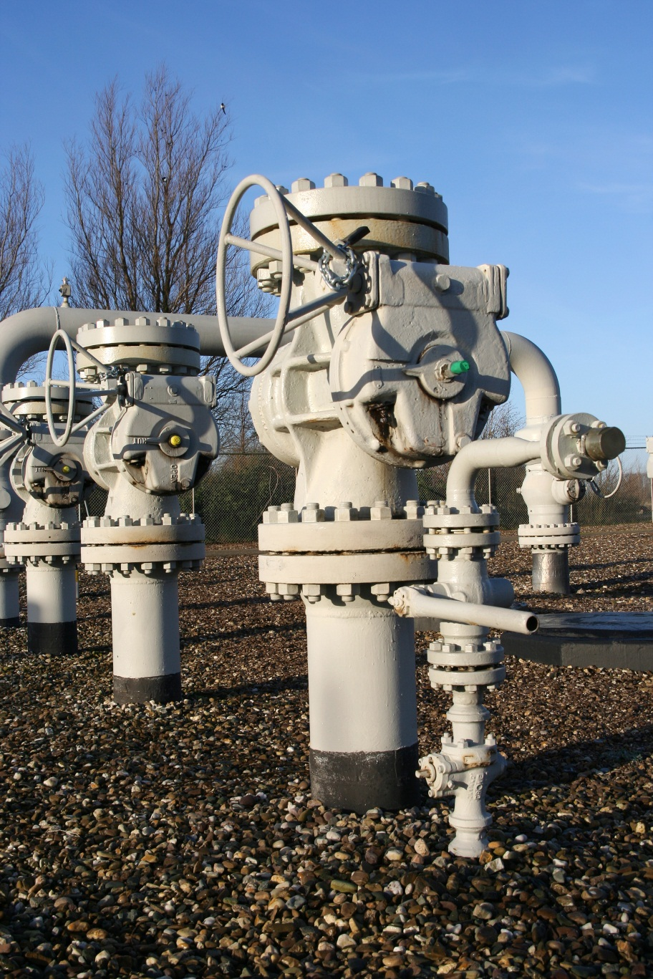
Don’t lose your head!
Notes:
Does anyone know what this kid is stealing.
This boy is stealing natural gas right off the well head in rural china
-Story of how Chinese are stealing gas.
-Hazardous Location
-Remote wellhead must be monitored so this won’t happen.
It may be a few months before you get to a site. Things have to be under control.
-What if a leak occurs?
-What if the gas output is not equal to delivered
What is the best way to make sure bad things don’t happen

Slide 7
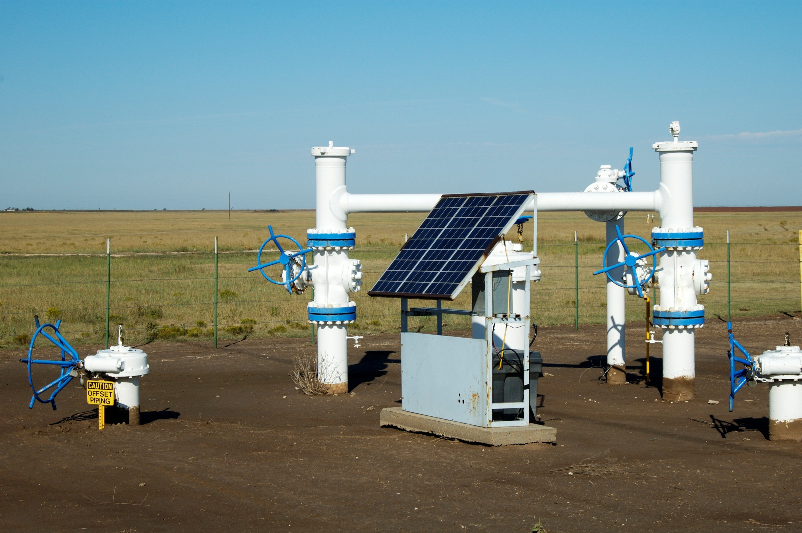
Wellhead monitoring
rtu
inside
Notes:
Slide 6 – Wellhead monitoring
Pic: Remote wellhead installation with RTU installed, Solar panel, Christmas tree, the whole works.
Remote locations need reliable equipment
- Customers have been using RTU as flow computer for years → we finally figured out;
Installed in Aus outback and middle east
-HAZ LOC certifications
-Linux OS – Reliable and Flexible
-Extreme Temperatures.
I/O Controls
-Shut off valves
Measure Gas →next slide

Slide 8
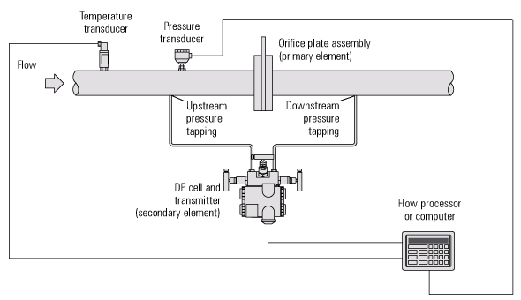
Measure Gas
Notes:
Pic: Measuring gas through an orifice plate.
Measure gas coming from the ground
-Used in API 21.1 today
--Gaps filled by integrator
--Show AGA
-Future – API 21.1 and 21.2 (gas and liquids)
--Just provide SCADA host and RTU will connect to it.
--smaller gas companies

Slide 9
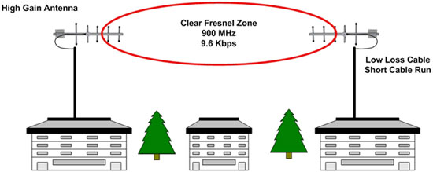
Atomic Downloading
Notes:
Pic: Lossy radio network
Demonstration of the remote loading.
Most radio networks are inherently unreliable
Benefits of Atomic loading is

Slide 10
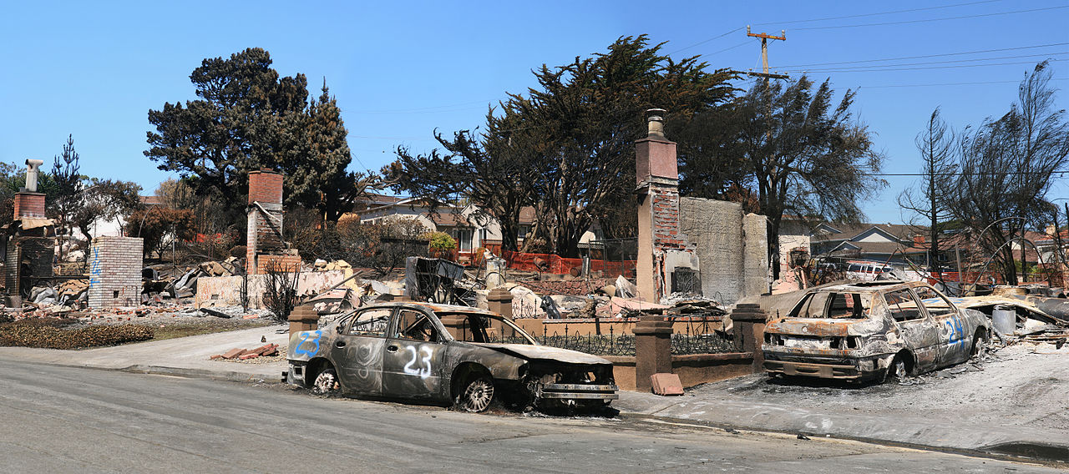
Pipeline to possible problems!
Notes:
Pic: Destroyed LNG pipeline that was destroyed.
Story of how unmonitored pipeline could be a ticking time bomb.
-Pipeline exploded in San Bruno California
Segway: How to prevent this from happening?

Slide 11
Distribution pipeline monitoring
Storage Field
Compressor
City Gate
Notes:
Pic: Consumer’s Distribution Network
Story of Consumers Energy
-Pipeline and distribution network monitoring
-Sixnet RTU and IO are installed at the City Gate
--Measures pipeline pressure
---Measure pressure at all ends so it can detect leaks.
--reduces pipeline pressure
--Adds odor for safety

Slide 12
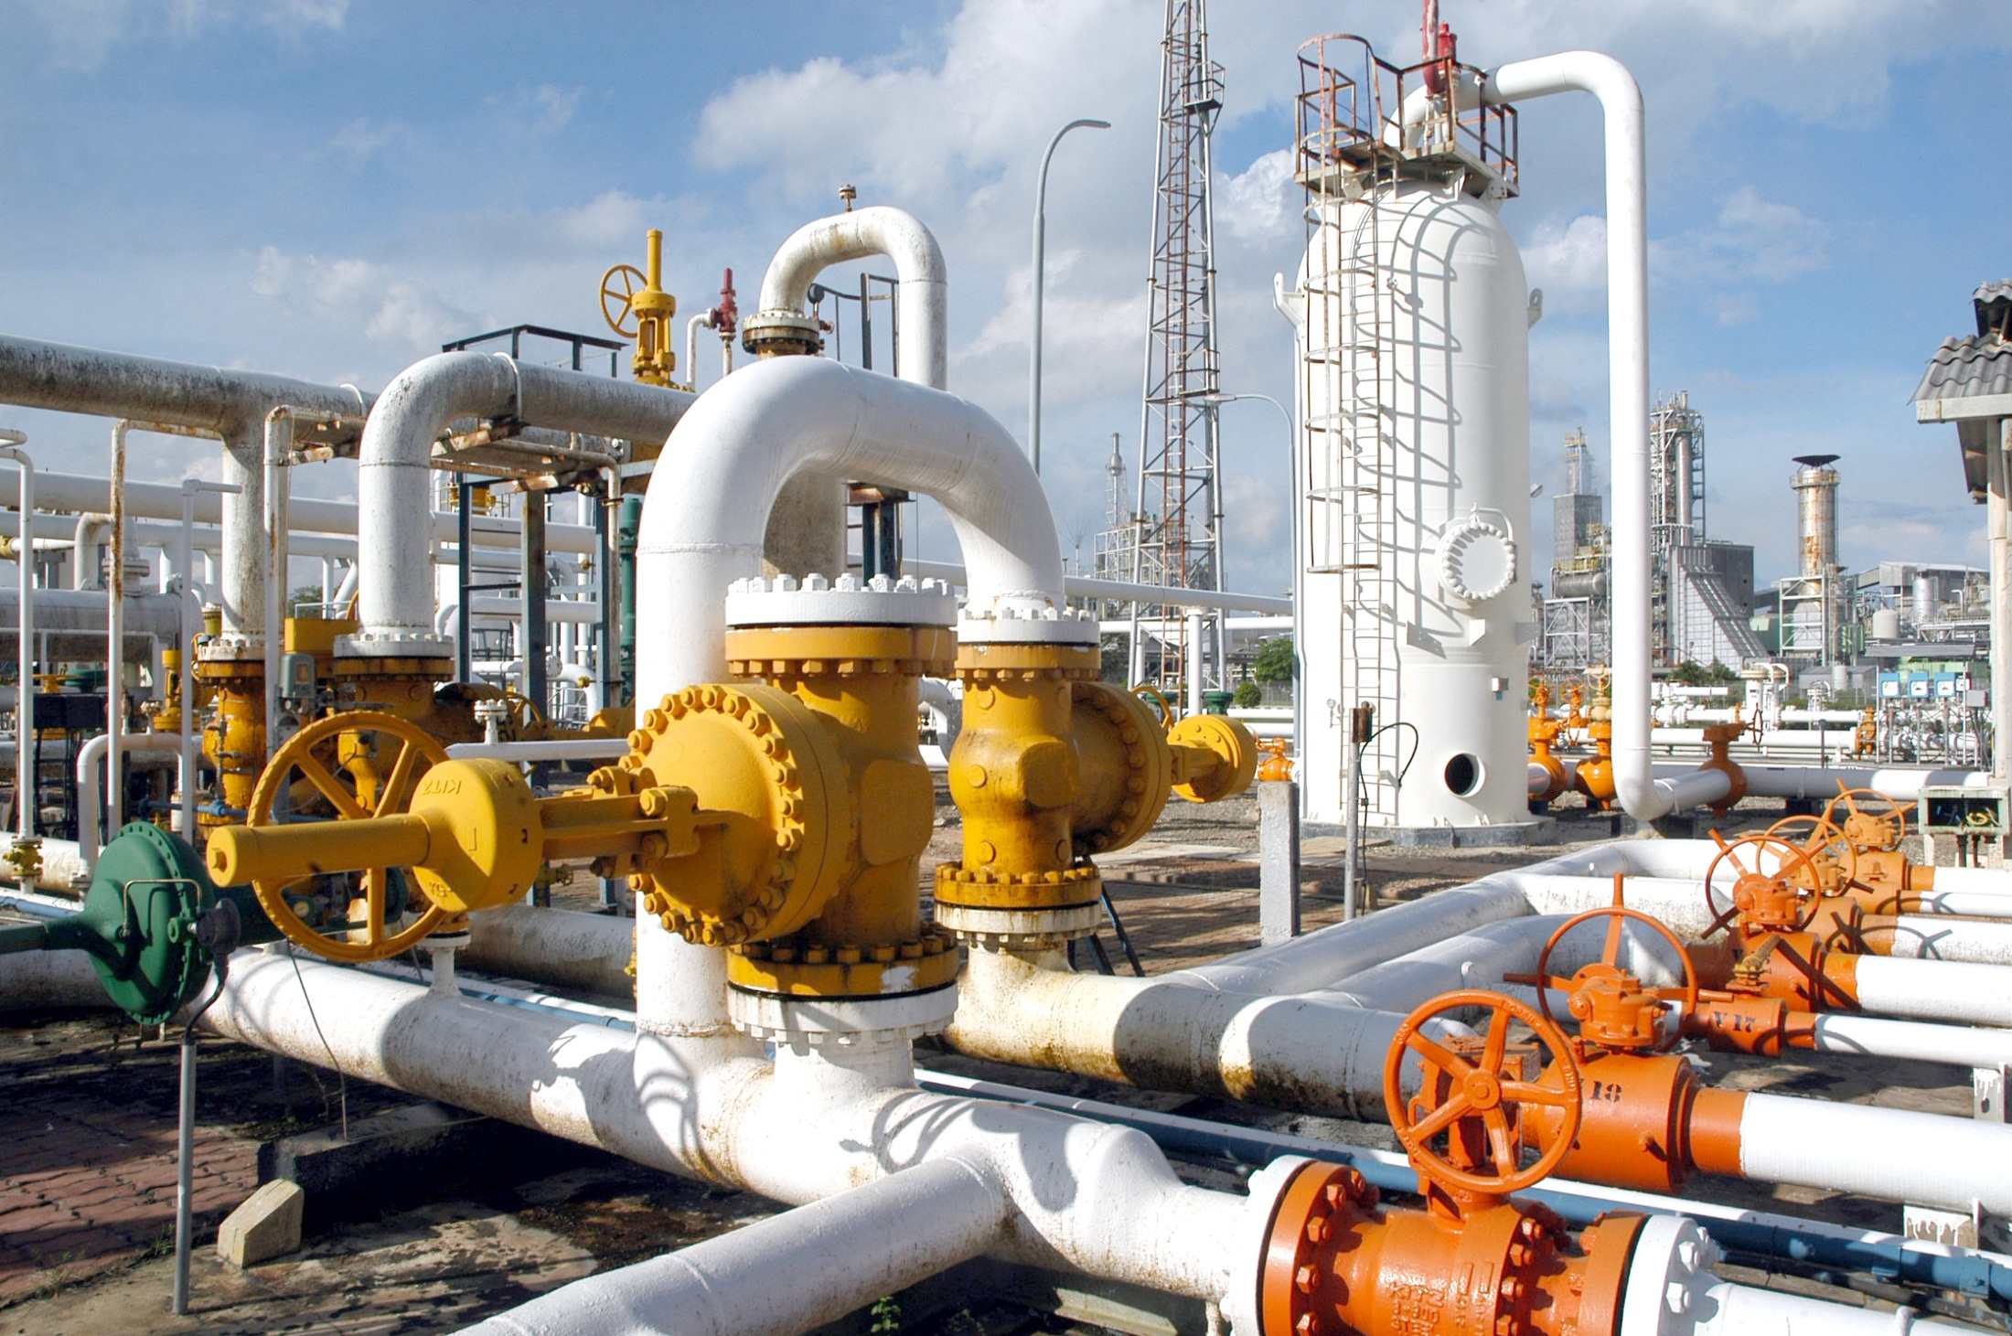
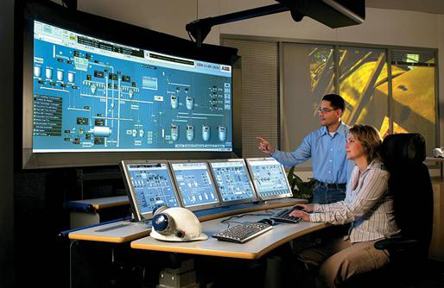
Need More I/O?
Notes:
Pic of RTU and E2 I/O being added to it as instruments are added to the network.
Some locations need a lot of I/O
-Add EtherTRAK-2 modules
What if there is no RTU?
-Add EtherTRAK-2 anyway.
-Modbus ASCII/RTU
-Modbus TCP and UDP

Slide 13
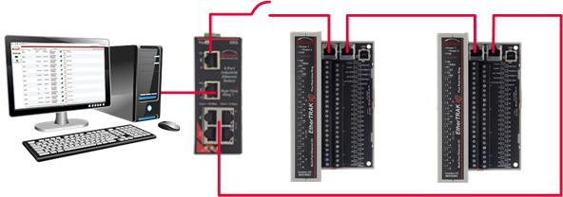
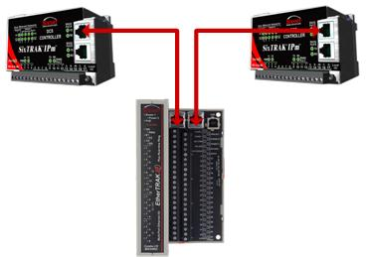
Network Flexibility
Ring Switch Mode
Switch Elimination Mode
Two Networks Mode
Notes:
DIFFERENTIATING FEATURE IS NETWORKING
THREE DIFFERENT NETWORK MODES
Ring
-Use with SLX-6RS and SLX-5MS/8MS
Switch Elimination mode
-Not going to eliminate every switch
Two networks
-Two different subnets
Pass-out the EtherTRAK-2
Anatomy of the EtherTRAK-2

Slide 14
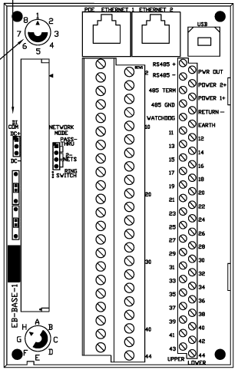
E2-MIX24882-D Wiring
DI
DI/DO
AI
AO

Slide 15
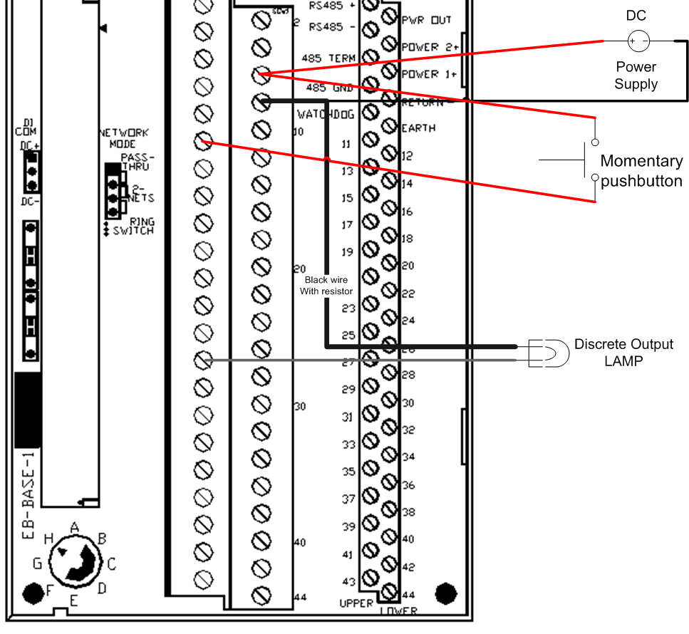
Wiring-up the EtherTRAK-2
Notes:
Unplug power supply.
Wire-up the EtherTRAK-2
Plug in power supply

Slide 16
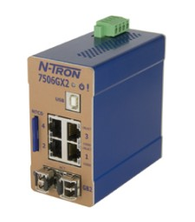
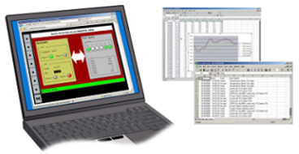
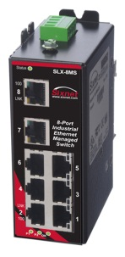
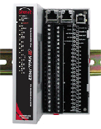
RAM LTE for remote access
192.168.1.3
7506TX for local network
192.168.1.4
Graphite HMI with local I/O
192.168.1.20
SLX-8MS-1
192.168.1.2
Dedicated PID controller with display
Laptop for remote monitoring and control
192.168.1.100
E2 I/O for remote I/O
192.168.1.1
Notes:
Pass out switch and connect network.
How to connect the network…

Slide 17
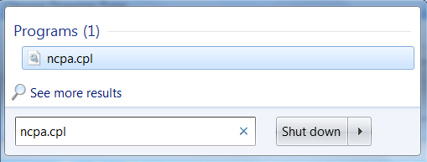
NCPA.CPL
Notes:
NCPA.CPL
The Network adapter with “x” that is not a VPN.
Right-click go to “Properties”
IPv4 Properties

Slide 18
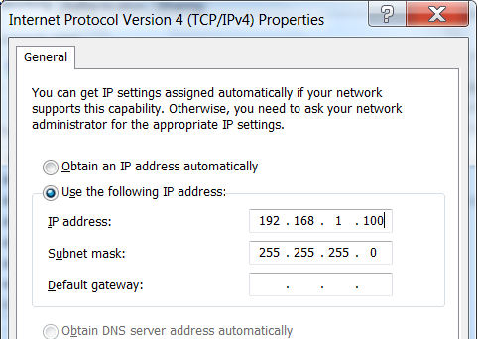
Set-up IP address on computer
Notes:
Connect to the RTUs via computers
Intro to the Webui.
-Set IP address show some features
-Enable Counters
-Enable Discrete Outputs

Slide 19
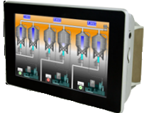
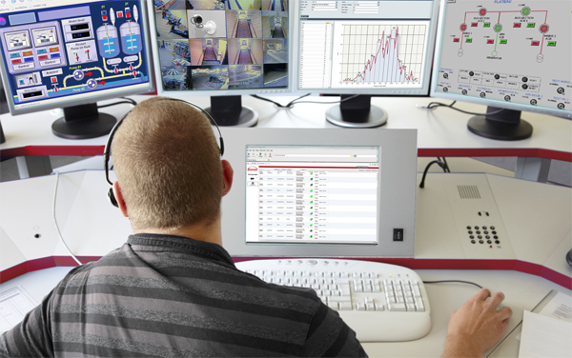
Controlling outputs
Notes:
HMI/PLC/Control Room – Writing outputs – hopefully not at the same time.

Slide 20
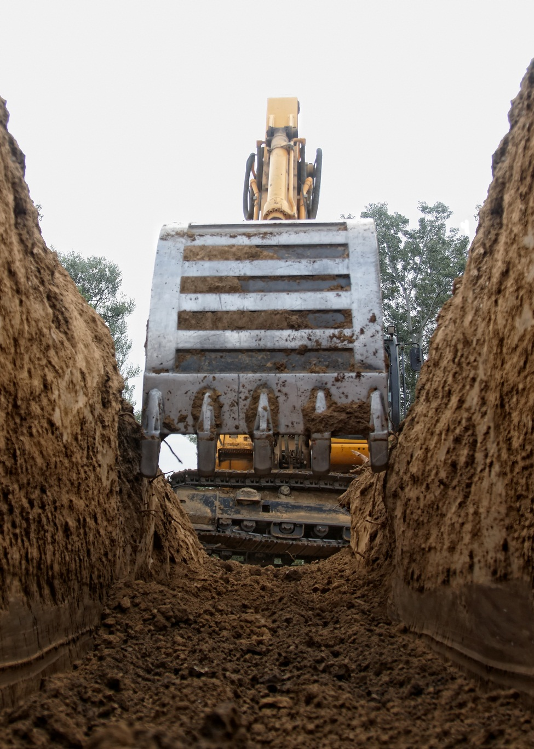
What if the network fails?
Notes:
Pic: Network between RTU and HMI is broken (backhoe tax).
HMI controls outputs
Heartbeat timeout feature.
Demonstrate Heartbeat timeout

Slide 22
Modbus Registers and IP addresses
Counter Input – Analog Input - 30009
Discrete Output – Coil – 00001
Notes:
Show the tool kit software.

Slide 23
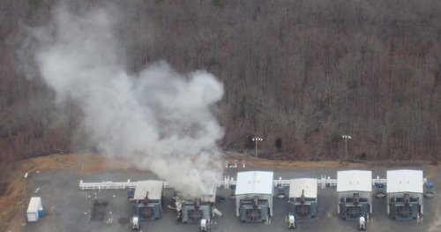
Value is compressed into RTU and I/O
Notes:
Pic: Compressor smoking or running inefficient
An unmonitored compressor is NOT running efficiently or could be damaged.

Slide 24
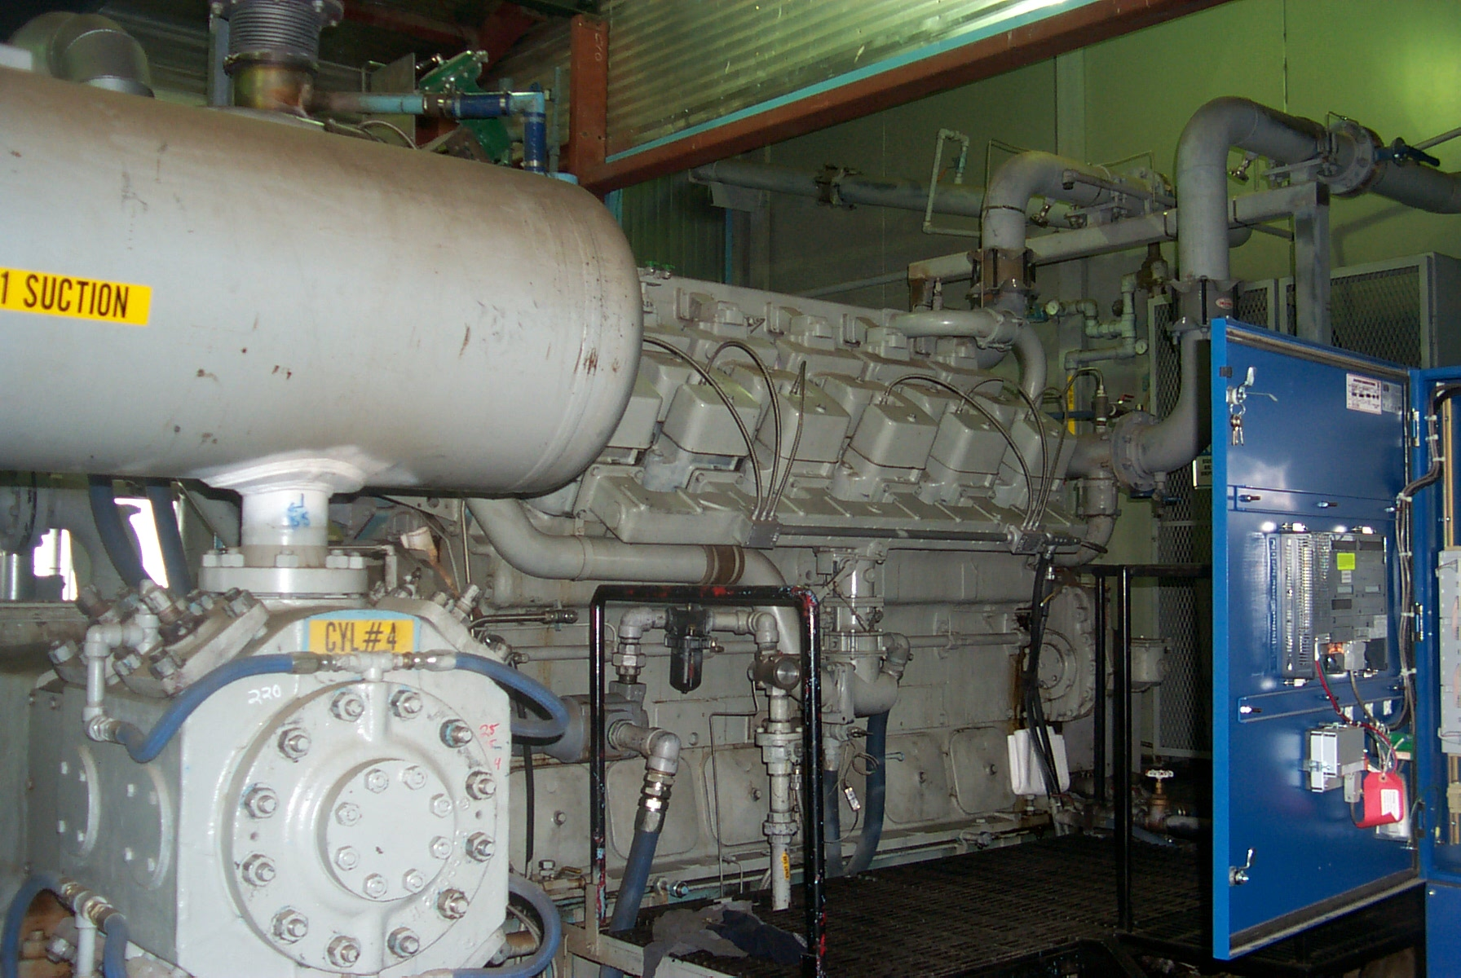
Compressors run better with RTUs & IO
Notes:
Example of RTI Compressor.
Over 4000 RTUs and I/O install in Northern Canada (near artic circle)
OEM takes knowledge of compressors and programs it into the RTU
RTU and I/O perform safety shutdown
The Program in the RTU make the compressor run better
-- Natural gas that is normally lost is reclaimed
-- End Customer get Environmental credit

Slide 25
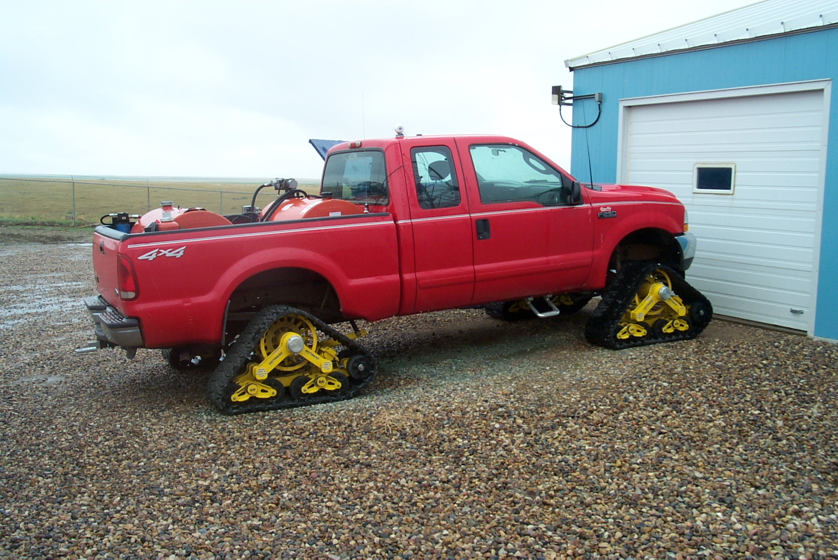
RTU and I/O are remote
Notes:
The RTU is installed in remote locations
Install the RTU and I/O where people are not.

Slide 26
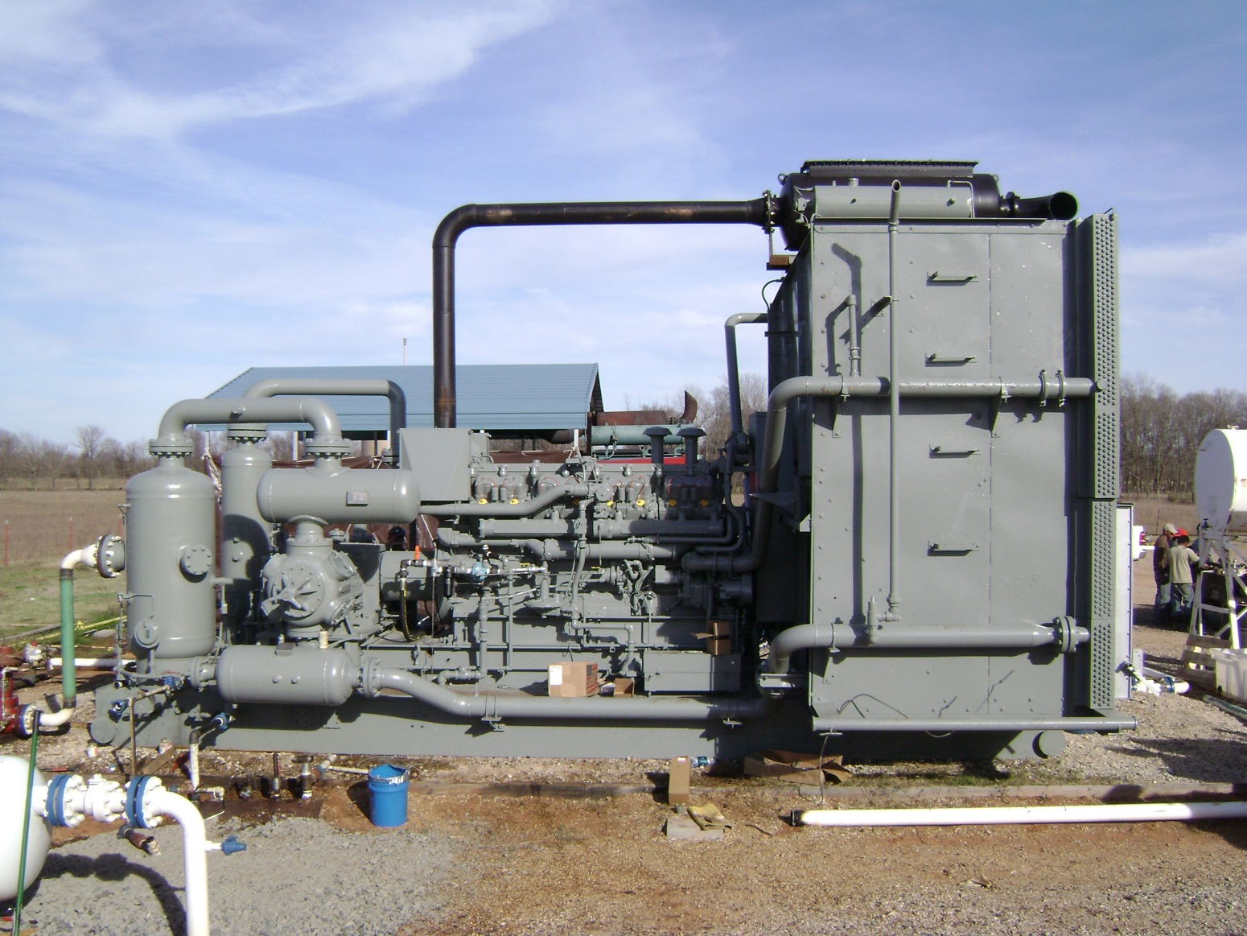
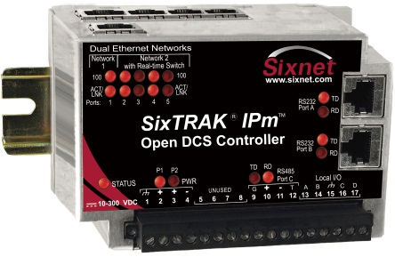
Various types of I/O
Notes:
Pic: E2 connecting all types of I/O to compressor
Analog Inputs
Analog outputs
Discrete inputs
Discrete outputs
Temperature

Slide 27
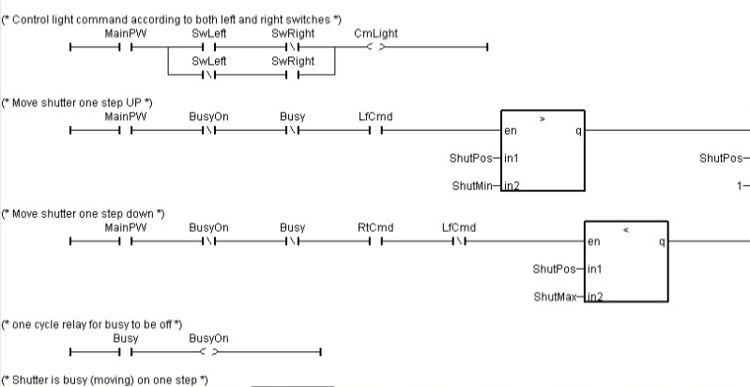
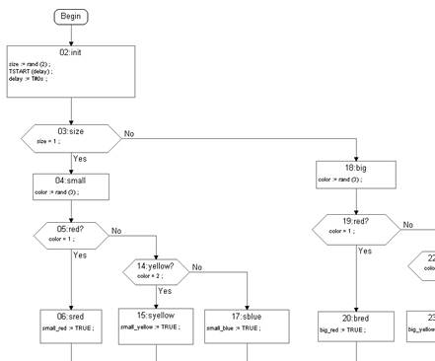
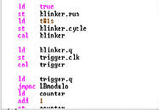
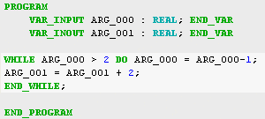
Flexible Programming – IEC61131-3
Notes:
From Left to right starting at the top the languages are:
FBD – Function Block Diagram
Ladder – Quick Ladder
SFC – Sequential Function Chart
IL – Instruction List
ST – Structured Text

Slide 28
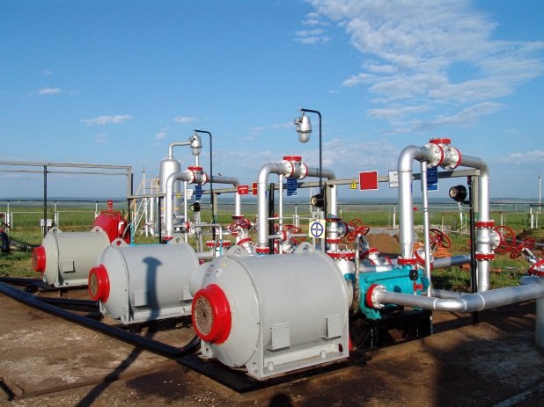
IEC61131-3
Notes:
C programming
ISaGRAF
Linux
- Use all in combination to make their perfect application.
-- Their own protocol (ex: IEC60870)

Slide 29
Integrator and OEM
Notes:
Do you have customers like this guy?
They can program anything.
They are technical
They know their market
RTU and I/O is perfect for the integrators and OEMs like him.

Slide 30
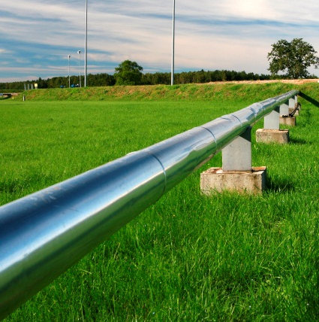
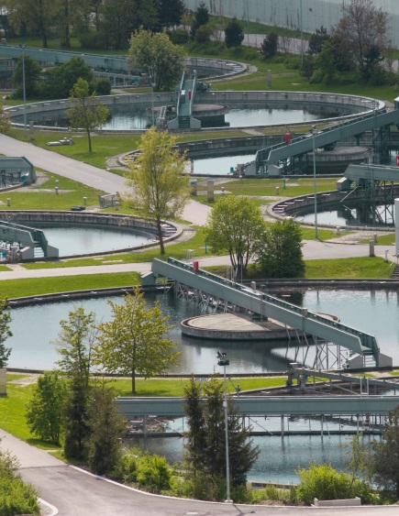
Use the RTUs and I/O anywhere
Notes:
Pic: The various applications in a thought bubble above someone’s head
If they can dream the application chances are the RTU and I/O can do it.

Slide 31
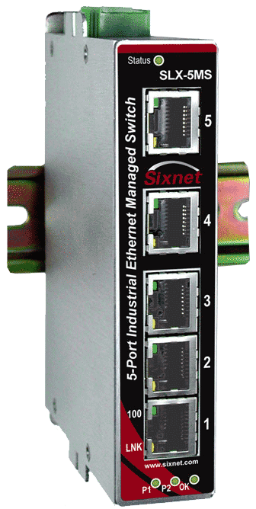
I/O and Switches - pull through
Notes:
E2 connected to variety of products and can be distributed I/O
EtherTRAK-2 is a great I/O Line by itself
Add it to the HMI

Slide 32
Thank You

