Slide 1
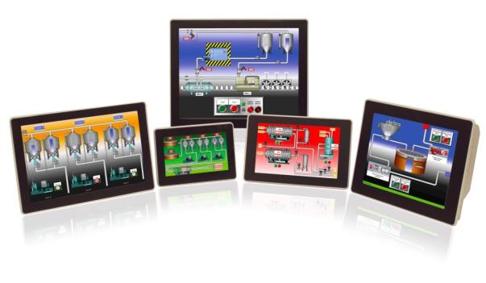
Graphite Series
Graphite HMI Series

Slide 2
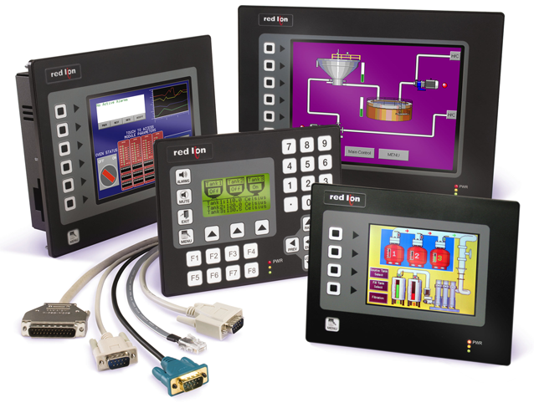
Our G3 Line-up

Slide 3
Voice of Customer
Don’t change Crimson
Improved temperature specifications
Easier mounting
Eliminate the old CF card technology
Add I/O
Better display resolutions
Make it look better

Slide 4

Introducing The Graphite Series
Sleek, Rugged & Flexible

Slide 5
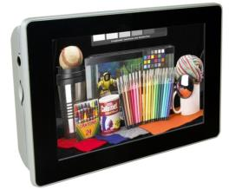

Sleek
Improved appearance
Eliminated the buttons
Better display resolutions
Added widescreen displays
No logo

Slide 6
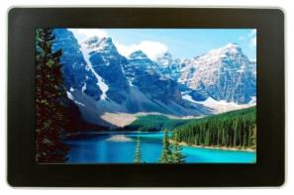
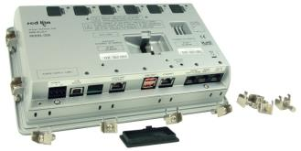
Rugged
Cast aluminum construction
- 20 to 60 ˚C temperature rating
Improved shock and vibration
High retention USB connectors
NEMA4X front panel seal

Slide 7
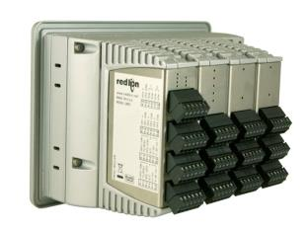
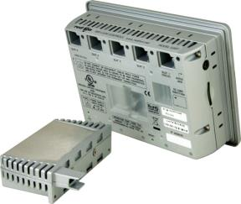
Flexible
Add modular capability
Digital and analog I/O
Full PID control, single and dual modules
Communication modules coming
Future proofing the application

Slide 8

Graphite Models
7" Display Models, Wide Screen
  Indoor, WVGA (800 x 480)
  Outdoor, WVGA (800 x480)
9" Display Model, Wide Screen
  Indoor, WVGA (800 x 480)
10" Display Models
  Indoor, VGA (640 x 480)
  Outdoor, VGA (640 x 480)
  High Resolution, SVGA (800 x 600)
12" Display Model, Wide Screen
  Indoor, WXGA (1280 x 800)
15" Display Models
  Indoor, XGA (1024 x 768)

Slide 9

Graphite Facts
24 VDC power, low DC voltages will be addressed
Temperature currently -20 to 60˚, working towards -20 to 70˚
Improved touchscreen look/feel
Reduced footprint and easier to install
Complete serial port isolation
Agency approvals will come
Supported by Crimson 3

Slide 10
Plug-In Modules
1st Release of Modules
Eight versions of PID modules
Four output analog module
Six input RTD module
Eight input TC module
Eight input DC current module
Eight input DC voltage module
Eight input, six output digital module
Four input universal module

Slide 11
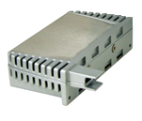
Module Facts
Temperature – -40 to 75˚ C
Comms via patent-pending USB connections
All modules program with Crimson 3
Control modules run independent of HMI
Note: modules are not hot-swappable
Universal module is completely isolated (inputs, power and core)
PID modules have universal inputs; TCs, RTDs, 0 – 10 VDC and process signals

Slide 12
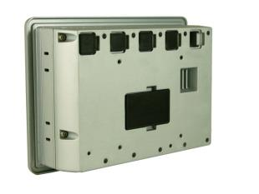
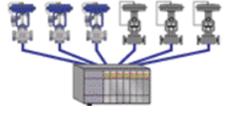

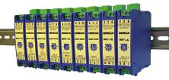
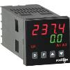
Graphite’s Module Value
Digital I/O
Protocol Converter
Analog Signals
PID Control

Slide 13
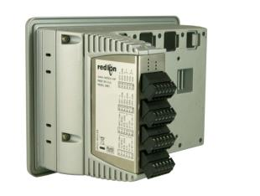
Graphite’s Module Value
Protocol Converter
Analog Signals
PID Control

Slide 14
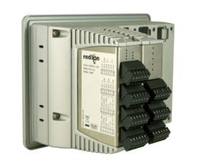
Graphite’s Module Value
Protocol Converter
PID Control

Slide 15
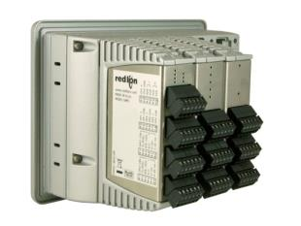
Graphite’s Module Value
Protocol Converter

Slide 16
Graphite’s Module Value
Overall reduction in installation costs
Saves space
Removes system complexity
Single configuration
Single source supplier
Single source tech support

Slide 17
Graphite’s Critical Features
The big three?
Protocol conversion
Data logging
Web server

Slide 18
Graphite’s Critical Features
The big three FOUR!
Protocol conversion
Data logging
Web server
Modular flexibility

Slide 19
Crimson’s Critical Features
User programs
Not to mention…
Custom & data web pages
FTP Host
Email support
Security manager
SMS text message support
Easy animation
SQL Sync
FTP client

Slide 20




Competition

Slide 21
Competitive Comparison

Slide 22

Graphite Series
Sleek, Rugged & Flexible

Slide 23

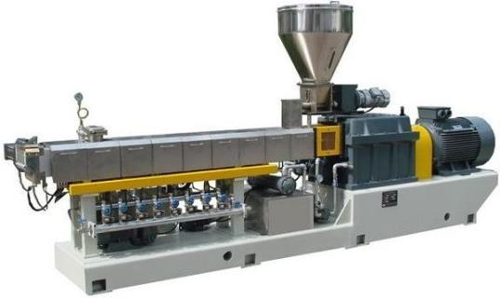
Applications
Plastic extrusion, multi-zone PID control

Slide 24
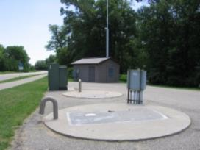
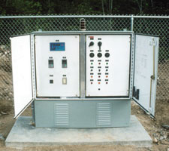
Applications
Lift stations, pump controls

Slide 25
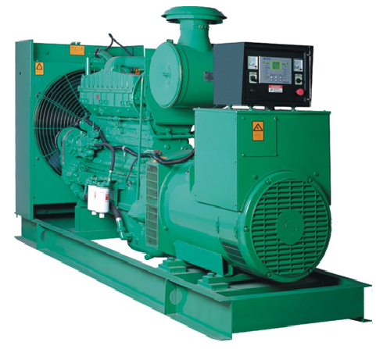
Applications
Gen-sets, engine and day-tank monitoring

Slide 26
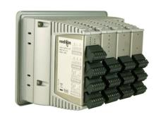
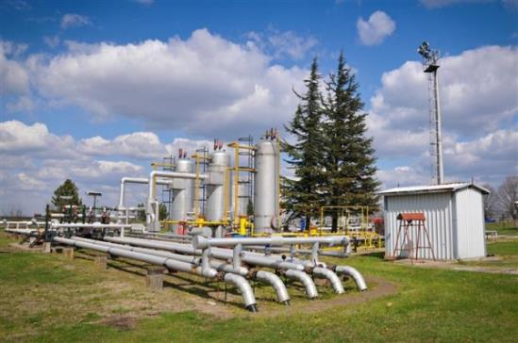
Applications
Compressor stations, flow and pressure data

Slide 27


Applications
Wind farms, remote management

Slide 28
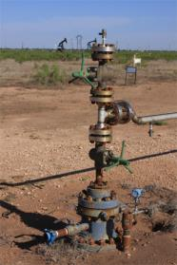
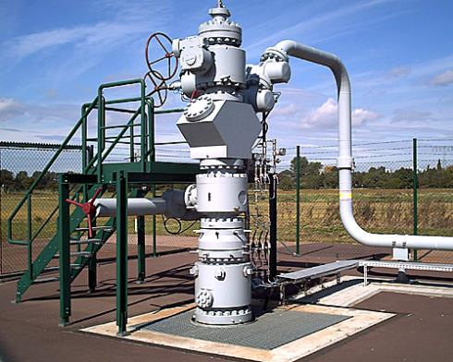
Applications
Well head, rugged environment

Slide 29


But above all..
have fun selling something they ain’t got!
The Graphite Series
Sleek, Rugged & Flexible

Slide 30
Thank You

