Slide 1
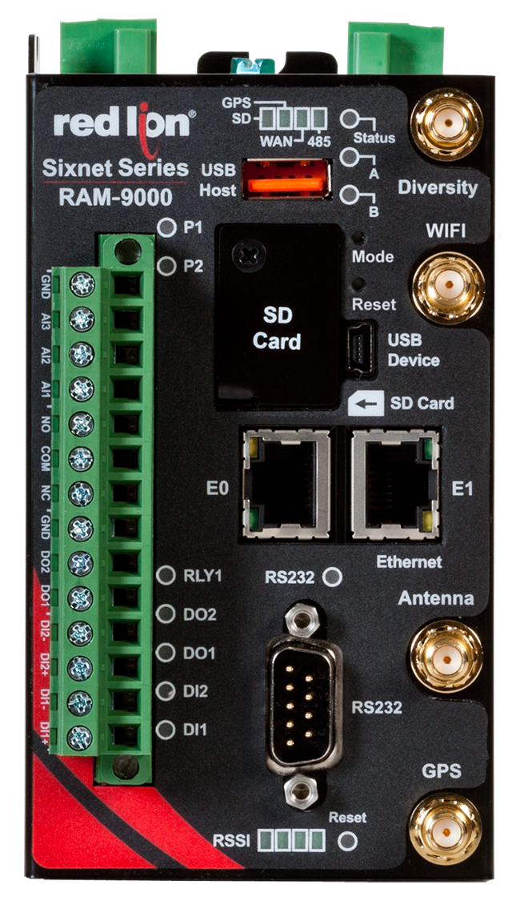
Introducing the RAM 9000
Notes:
The new Red Lion Sixnet Series RAM-9000 industrial cellular RTU perfect for the most demanding M2M applications!!!

Slide 2
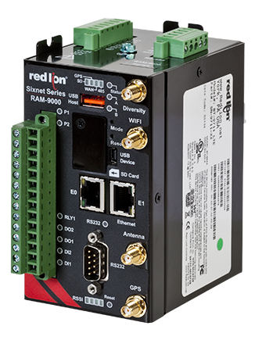
RAM 9000 Features
4G LTE With Fallback to 3G and 2G
RS-485 and RS-232 Serial Ports
1 or 2 Ethernet Port Models
2 Digital Inputs and 3 Analog Inputs
2 Digital Outputs and 1 Relay
Active GPS for asset location info
Optional Wi-Fi
UL Class 1, Div. 2, Groups A,B,C & D
ATEX and IEC Ex (Pending)

Slide 3
RAM 9000 Overview
Dual power connections
24VDC
RS-485 serial port
2nd cellular antenna
connector
Power indicators
Wi-Fi antenna
connector
Reset button
USB device
port
1 or 2 Ethernet
ports
I/O connections with
removable terminal block
Cellular antenna
connector
RS-232 serial port
Received Signal
Strength Indicator
(RSSI)
GPS antenna
connector
Notes:
This Diversity port is used for RX Diversity on 3G connections and multiple-input and multiple-output (MIMO) for 3G LTE connections. Receive Diversity or MIMO is a
transmission technique that consists of using two separate antennas to achieve the most robust cellular signal possible. Diversity will help achieve fast, reliable data
throughput in applications that require a high amount of bandwidth. This antenna is not mandatory for 3G, however it will improve throughput in low signal
and fringe areas. This antenna is required for LTE MIMO operation.

Slide 4

RAM 9000 Overview
Battery and cellular
Subscriber Information Module (SIM)
are located on bottom of unit
Notes:
Subscriber Information Module (SIM) card must be placed in SIM1 slot.

Slide 5
RAM 9000 Overview
Reliable operation in extreme conditions with -40° to 75°C operating temperature range*
Supports varying field power 8-30 VDC (12 or 24 VDC nominal)
Features DIN rail and panel mounting for diverse applications
Built to withstand industrial environments offering shock, vibration, humidity and electrical safety certifications:
  IEC60068-2-27
  IEC6008-2-6
  5% to 95% Non-Condensing
  UL508/CSA22.2/14, (CUL): IEC61010‐1
* Consult product manual for more details
Notes:
The RAM 9000 is built to withstand the most demanding industrial M2M applications!

Slide 6
RAM 9000 Overview
Future releases will feature:
More certified cellular carrier specific devices
SMS text messaging
SD card support for data logging or configuration upload/download
Support for SIM2 slot to allow multiple cellular
account/carrier usage
Support for USB host port

Slide 7
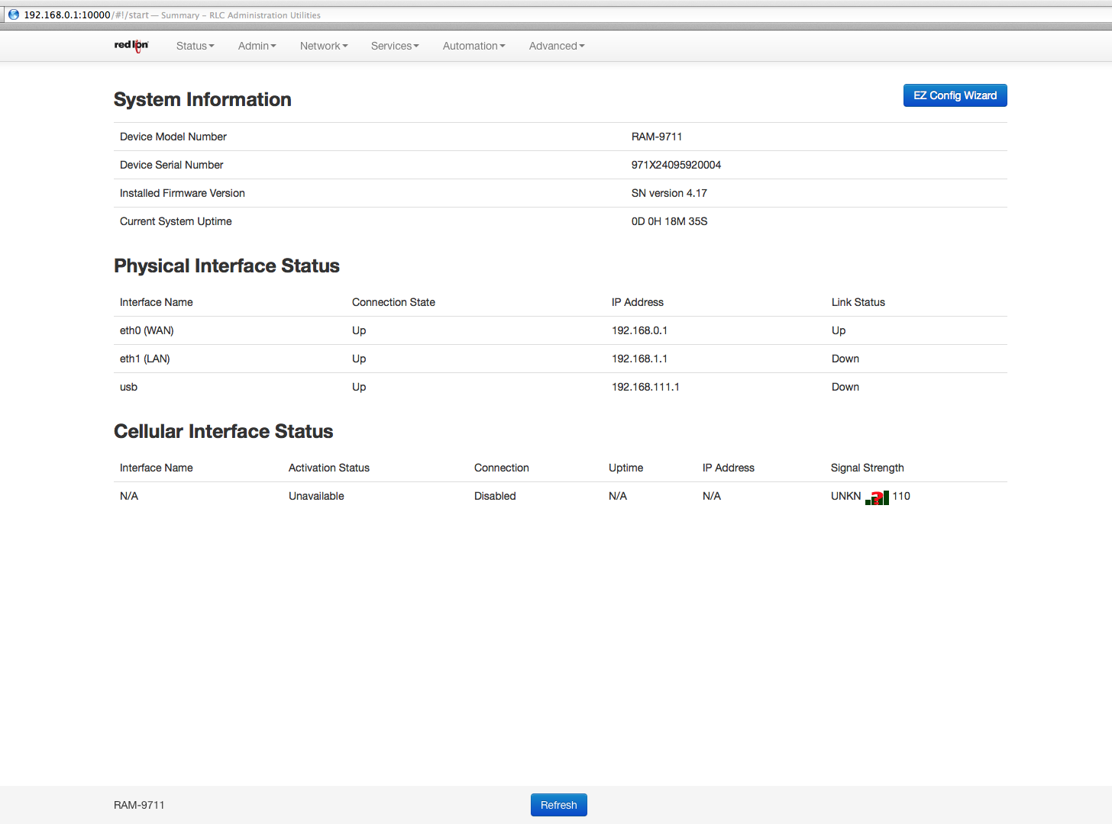
Graphical User Interface
New streamlined graphical user interface

Slide 8
Graphical User Interface
New EZ Config Wizard for easy setup and configuration

Slide 9
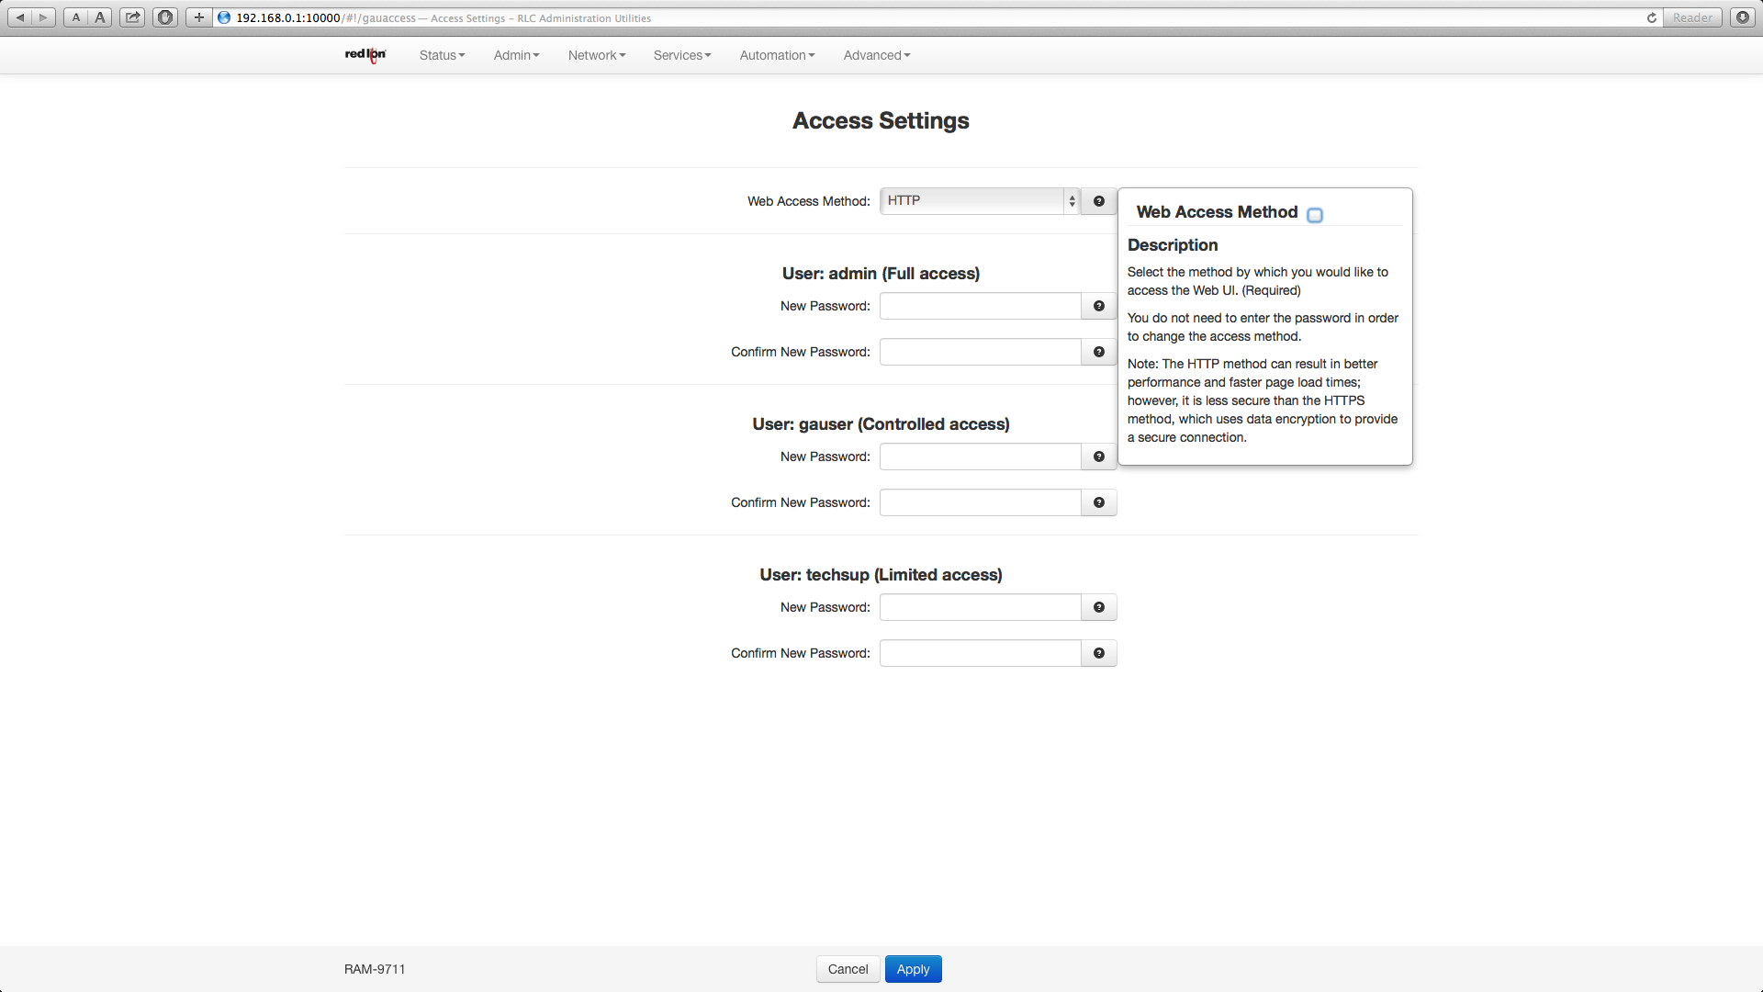
Graphical User Interface
New help descriptions to guide users through the setup

Slide 10
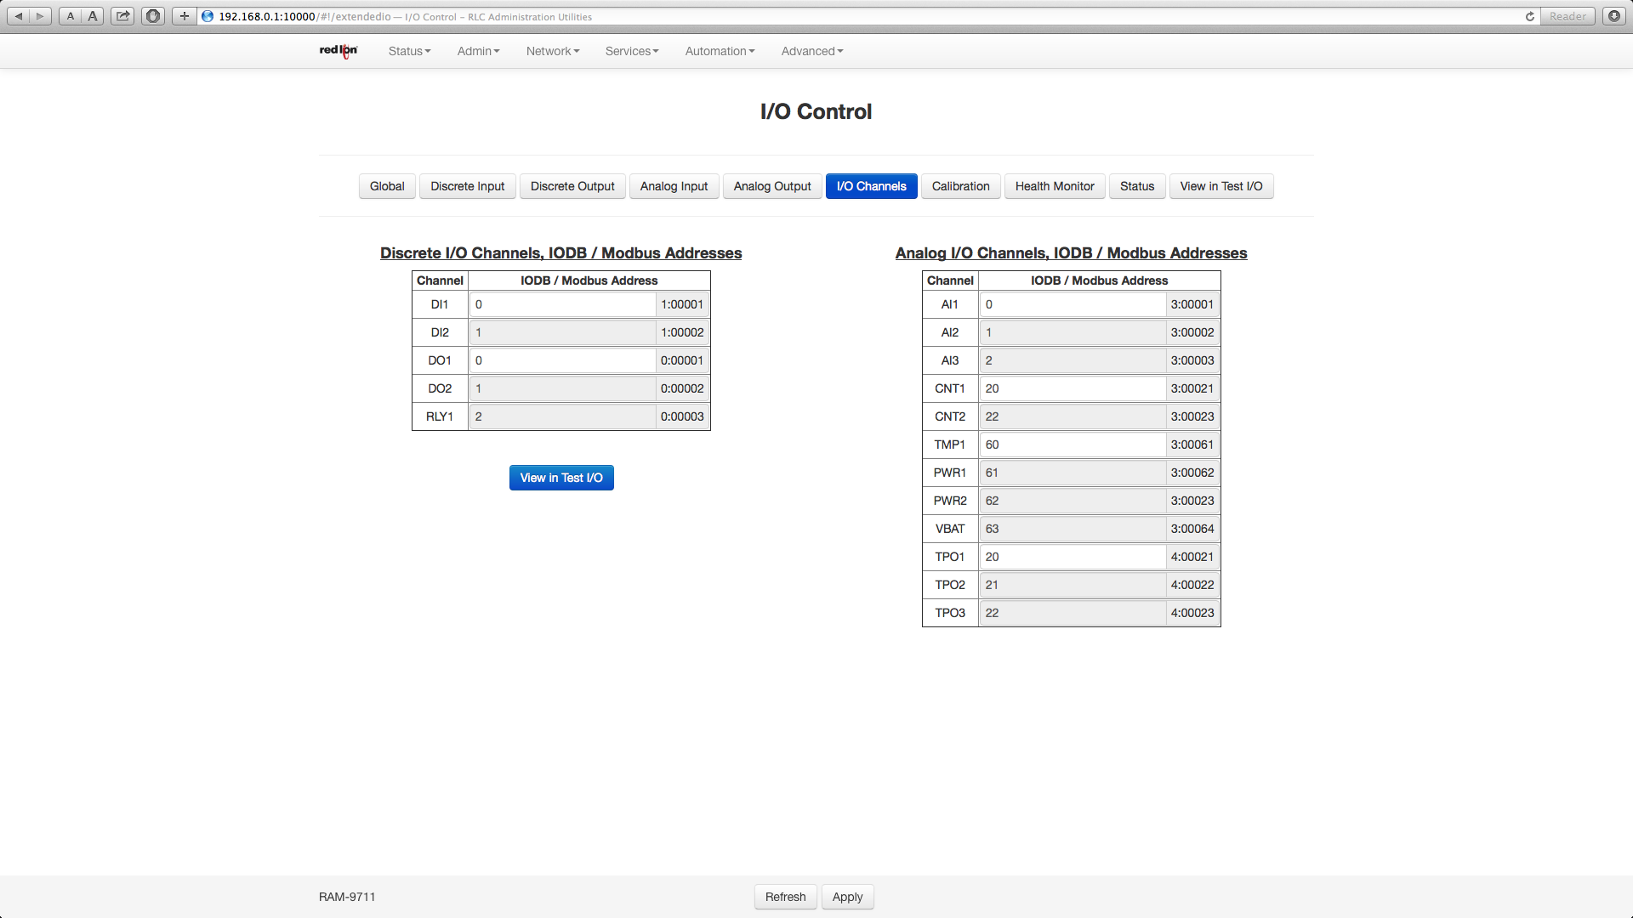
Graphical User Interface
New I/O Channels screen to set up and control built in I/O

Slide 11
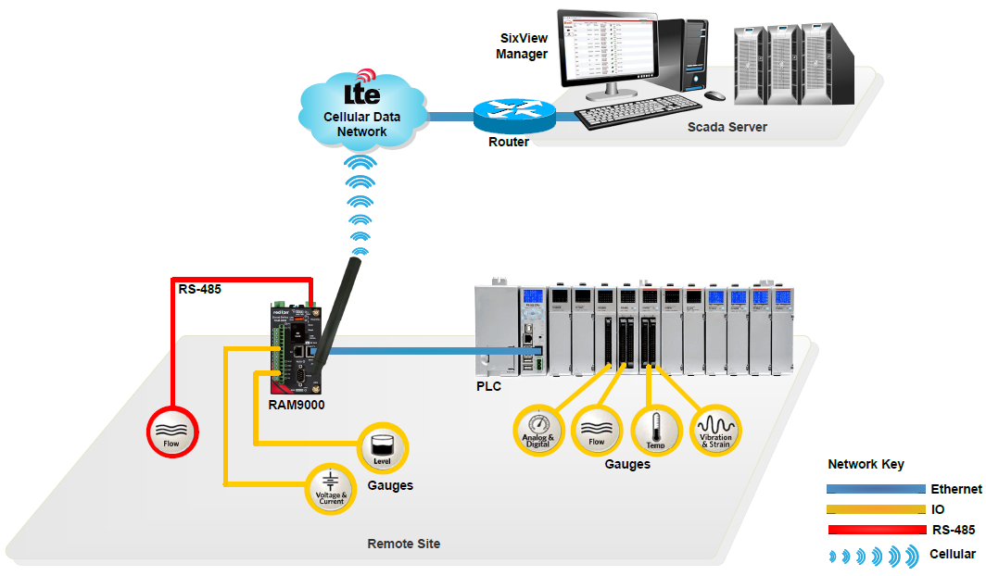
Applications
I/O
Notes:
Locations with existing PLCs that use dial-up modems or have no connectivity – The RAM 9000 offers secure cellular connectivity. Locations that use Ethernet or serial-based Modbus for communications with limited remote connectivity – RAM 9000 has a serial-to-Ethernet bridge built in. Customers that want a low-cost, out-of-the-box solution for monitoring and controlling remote locations – RAM 9000 . Any application that is security sensitive – RAM 9000 supports encryption levels up to 1024 bit, ahead of standard industrial communications devices.

Slide 12
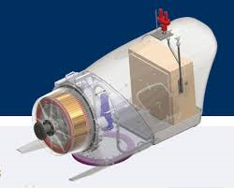

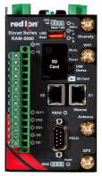
Applications
Utilities - Wind Turbine Monitoring
RAM 9000
inside
Notes:
Used to monitor critical data including power generated from wind turbine and reported back to utility or end user.

Slide 13

Applications
Oil & Gas - Well Head Monitoring
RAM 9000
inside

Slide 14



Applications
Transportation & Mining
Train – Track side controls,
signaling and surveillance
Mining – Surveillance and monitoring

Slide 15
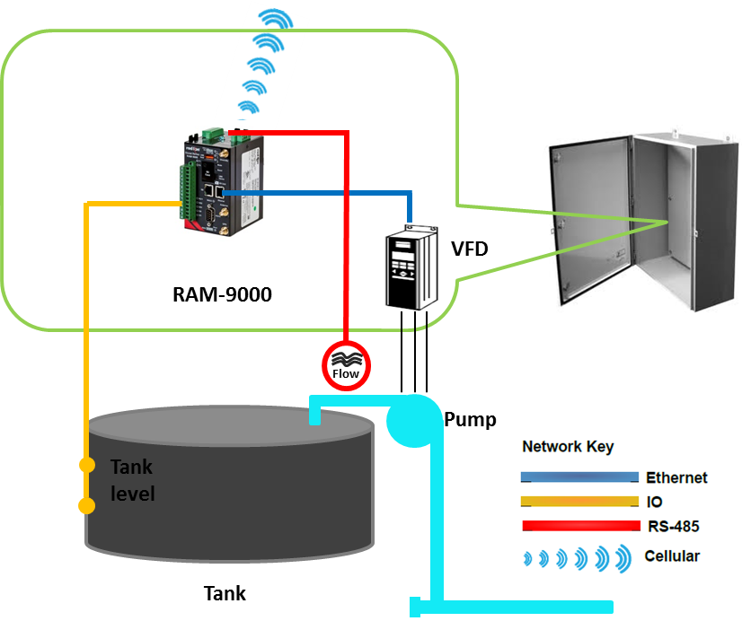

Applications
Water - Lift Stations, Pump Controls

Slide 16

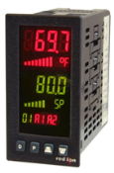
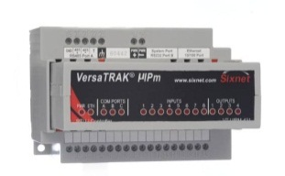
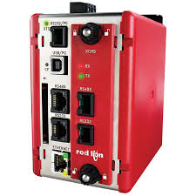
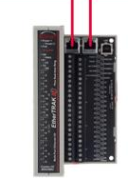
Other Applications
Control systems that have no extra I/O can have signals brought directly into RAM 9000
OEMs can connect remotely to equipment in the field to troubleshoot or update controllers
Can provide true redundant backhaul communications and remove the risk of failure of wired only networks
Flow
RAM 9000
3rd Party
PAX2C PID
VersaTRAK RTU
Graphite HMI
DSP
…
E2 I/O
E2 I/O
Can be a great addition to other Red Lion product applications !!!

Slide 17
Competitive Comparison

Slide 18
RAM 9000 Models
RAM-9701 4G LTE, 1 Ethernet Port
RAM-9711 4G LTE, 2 Ethernet Ports
RAM-9731 4G LTE, 2 Ethernet Ports, Wi-Fi option*
Available with AT&T Certified and Generic cellular configurations
* Future Availability
Notes:
Note: generic versions are not specific carrier certified devices. Please ensure that you check with your cellular carrier for compatibility.
Use of generic devices may result in lower level of support, from the cellular carriers, than a certified solution.
RAM 9000 generic models above work with:
LTE Bands 1, 4, & 17; Frequencies 700, 2100, & Advanced Wireless Services (AWS) 1700 & 2100 MHz
HSPA Bands 1, 2, 5, & 6; Frequencies 800, 850, 1900, & 2100 MHz
GSM Frequencies 850, 900, 1800, & 1900 MHz

