Slide 1
WELCOME.
the webinar will begin shortly
MobilityPro® 5000 with WiFi Capabilities
Mahesh Patel | July 2012
NOTE: Due to bandwidth-induced audio problems, the audio portion is via phone only. To connect via phone, select the audio option at the top of your monitor,
and follow the dial-in instructions.
Notes:
1

Slide 2
Agenda
Why are we here today?
MobilityPro 5000 with NEW WiFi Capabilities
  What is the MobilityPro 5000?
  What is the NEW WiFi feature?
  Why customers need the MobilityPro 5000 with WiFi?
  Who uses the MobilityPro 5000 with WiFi?
  What is the competition?
  What happens next?

Slide 3
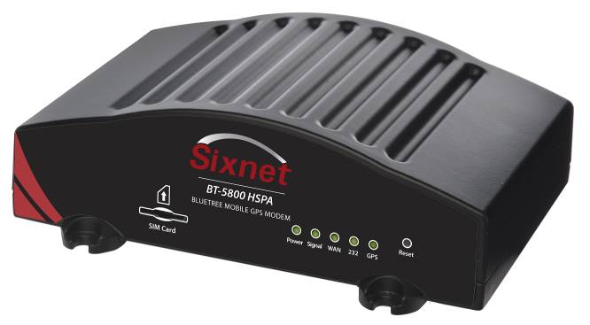
What is the MobilityPro 5000?
Offers Maximum Flexibility
  WiFi option for high-performance wireless wide area connectivity
  USB expansion port supports multiple serial devices
  Software Development Kit supports custom applications
Increases Mobile Efficiency
  On-board GPS for real-time location tracking
Delivers Proven Reliability
  Extreme temperature rating -40 to 85◦C
  Heavy-duty, shock-resistant and MIL spec
Provides Better Access to Vehicle Data
  Built-in I/Os
Delivers Secure, Reliable Mobile Data Communications

Slide 4
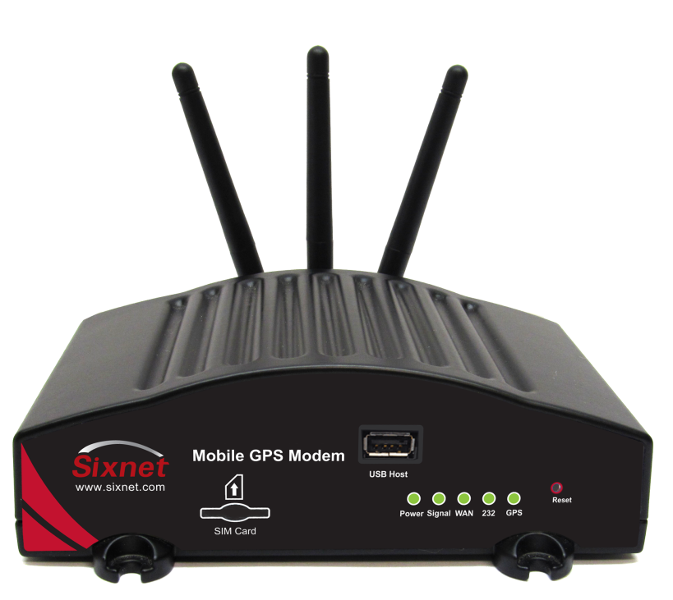
What is the NEW WiFi Feature?
802.11 b/g 2.4 GHz Radio Compliant Access Point
  Single SSID
  Supports up to 128 concurrent users
  WEP (64/128bit, only for b/g)
  802.11 authentication
    IEEE 802.1x
    EAP-MD5/TLS/TTLS/

Slide 5
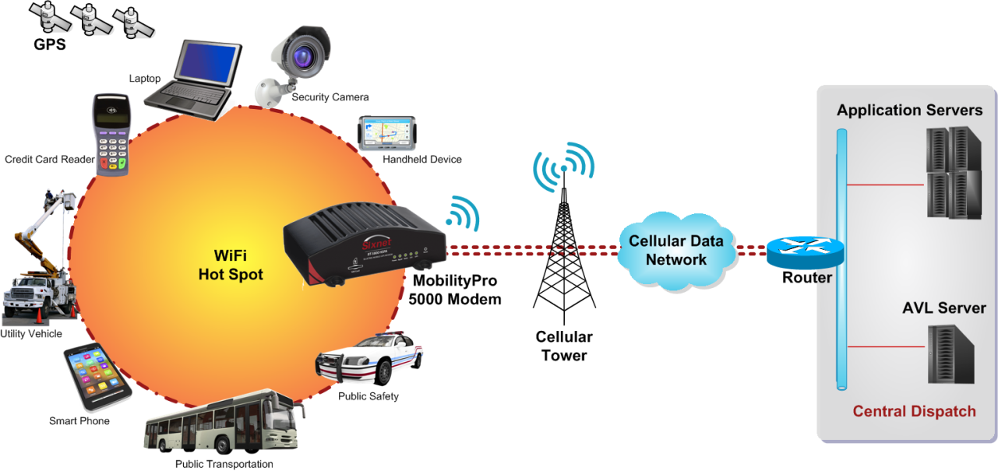
Why Customers Need WiFi?
Vehicle Area Network
Increases Flexibility of Data Access
  Local area network is WiFi
  Wide area network is Cellular
Improves Mobile Efficiency & Safety
  Stay connected away from the vehicle
  Connect equipment without wires

Slide 6
Who Uses the MobilityPro 5000?
First Responders – speed response times by automatically connecting to in-vehicle modems to
Authorities – use handheld devices to quickly print and issue citations from outside the vehicle
Paramedics – immediately send and receive vital data without returning to the ambulance
Utility Workers – can easily access diagrams and manuals without having to go up and down in the bucket
Mobile Workers – easily access applications outside the vehicle
Increases Efficiency & Enables Faster Response Times

Slide 7
What is the Competition?
Feature | Sixnet (BT5x30) | CalAMP (Vanguard) | Cypress (CTM15X) | Sierra (GX)
Access Point | 802.11 b/g | 802.11 b/g/n | 802.11 a/b/g/n | 802.11 b/g/n
Access WiFi and ETH | Yes | Yes | Yes | Yes
WAP/WEP | Yes | Yes | Yes | Yes
Devices Supported | 128 | 10 | ?? | 8
Temperature | -40⁰ C - +85⁰ C | -30⁰ C - +70⁰ C | -30⁰ C - +65⁰ C | -40⁰ C - +70⁰ C

Slide 8
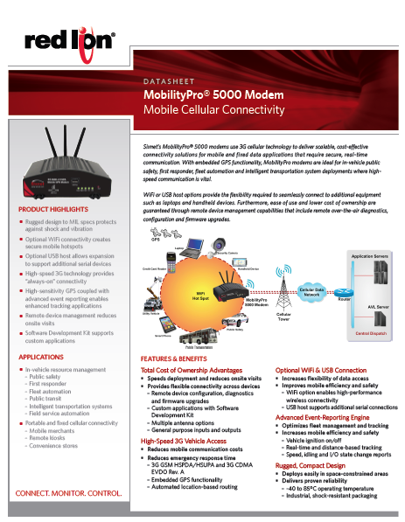
What Happens Next?
Product Launch
  Press Release
  Pricing
  Datasheet
  Web
Contact Your Sales Manager to Learn More

