Slide 1
Product Briefing: E3 I/O™ Modules
WELCOME.
the webcast will begin shortly
Paul Bunnell| February 2016
NOTE: Due to bandwidth-induced audio problems, the audio portion is via phone only. To connect via phone, select the audio option at the top of your monitor,
and follow the dial-in instructions.

Slide 2
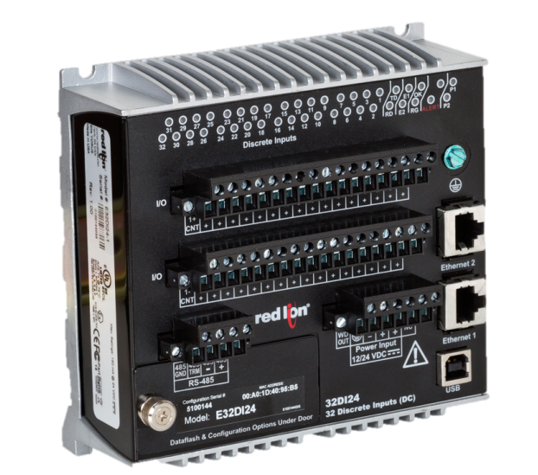

Product Briefing:
E3 I/O™ Modules
Paul Bunnell
Director of Product Management
Red Lion Controls

Slide 3
Agenda
Introducing E3 I/O™ module platform
What are remote I/O modules?
Features and benefits
  Hardened rugged design
  Wide variety of I/O types
  Connections
  Ethernet networking options
High-density I/O extends Graphite® HMI capabilities
Model number explanation
Setup and configuration
Where to sell

Slide 4
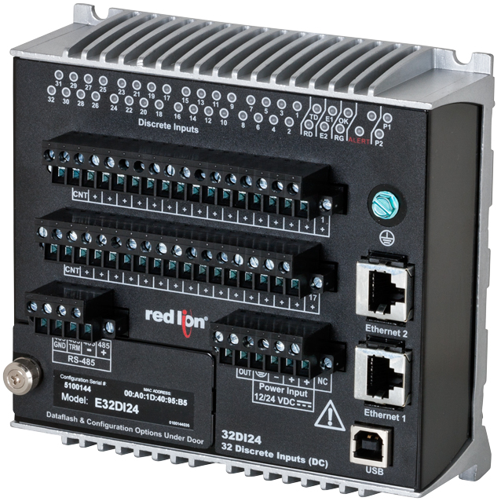
Introducing E3 I/O™ Platform
What: a set of 17 high-density
I/O modules with hardened
metal enclosures and powerful
communication options
When: February 9, 2016 launch
Why: designed to withstand the
critical demands of localized and
distributed I/O applications
  Features robust networking
  capabilities with redundant Ethernet
  ports and built-in serial communication
  Marks Red Lion’s first rugged I/O modules
  configurable using Crimson® 3.0 software

Slide 5
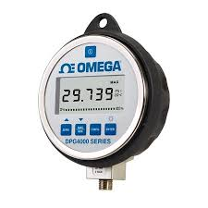
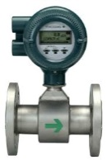
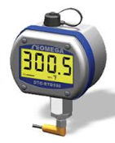
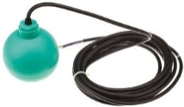

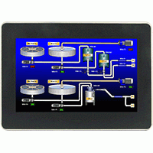
What are remote I/O modules?
Remote I/O modules are field devices that gather hardwired on/off or current/voltage information from
various types of sensors, i.e. flow, temperature, level, float, etc.
That information is typically sent over
a network to a controller (PLC/RTU)
or (HMI) to act on that data

Slide 6
Features & Benefits

Slide 7
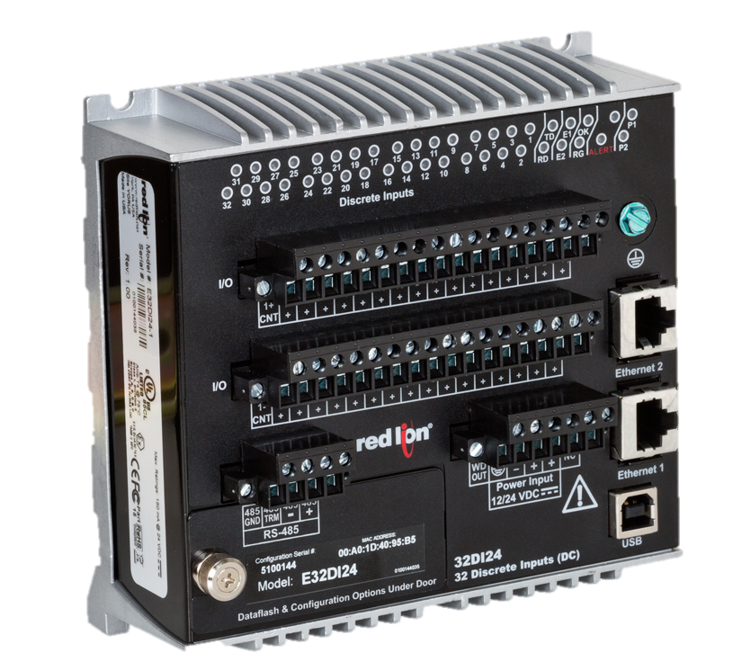
Hardened Rugged Design
-40° to 75°C operating temperature range
High tolerance to
shock and vibration
Hazardous location ratings
  UL Class 1, Div2.
  ATEX/IECEx
All-metal enclosure
DIN-rail or panel mounting
Can be installed in harsh environments closer to sensors

Slide 8
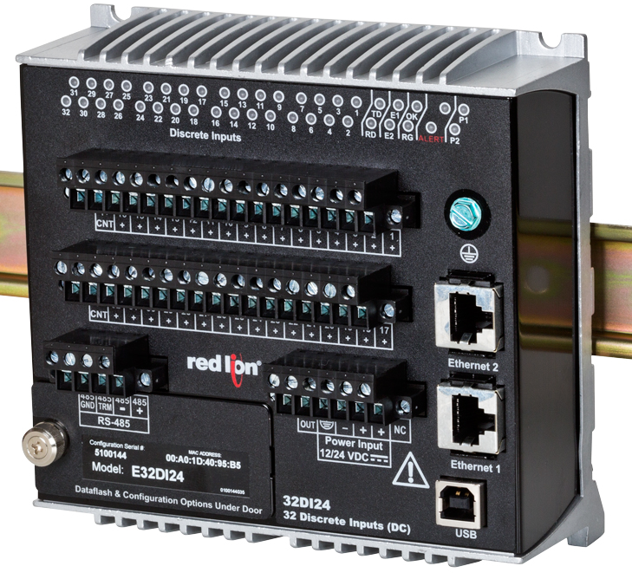
Wide Variety of I/O Types
Analog Inputs (AI)
  Temperature
  Sensors
Analog Outputs (AO)
  Values
  Motors
Discrete Inputs (DI)
  Non-isolated
  Isolated
Discrete Outputs (DO)
  Solid-state
  Relay
Only one platform is required to cover any application

Slide 9
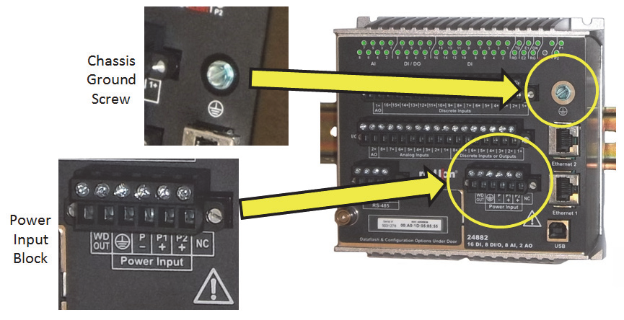
Power Connections
Redundant DC power – 10 to 30V

Slide 10
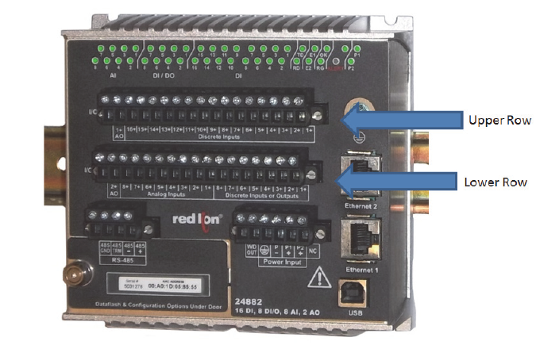
I/O Connections
Two rows of removable terminal
blocks for wiring field devices

Slide 11
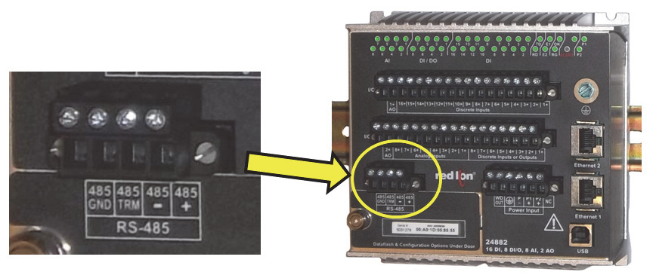
Serial Connection
RS-485 network for connecting legacy
serial field devices

Slide 12
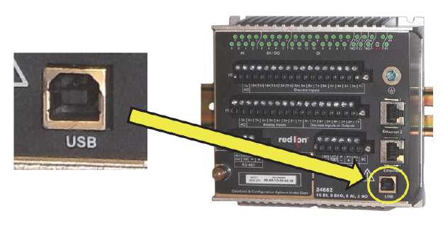
USB Connection
USB port for device configuration

Slide 13
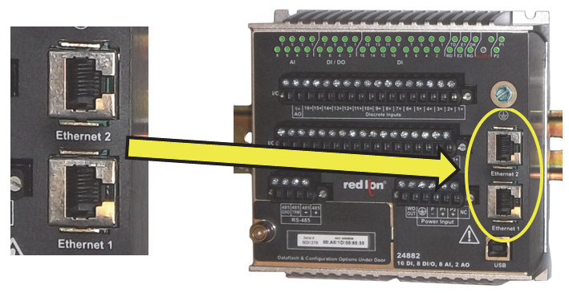
Ethernet Connections
Dual Ethernet ports for device
configuration and networking

Slide 14

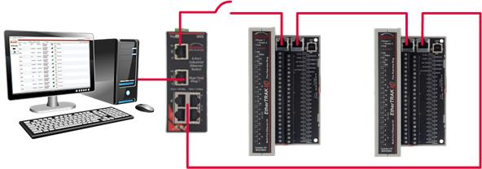
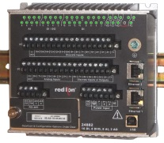

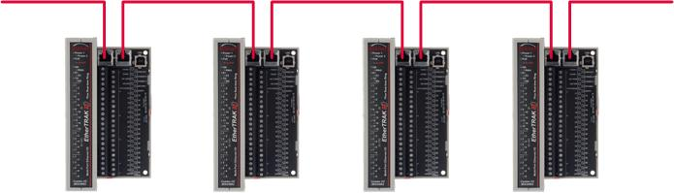
Ethernet Networking
1. Real-Time Ring Mode
Create redundant Ethernet reliability without additional costly equipment
2. Switch Elimination Mode
Daisy-chain modules – without the need for external switches – saves money and reduces complexity
3. Two Networks Mode
Each Ethernet port has a unique MAC and IP address for connecting two independent physical networks

Slide 15
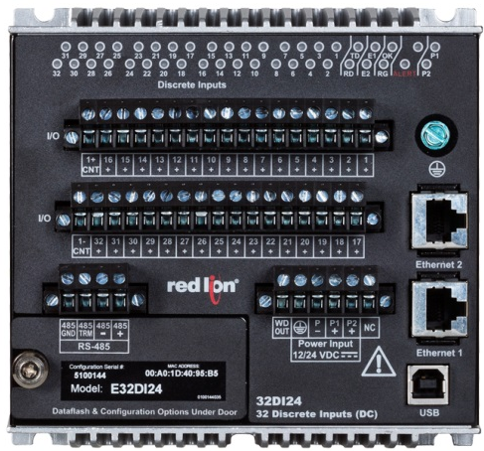
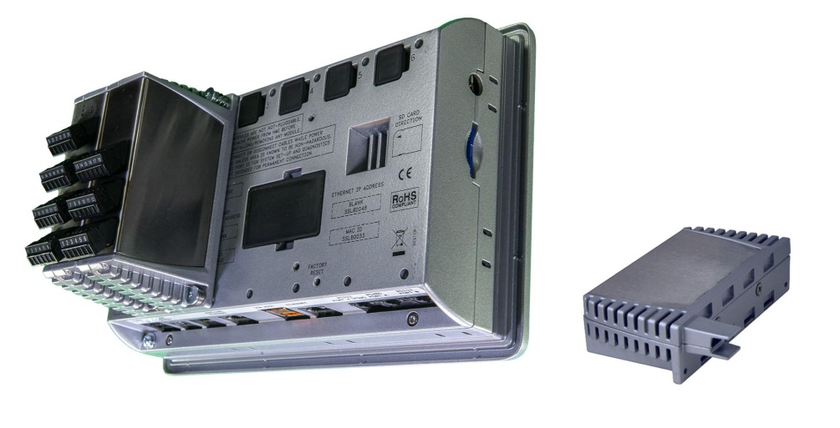
Extend Graphite® HMIs I/O
Out of space on the back of the Graphite HMI?
  Add multiple E3 I/O™ modules via Ethernet network
  Mount E3 I/O modules to the back of the panel
  Distribute E3 I/O modules to other parts of the factory

Slide 16

Model Numbers, Set Up & Configuration

Slide 17
E3 I/O™ Module Model Explanation
E3-##AABB-1
Future
Signal type
I/O type (DI, DO, AI, AO)
Number of channels
E3 product line
Example: E3-32DI24-1
Exceptions:
E3-MIX20884-1, E3-MIX24880-1,
E3-MIX24882-1, E3-16AI8AO-1

Slide 18

E3 I/O™ Module Part Number List
E3-MIX24880-1
E3-MIX24882-1
E3-MIX20884-1
E3-32DI24-1
E3-16DI24-1
E3-16DIAC-1
E3-32DO24-1
E3-16DO24-1
E3-16DORLY-1
E3-32AI20M-1
E3-16AI20M-1
E3-16AI8AO-1
E3-8AO20M-1
E3-10RTD-1
E3-16ISOTC-1
E3-16ISO20M-1

Slide 19
Part Number/Description/USD List
Part # | Description | List USD
E3-16AI20M-1 | E3 I/O™ Module, 16 analog inputs (4-20mA) | $960
E3-16AI8AO-1 | E3 I/O module, 16 AI and 8 AO (4-20mA) | $1,120
E3-16DI24-1 | E3 I/O Module, 16 Isolated discrete inputs (12/24VDC) | $640
E3-16DIAC-1 | E3 I/O module, 16 Discrete Inputs (24/120 DC/AC) | $640
E3-16DO24-1 | E3 I/O Module, 16 Isolated discrete outputs (12/24VDC) | $640
E3-16DORLY-1 | E3 I/O module, 16 Relay discrete outputs (Form C and A, 12/24 DC/AC) | $640
E3-16ISO20M-1 | E3 I/O module, 16 Isolated analog inputs (4-20mA) | $1,120
E3-16ISOTC-1 | E3 I/O module, 16 Thermocouples Inputs | $1,120
E3-32AI10V-1 | E3 I/O module, 32 Analog inputs (0-10V) | $1,120
E3-32AI20M-1 | E3 I/O Module, 32 analog inputs (4-20mA) | $1,120
E3-32DI24-1 | E3 I/O Module, 32 Discrete inputs (12/24VDC) | $640
E3-32DO24-1 | E3 I/O Module, 32 Discrete outputs (12/24VDC) | $640
E3-8AO20M-1 | E3 I/O module, 8 Analog outputs(4-20mA) | $600
E3-MIX20884-1 | E3 I/O module, 12 DI (DC), 8 DI/DO (DC), 8 AI (mA), 4 AO (mA and V) | $1,140
E3-MIX24880-1 | E3 I/O Module, 16 DI(DC), 8DI/DO (DC), 8AI (mA), 0 AO | $832
E3-MIX24882-1 | E3 I/O Module, 16 DI(DC), 8DI/DO (DC), 8AI (mA), 2 AO | $952

Slide 20
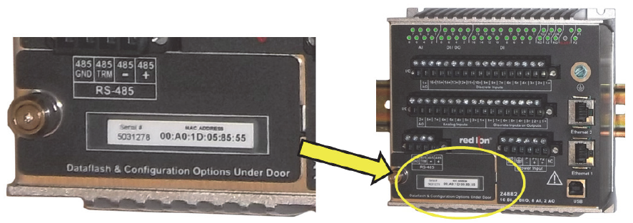
Setup and Configuration
Used to select Ethernet networking mode
and type of DI (sinking or sourcing)

Slide 21
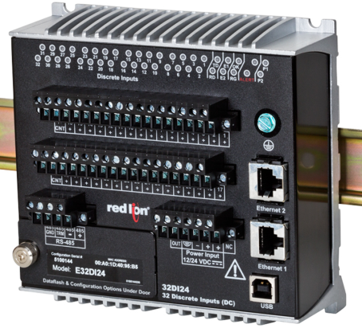

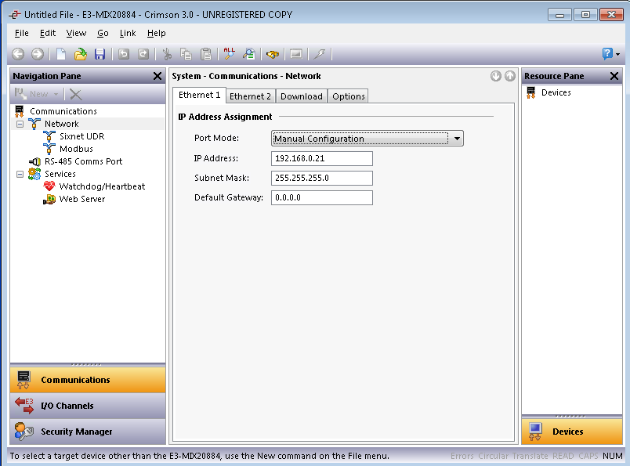
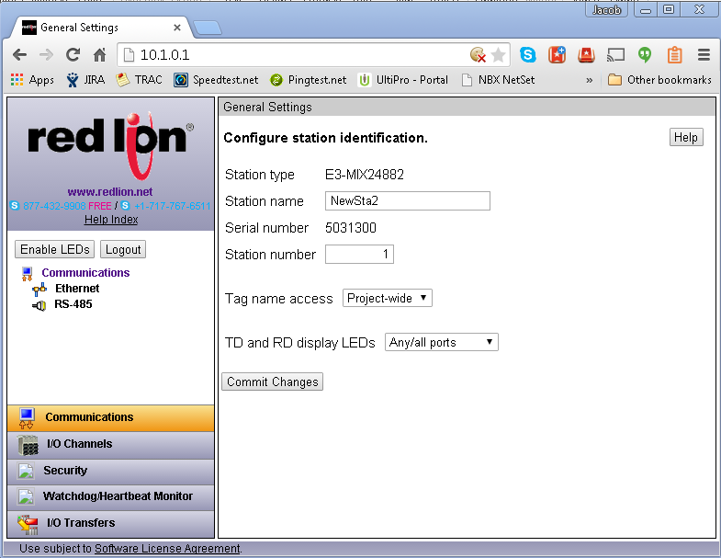
Setup and Configuration
OR
Device-based Web UI

Slide 22
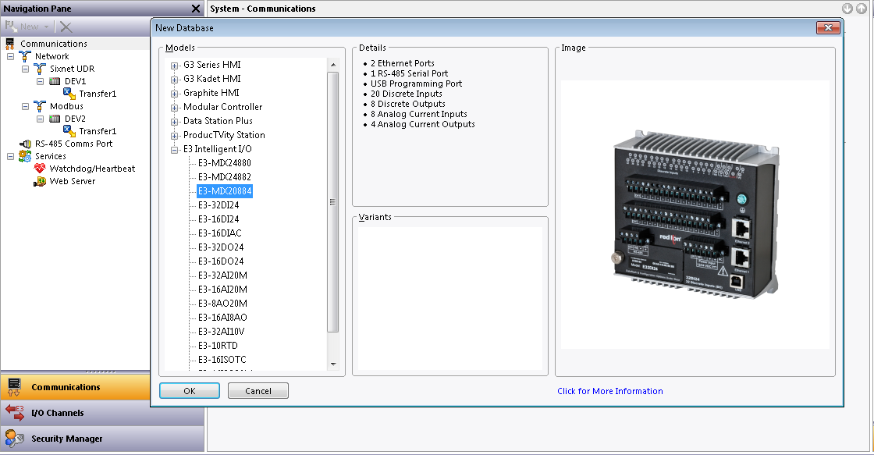
Setup and Configuration

Slide 23
Where to Sell?

Slide 24
Where to Sell?
Graphite® HMI customers that require high-density I/O that
can be mounted on the back panel of the enclosure
Applications where sensors are long distances from controller or HMI – can eliminate large bundles of wires
  Example: continuous process ovens, storage tanks and material handling
Harsh industrial environments
  Example: oil & gas (onshore and offshore), water/wastewater, solar, or wind turbines
With other Red Lion RTU products
As I/O for 3rd party controllers, SCADA systems and remote monitoring equipment

Slide 25
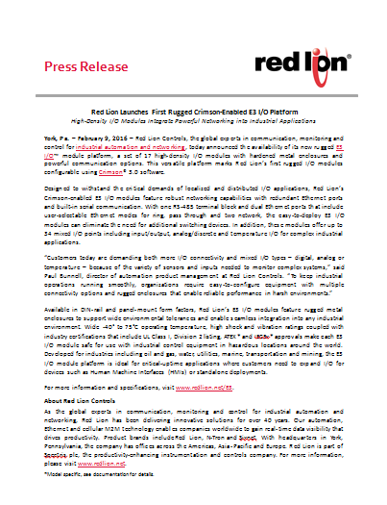
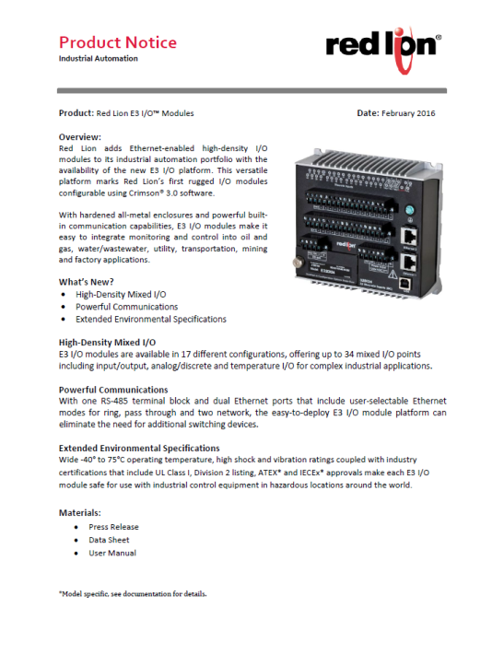
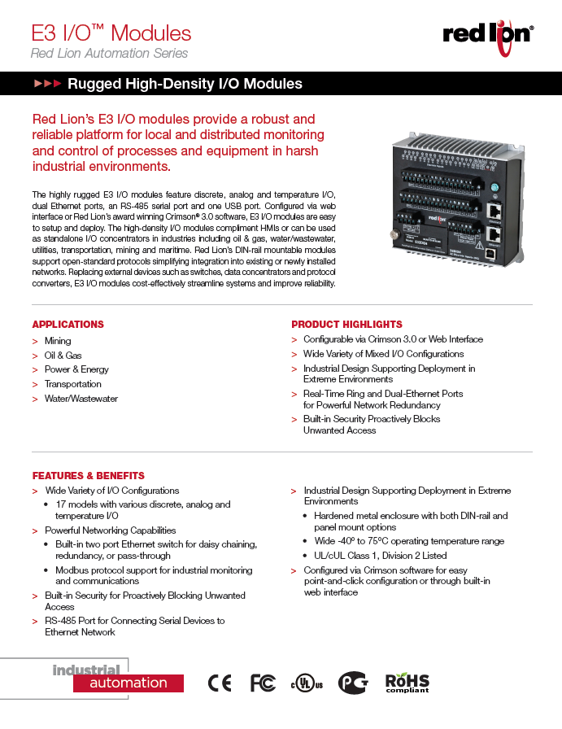
E3 I/O™ Launch Information
February 9, 2016 Launch
Digital / PR / Email
  www.redlion.net/E3 with
  product information (data sheets)
  Press Releases in English, Chinese,
  French and German
  Product Announcement Email
Distributor Portal
  Sales Primer
  Product Notice
  Product briefing (PPTX & video)
  High-res pictures
Events
  DistribuTECH tradeshow in Florida
  Press Days in Germany

Slide 26

Rugged. Reliable. Scalable.
E3 I/O™ Modules for
Industrial Applications

