Slide 1





After the first use, if you need to add a new image make sure to right click on the uploaded picture and select “Send To Back”
From Legacy to IIoT
The Complete Strategy
*Correct use of image layers
Brett Lincoln
Sales Area Manager for Red Lion
Excellence. Redefined.

Slide 2

01
02
03
Establish Your Why
Create a Framework
Take Small Steps
04
05
06
Increase Operational Efficiency
Gamify Your
Operations
Create End-to-End
Connectedness
Summary

Slide 3
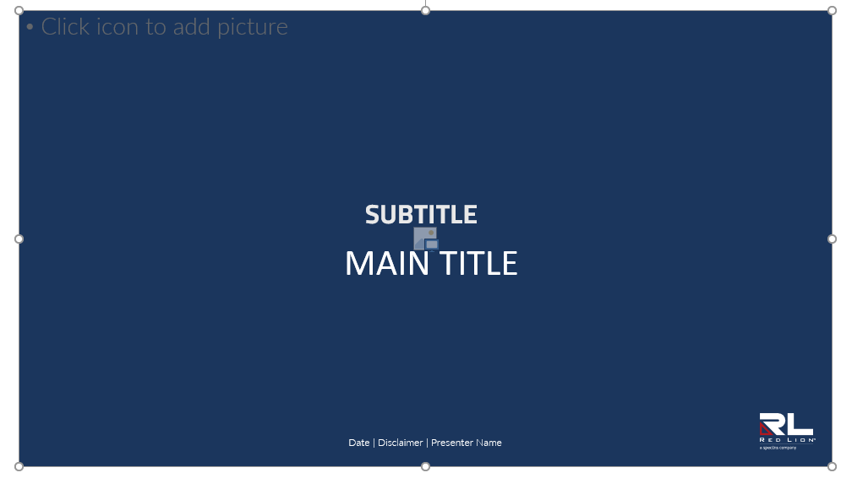
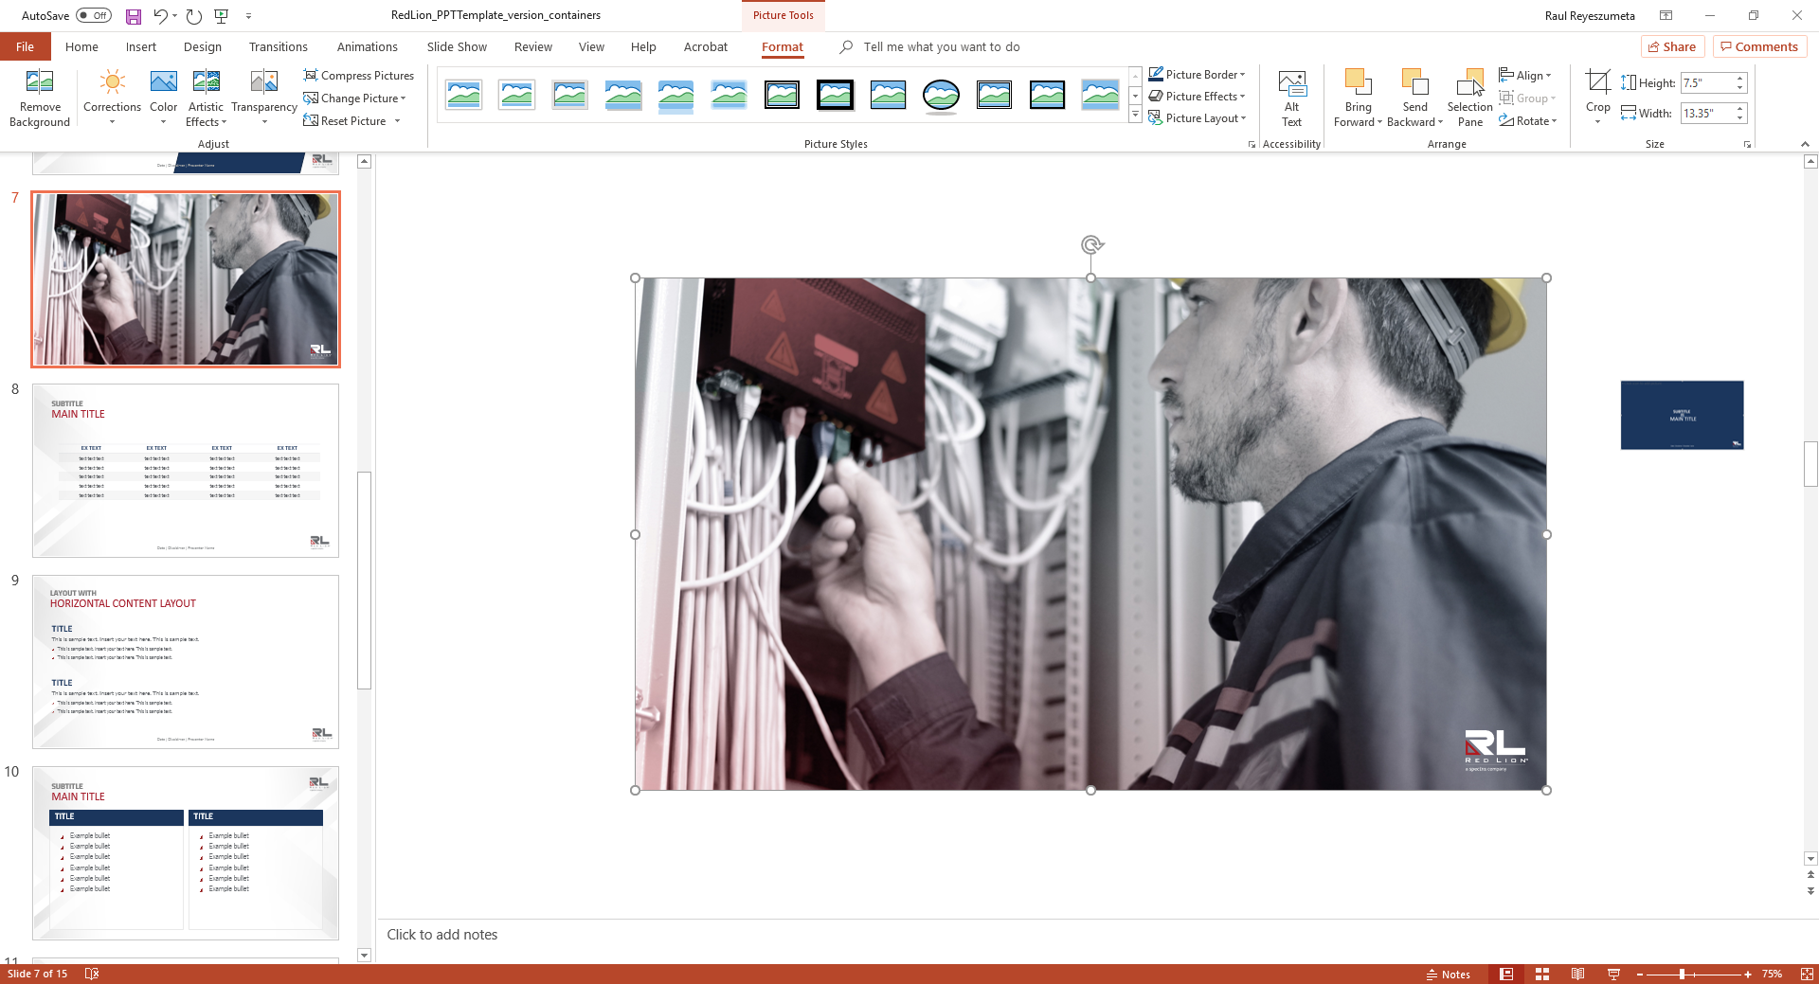
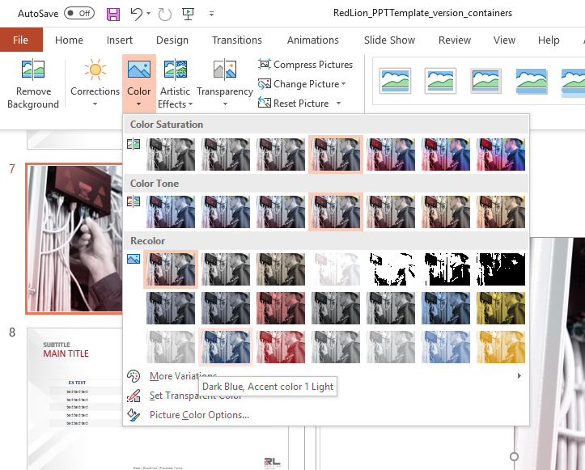
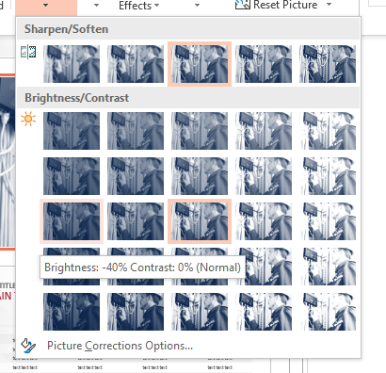
1. Click on icon to add picture
Establish Your Why
Quality Improvement? Margin Enhancement?
Knowing what the final picture should look like is critical to success
2. Click on color and choose
Dark blue
3. Click on corrections
Brightness: -40%
Contents of this document are confidential and for Red Lion Controls use only. © Copyright Red Lion 2019.
Notes:
1 minute

Slide 4







Enhancements Must Deliver Meaningful Outcomes
Cost and Budget
Data aggregation & analysis enables:
Smart capital expense optimization
Doing the right things with the right amount – replacing “do more with less” mentality
Manufacturing
Yield, energy & throughput analytics enables:
Real-time performance management
Data-enabled predictive maintenance
Zero-based budgeting (ZBB)
Digital
manufacturing
End-to-end digital enablement
Analytics to
value
Customer Journey
Intelligent process automation, robotics and end-to-end digitization of processes enables:
Values-driven changes to be made more quickly, easily & sustainably
Product
Connect new and existing data sources with new technologies enables:
Complexity management
Design-based optimization
R&D productivity through machine learning
Source: McKinsey & Company

Slide 5
Key Performance Indicators (KPIs) to Consider
Customer Experience
OTD to Commit
Cycle Time
Improving Quality
Yield
Efficiency
Throughput
Capacity Utilization
Changeover Time
Customer Rejects/RMAs
Incoming Supplier Quality
OEE
Production Attainment
Compliance
Health and Safety Incidents
Reportable Environmental Incidents
Number of Non-Compliant Events per Year
Reducing Maintenance
Downtime vs Operating Time
Flexibility & Innovation
Rate of New Product Introduction (NPI)
Engineering Change Order Cycle Time
Reducing Costs & Increasing Profitability
Revenue Productivity per Employee
Total Manufacturing Cost per Unit Excluding Materials
Planned vs Emergency Work Orders
Average Unit Contribution Margin
Return on Assets

Slide 6
Questions to Ask
Is my current operation, process or department as efficient as it can be?
Is it capable of consistently running at target capacity?
Are delays and downtime minimal?
Can changeover time be shortened?
Is work scheduled based on demand versus forecast?
For OEMs: Am I spending too much on warranty service & repair?
WHY?

Slide 7
1. Click on icon to add picture
Create a Framework
Now that you know the “why”, determine information can help you achieve your goals
2. Click on color and choose
Dark blue
3. Click on corrections
Brightness: -40%
Contents of this document are confidential and for Red Lion Controls use only. © Copyright Red Lion 2019.
Notes:
1 minute

Slide 8
What Do Staff Need? Some Examples
Operations Manager
Must increase throughput without sacrificing quality
Operator
Needs easy to understand systems & controls to accelerate learning and increase knowledge retention
Quality Manager
Engineer
Must meet aggressive development time & cost goals
Ideal to create a solution that can be quickly & easily modified to fit a new application need, versus reinventing the wheel
Focused on achieving year on year savings and reduced downtime
Needs closed-loop, repeatable processes that can be measured & reported
Wants early warnings into potential problems and clear information on how to resolve
Needs historical data for traceability in case of issues, regulatory compliance
Wants to reduce quality variations
Needs equipment with easy installation and minimal maintenance cost
Wants data/reports to make better informed decisions

Slide 9





Create a Framework
Assess Equipment
Protocols & Communication
Location & Environment
Security
Organization
  How old is your equipment?
  Can it communicate with newer technologies?
  Are the necessary sensors installed to provide real time feedback?
  What cost-effective solutions address this issue?
  How many different protocols are being used?
  Do I want equipment to communicate locally as well as upstream?
  What type of media is being used?
  What cabling must be supported?
  Will devices be monitored via 4G/LTE, fiber or broadband?
  Are there temperature fluctuations or noise to deal with?
  High vibration conditions?
  Industry certifications required for operation?
  How can sensitive data be protected as it’s collected and transferred?
  Are there any in-house regulations regarding the protection of data & information?
  What security measures are already in place?
  Is leadership invested in IIoT to help address their business goals?
  Is IT bought in to Operational success?
  Do we have the right skillset in-house for planning, installation & monitoring?

Slide 10
1. Click on icon to add picture
Take Small Steps
“Do the difficult things while they are easy and
do the great things while they are small” – Lao Tzu
2. Click on color and choose
Dark blue
3. Click on corrections
Brightness: -40%
Contents of this document are confidential and for Red Lion Controls use only. © Copyright Red Lion 2019.
Notes:
1 minute

Slide 11
Take Small Steps
Gemba Walk
Gemba Walk
Go to the “real place” - where the work happens – and observe. Collaborate with personnel and find improvement spots in the process.
Begin Again
Iterating often ensures changes can be adopted, and adapted, quickly. Create and communicate achievable plans with short timetables. Follow up during gemba walks and monitor for success.
Begin Again
01
Set KPIs
07
02
Set KPIs
Based on your “why”, in alignment with your framework and after understanding your staff’s unique needs, establish metrics in line with key priorities.
Log & Analyze
Collect sensor, production, KPI, personnel feedback, and machine data for historical analysis. Look for correlation between events and data.
Log & Analyze
06
03
Data Fluency
Data Fluency
Increase your data fluency: take an inventory of the protocols, media types and applications used in the operation. Do you lack insight into orphaned equipment that’s critical to your success?
Act Locally
05
04
Add panel meters and HMIs to provide information to production personnel. Calculate and display KPIs to provide awareness of performance. Enable standardized entry of problems and causes. Use sensor and machine data to facilitate troubleshooting using descriptive diagnostics.
Act Locally
Install Sensors
Install Sensors
Sensors transform the physical world into digital insights and offer feedback on processes in a predictable, consistent and measurable way. Add signal conditioners
in areas of high noise or if you’re sending data a long distance.

Slide 12
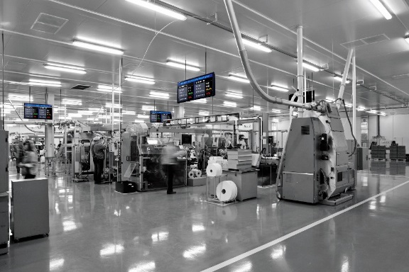
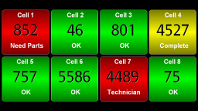
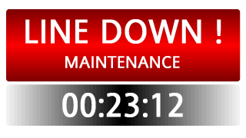
Small Step: Connect Operators to Goals with Key Performance Indicators (KPIs)
Although changing from a reactive to proactive culture is difficult, it is achievable. It requires monitoring and rewarding operating activities aligned with organizational policies.
Count & Reject Ratio
Takt Time
Target
Downtime
OEE
Many companies
will compare individual worker and shift output to invoke a
competitive spirit among employees.
Takt time is the amount of time required for the completion of a task or the cycle time of a specific operation.
Display target values for output, rate, takt time and quality. This KPI helps motivate employees to meet specific performance targets.
Whether the result of a breakdown or simply a changeover, downtime is considered one of the most important KPI metrics to track.
OEE is a metric that multiplies availability by performance and
quality to determine utilization. The higher the number, the more efficient the operation.

Slide 13
1. Click on icon to add picture
Increase Operational Efficiency
Address intermittent inefficiencies and improve output across the organization, RIGHT NOW
2. Click on color and choose
Dark blue
3. Click on corrections
Brightness: -40%
Contents of this document are confidential and for Red Lion Controls use only. © Copyright Red Lion 2019.
Notes:
1 minute

Slide 14
The Challenge
How can I improve data collection & monitoring without adding significant cost and complexity?
Accessing diverse data across an entire plant is key to improving processes and increasing operational efficiency.
However, many data acquisition systems are designed with proprietary technology which can limit flexibility or require a significant investment in hardware or software in order to connect equipment.
COST & COMPLEXITY

Slide 15
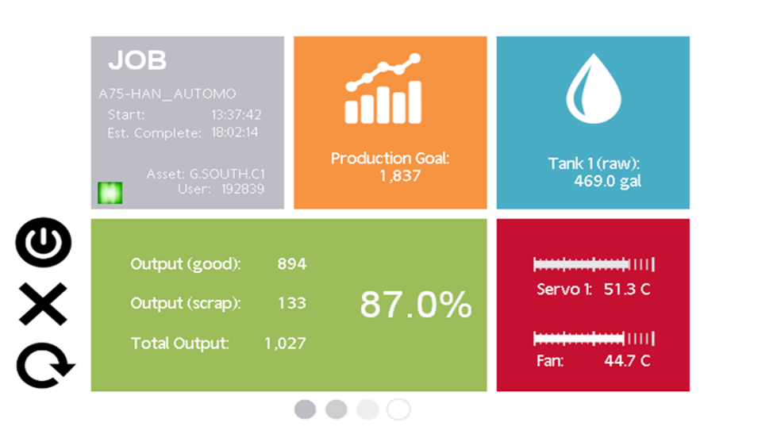
Reduce Total Cost of Deployment
Leverage data acquisition products that can collect data from virtually any source
Use simultaneous protocol conversion to simplify networks by passing data to almost any device without additional converters
Gain insight into what equipment is doing anytime, anywhere, any way while also reducing development time with point-and-click simplicity

Slide 16
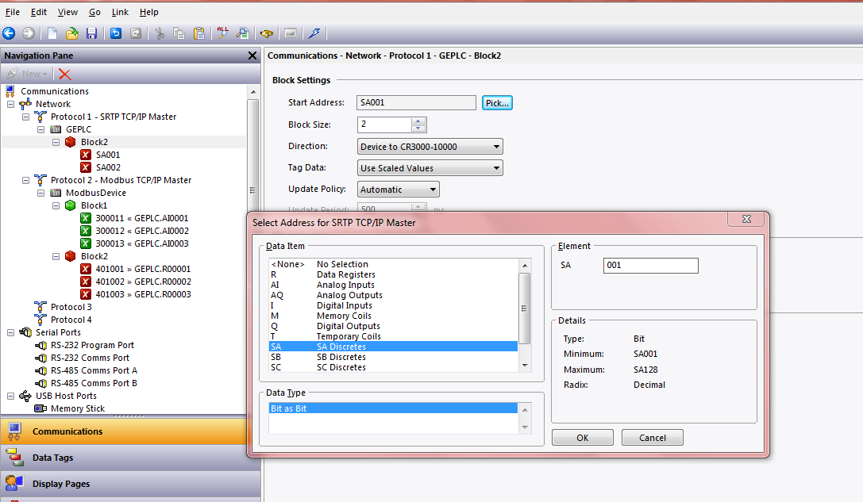
Create Out-of-Box Compatibility with
New or Existing Equipment
Built-in support for over 300 industrial drivers ensures equipment remains relevant for years to come

Slide 17
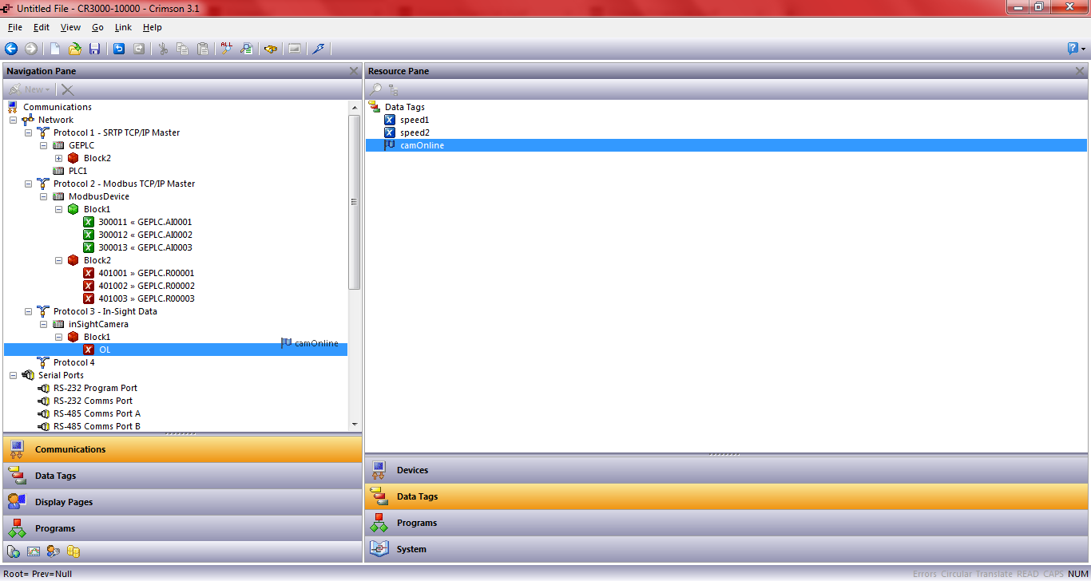
Seamlessly Integrate Multi-Generation, Multi-Vendor Systems
Bridge the communication gap between disparate serial, Ethernet and fieldbus devices, orphaned by incompatible communications standards, using a simple point-and-click user interface

Slide 18
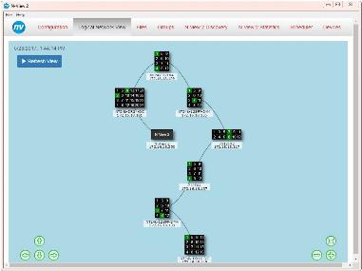
Make the Move to Managed Switches
When it’s important to have input and control over traffic on the LAN, it’s time to move to a managed switch.
Managed switches enable you to:
  Provide communications redundancy
  Have control over how data travels and who has access to it
  Monitor switch performance
  Detect, diagnose & repair problems

Slide 19

Key Managed Switch Features
Virtual LAN (VLAN)
Remote Monitoring
Logically group devices together to isolate traffic between them, even when traffic is passing through same switch
Get easy-to-understand information about network devices and real-time alerts when there are problems
Redundancy
Port Mirroring
Safeguard a network in case a connection or cable fails by providing an alternate data path for traffic
Copy & forward network traffic to observe data on other ports or segments without taking the network out of service

Slide 20
Additional Uptime Considerations
Media Conversion
POE/POE+
IP67 rating with M12 Connectors
Reduce wiring and installation costs
Eliminate the need for separate power cabling
Powered devices no longer have to be located near power outlets
Benefits of using fiber:
Noise immunity
Surge immunity
Increased data transmission distance
Mount directly in cell/plant
Simplify access, installation & maintenance
Lower total system cost by reducing custom panel requirements

Slide 21
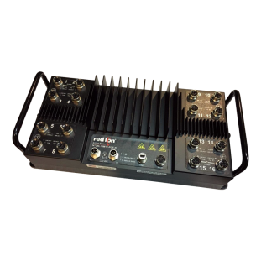
Consider IP67-Rated Devices
Some customers are moving to IP67 options they can mount directly in-cell, versus non-IP67 devices built into custom panels
As a result, the units are:
  Easier to install with reduced wiring
  Easier to access & maintain
And consequently offer them:
  Reduced total system cost
  Reduced downtime when there is a problem
  Reduced total cost of ownership

Slide 22
1. Click on icon to add picture
Gamify Your Operations
Improve employee engagement, reduce turnover, and increase productivity
2. Click on color and choose
Dark blue
3. Click on corrections
Brightness: -40%
Contents of this document are confidential and for Red Lion Controls use only. © Copyright Red Lion 2019.
Notes:
1 minute

Slide 23

Why Gamification?
Unengaged employees are more likely to contribute to errors and mistakes and costs an approximately $3,400‡ for every $10,000 in annual salary.
Employees who perform better are aligned with their goals, aware of their performance gaps and motivated to improve.
Millennials will make up 75% of the workforce by 2025, with the average millennial having played 6,000-9,000 hours‡ of video games before the age of 21.
It works. Ford Motor Company recently reported a 417% increase in worker use of gamified learning portals, with their younger workforce responding particularly strongly to the new strategy.*
*Source: dynistics.com
‡Source: inc.com

Slide 24
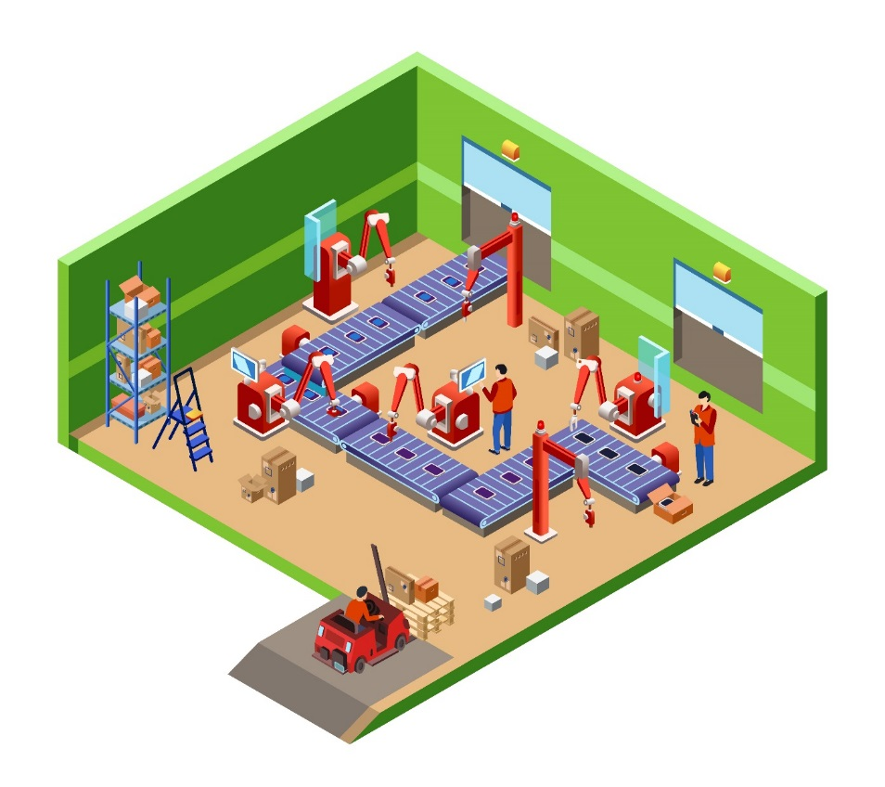
What is Gamification?
The most accepted definition of gamification is ‘the use of game elements and game-design techniques in non-game contexts’.
The goal of gamification is to improve employee engagement by:
  Fighting against tasks that can easily become routine
  Preventing employees from ‘zoning out’, a potentially dangerous occurrence, especially in industrial environments

Slide 25
Gamification is a Mindset
Gamification isn’t about any one technology nor is it just about feedback.
It’s important to understand the psychological and social motivations of human beings and how game mechanics can help satisfy those needs.
Game psychology drives players to continue even after seeing “GAME OVER” on the screen. On average, gamers fail 80% and yet still find the experience enjoyable.
In addition, game behavior aligns well with the Lean iterative process
Act
Feedback
Motivate
Plan
Do
Check
Act

Slide 26





Leverage Game Elements to
Motivate Performance
Highlight Progress
Games offer progress bars and leaderboards that inform where the player started, how far they’ve come, how they stack up and how far they have left to go.
Clear visibility into the progress being made is an informative tool that offers motivation and fosters a competitive spirit.
Provide Hints
Games serve up hints when players are stuck to ensure they continue to play and stay engaged. They explain what is needed in enough detail to enable forward action.
Use real-time data to provide hints on how operators can improve their performance in the moment.
Promote Collaboration
Growing up playing massive multiplayer online games, millennials seek collaboration and learn better & quicker in teams.
Provide team-based performance insights in addition to transparency within individual functions.
Deliver Development
Gamers learn through action – but gamers also have the option to enter tutorials where they can hone their skills or practice a level until they master it.
Using real-time data insights, give a clear picture of what is expected and what skills are required to “level-up” within the organization.
Communicate Meaning
Gamers willingly struggle from level to level for the ultimate goal of saving the world.
By explaining clearly “If you do this, you’ll achieve this,” you engage employees in the “why” and give their efforts meaning.

Slide 27
1. Click on icon to add picture
Create End to End Connectedness
Whether on the plant floor or in the front office, employees should be able to act on real-time data from virtually any equipment, anywhere to make operational decisions that have meaningful business impact.
2. Click on color and choose
Dark blue
3. Click on corrections
Brightness: -40%
Contents of this document are confidential and for Red Lion Controls use only. © Copyright Red Lion 2019.
Notes:
1 minute

Slide 28
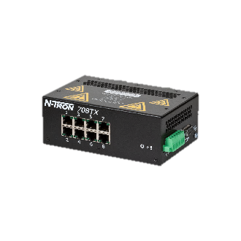


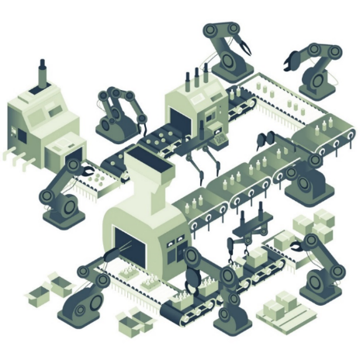




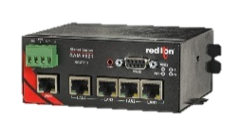
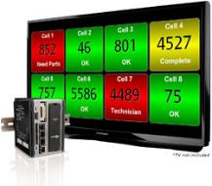
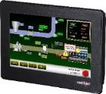
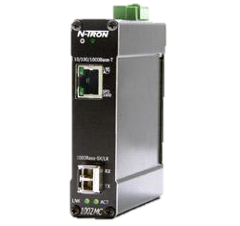


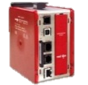
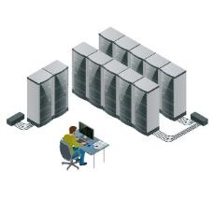

End-to-End Connectivity: So Far
Gigabit POE+
N-Ring™
Fiber
RS-485
Copper
Ethernet 10/100
Ethernet 10/100/1000
MQTT

Slide 29
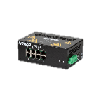









Ensure Operations Visibility, Anywhere
PAX2 Panel Meter
Dual-line, tri color display
Universal power and input capabilities
Optional field installable communications
Local display of information
ProducTVity Station
Plant floor visualization solution
Simultaneous protocol conversion
Data logging & server synchronization
Integrated web server enables insights anywhere
CR HMI
Local display of information
Simultaneous protocol conversion
Data logging*, SQL server synchronization & queries
Modular Controller
Simultaneous protocol conversion
Data logging & server synchronization

Slide 30
Experience Increased Uptime and Greater
Control of Your Network
708TX
Layer 2 Fast Ethernet
Managed Switch
NT24k-8TX
Layer 2 All Gigabit Managed Switch
NT24k-8TX
Layer 2 All Gigabit Managed Switch
NT24k-16M12
IP67-Rated
Layer 2 All Gigabit
Managed Switch
N-Ring™
Redundant media path
~30ms heal time

Slide 31
Leverage PoE, Media Conversion and
IP67-Rated Products for Additional Uptime
1000-POE+
Gigabit Power Over Ethernet
Injector
1002MC
Industrial Media Converter
NT24k-16M12
IP67-Rated
Layer 2 All Gigabit
Managed Switch

Slide 32
Now: The Challenge
59%
Industrial CxOs who believe cognitive computing, big data & AI are mature & market-ready
100+
Average number of software applications running in a manufacturing site
77%
Nexus survey respondents who said interoperability was their biggest challenge in IIoT
ERP, CLOUD & BIG DATA

Slide 33





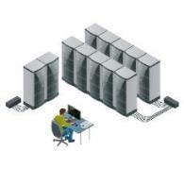





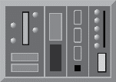








The Language of Industry 4.0 is Diverse and Evolving
IIoT Connectivity
MES, ERP, SCADA Systems
Industrial protocol conversion, data aggregation, synchronization, edge computing, OEE analytics
Machine 1
Built 2012
PLC with Ethernet
Sensors
(temp, level, pressure, vibration, flow, etc.)
Machine 2
Built 1999
PLC with serial interface
Machine 3
Built 1994
µC + drive controllers
Machine 4
Built 2002
PLC with CAN
Building data
(power, air, heat, etc.)

Slide 34
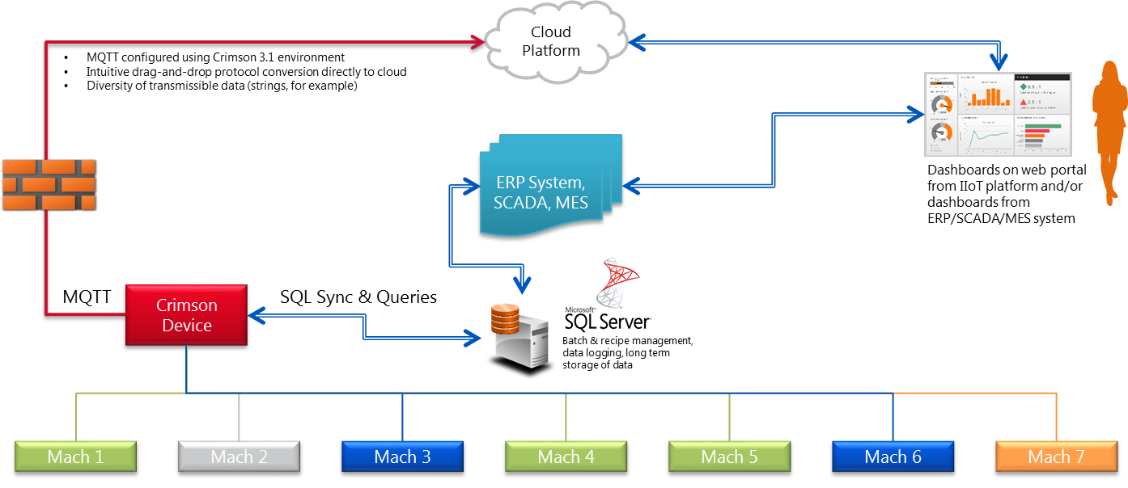
Connect Production to Front Office Applications Using SQL Sync & Queries
Sync data to system servers for long-term storage
Simplify batch and recipe management to ensure repeatable quality
Manage authorized operators from a central location

Slide 35
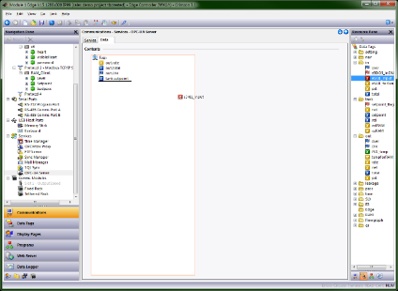
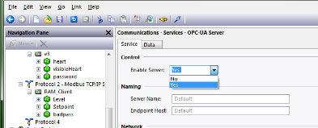
Streamline Data Transfer to Management and Enterprise Systems with OPC UA
Crimson’s 3.1 OPC UA Server is enabled with a simple Yes/No
Select any data tag to make it available to OPC UA clients
  Add deadbands to reduce communications overhead
Eliminate the need for additional intermediate server hardware, reducing cost & complexity

Slide 36

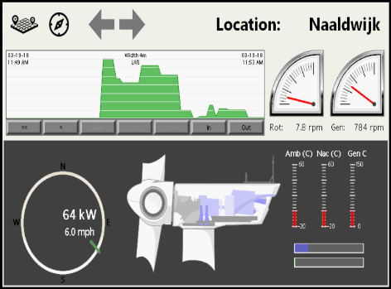
Trend: Product as a Service (PaaS) Strategies Continue to Grow in Industry
OEMs can remotely analyze historic maintenance data across multiple locations to formulate preventive strategies
  Reduce costs of warranty and routine service calls
  Increase uptime of assets and reduce maintenance costs by detecting symptoms of potential failures
Remote connectivity enables more effective monitoring and faster optimization by fewer highly-skilled personnel, regardless of equipment location

Slide 37
Simplify IIoT Strategies
Leverage software components that allow you to push data on a periodic basis or in response to a change of state from a device to an on-premises or cloud-based server.
Preconfigured profiles and intuitive user interfaces ensure you can start communicating in just a few minutes.

Slide 38
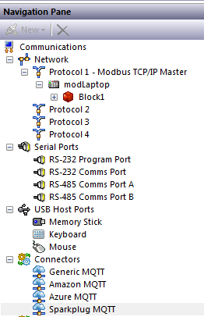
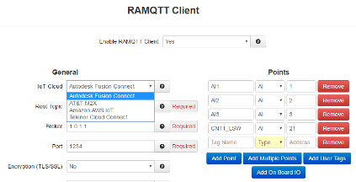
Simplify IIoT Platform Connectivity
Crimson
RAM Routers & RTUs
Cloud connectors are included in Crimson 3.1 and available to use with Graphite HMIs and Edge controller, CR3000 HMIs, and our new DA30D Data Station
RAMQTT client enables users to select any or all data quickly and intuitively
Choose IIoT platform providers from a drop-down menu

Slide 39
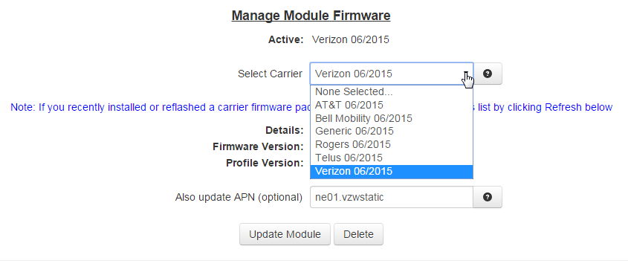
Multi-Carrier Support Offers Additional Flexibility
In North America, all five profiles are pre-loaded on each device, so
switching carriers only takes approximately 3 to 5 minutes.

Slide 40
1. Click on icon to add picture
Summary
2. Click on color and choose
Dark blue
3. Click on corrections
Brightness: -40%
Contents of this document are confidential and for Red Lion Controls use only. © Copyright Red Lion 2019.
Notes:
1 minute

Slide 41
Summary
Establish Your Why
Create a Framework
Take Small Steps
Increase Operational Efficiency
Gamify Your Operations
Create End-to-End Connectedness
OPTIMIZED PRODUCTION

