Slide 1
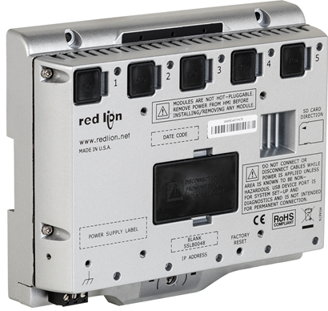
Graphite® Control Platform
October 2016

Slide 2
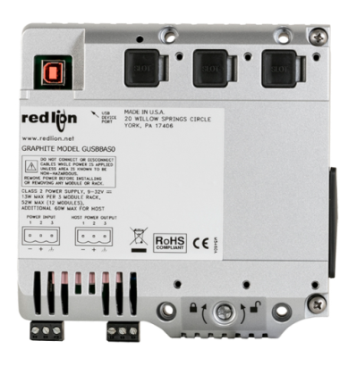
Graphite® Control Platform
Introduction
Features & Benefits
  Hardware
  Software
Model Numbers
Where to Sell?

Slide 3
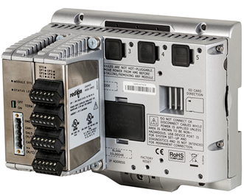
Graphite® Control Platform
What: new automation offerings
  Graphite Core Controllers
  Graphite Crimson Control Module
  (for use with Graphite HMIs)
  Graphite Expansion Racks
When: October 18, 2016
Why: adding a control engine to
the Graphite platform can help
reduce costs and complexity for
customer applications that require rugged
industrial controllers with or without a display
Graphite Control Offerings Launch Tuesday, October 18, 2016

Slide 4

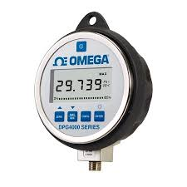
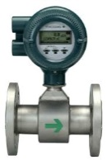
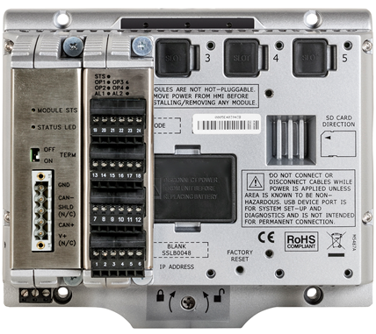
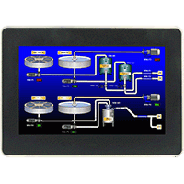
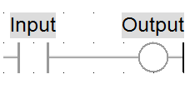
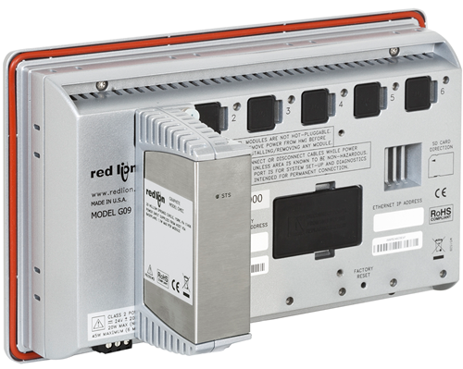
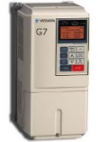

Graphite® Control Platform
Rugged industrial controller or Graphite HMI running an industry-standard IEC 61131 control engine for doing logic control like PLCs or RTUs
Offers all the networking, protocol conversion, industrial drivers, data logging and web server just like other
Red Lion automation products
Inputs
Logic
Control
Outputs

Slide 5
Features & Benefits

Slide 6
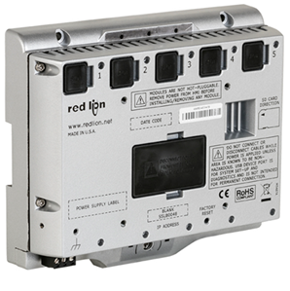
Graphite® Core Controller
Rugged controller with built-in
Crimson® Control engine
Configured using Crimson 3.0 software with Crimson Control functionality
Works with all existing Graphite I/O and communications plug-in modules
-40° to 70°C wide operating temperature
Communicates with over 300 industrial
protocols
Built-in data logging and webserver
CE, UL and cUL
All-in-one logic control and networking for harsh environments

Slide 7
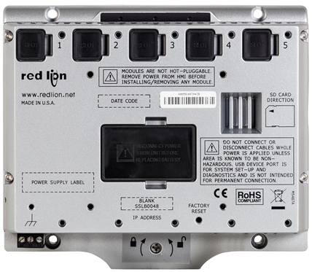
Graphite® Core Controller
3 Programmable
LED Indicators
Lithium
Battery
(Covered)
5 Slots for
Graphite
Modules
SD Card
Slot
Mounting
Hole
10-30VDC
Power
Easy DIN Rail mounting
and removal

Slide 8
Graphite® Core Controller
Mix and match
Graphite modules
as needed

Slide 9
Graphite® Crimson® Control Module
Seamlessly turn any new or existing Graphite HMI into a controller with add on Crimson Control Module
Develop IEC 61131 control programs within existing or create all new databases with Crimson software
Easily mounts to the back of the Graphite HMI or in an Expansion Rack
Use Crimson software to identify which slot module occupies –
no other configuration is required

Slide 10
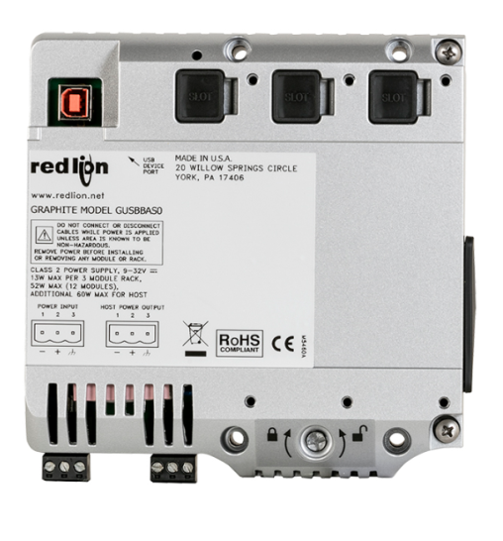
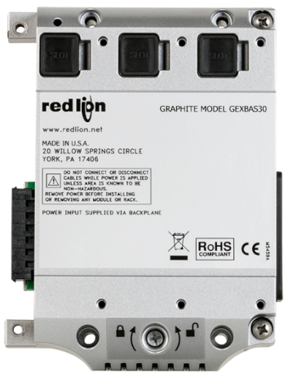
Graphite® Expansion Racks
Easily expands the number of Graphite modules on HMIs or
Core Controller without the need for other types of remote I/O products
Simplifies wiring by panel mounting all Graphite modules
Supports -40° to 75°C wide
operating temperature range
Requires wide rack and up to three standard racks
Connects using USB cable
Wide Rack
Standard Rack

Slide 11
Graphite® Expansion Racks
USB connector
3 slots for
Graphite
modules
Mounting
hole
10-30VDC
power for racks and
Graphite HMIs
or Controllers
Easy DIN rail mounting
and removal

Slide 12
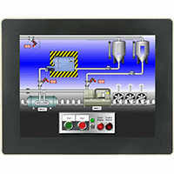
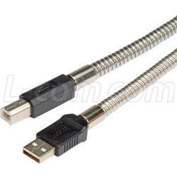
Graphite® Expansion Racks
USB Connector
Remote mount up to 12 modules

Slide 13
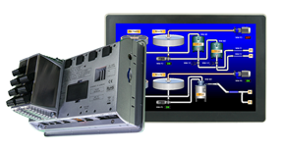
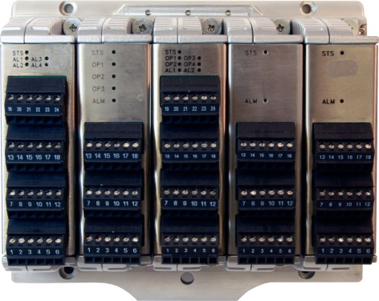
Graphite® Expansion Racks
USB Connector
Expand up to an additional 12 modules

Slide 14
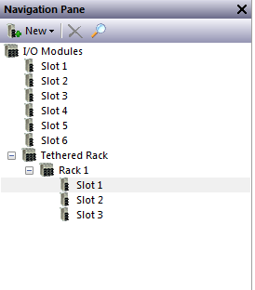
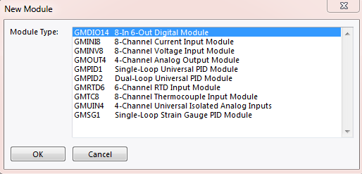
Expansion Rack Configuration
Expansion Racks are tethered to Graphite® HMI or Graphite Core Controller
Add rack in Crimson Navigation
Pane and pick appropriate
Graphite module

Slide 15
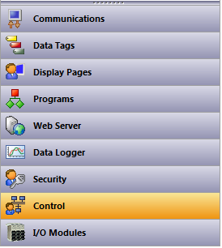
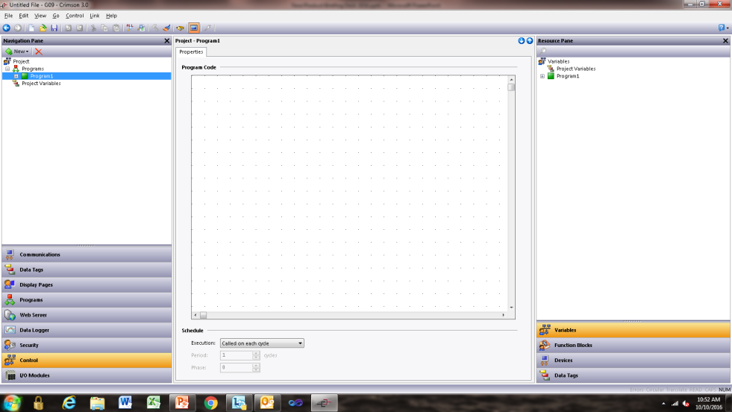
Crimson® Control
New Crimson Navigation Pane category – Control
Is shown when choosing a Graphite Core Controller or any Graphite HMI

Slide 16
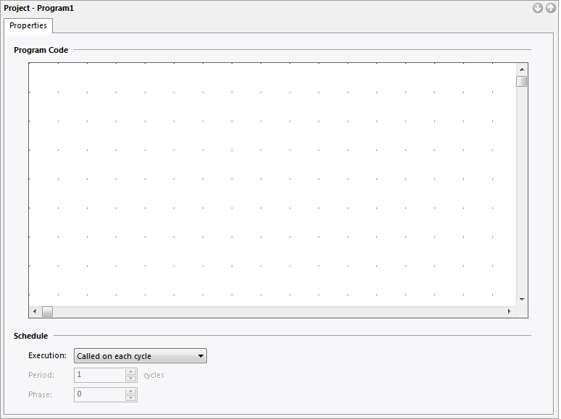
Crimson® Control
Program Code Editing Pane opens in central portion of the window after clicking on Control bar
Program Code Editing Pane is used to develop logic control code using any one of four IEC 61131 programming languages
Simply download database to target device

Slide 17
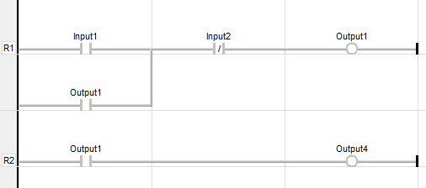
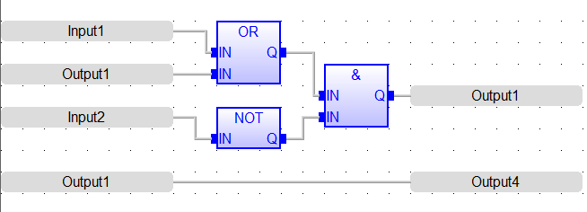
IEC 61131 Programming Languages
Ladder Logic
Function Block

Slide 18

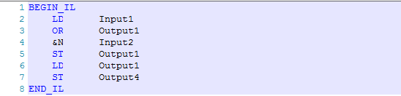
IEC 61131 Programming Languages
Structured Text
Instruction List

Slide 19
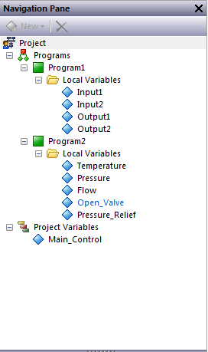
Crimson® Control
Top section of Navigation Pane for Control category shows how control projects are developed
Projects can contain multiple programs as needed for each application
Each program can be any one of four IEC 61131 language types
Projects and programs have control variables that are mapped to real or virtual I/O, system variables or Crimson Data Tags

Slide 20
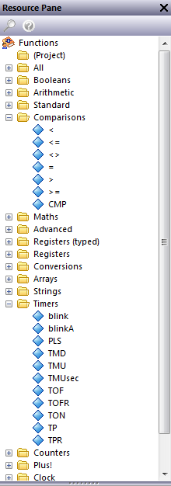
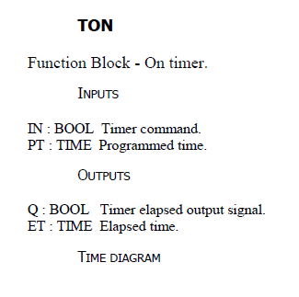
Crimson® Control
Top section of Resource Pane for Control category shows the list of function blocks available
Show function block help info by simply right clicking mouse on any item in the tree

Slide 21
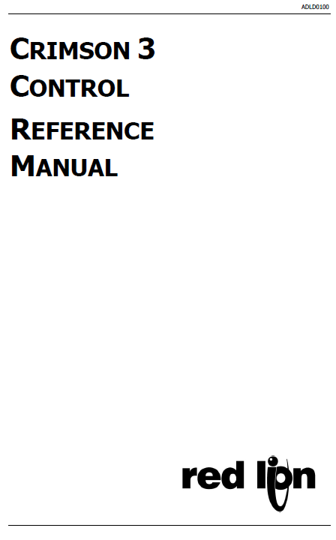
Crimson® Control
Crimson Control Reference Manual added to Crimson 3.0 software
Details on how to use each
function block in the four
IEC 61131 programming
languages

Slide 22
Crimson® Control
Integrated into Crimson® 3.0 Software
  No need for add-on or special extra software reduces complexity
Available for download from the Red Lion website
  Start developing projects today
Industry-standard IEC 61131 programming languages
  No need to learn special programming languages which can lead to faster project development
All-in-one solution for control, networking and data visualization
  Combines industry-standard control with Red Lion’s protocol conversion support for over 300 industrial drivers, data logging and web server with and without display

Slide 23
Model Numbers

Slide 24

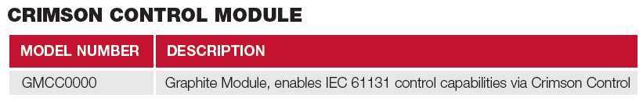
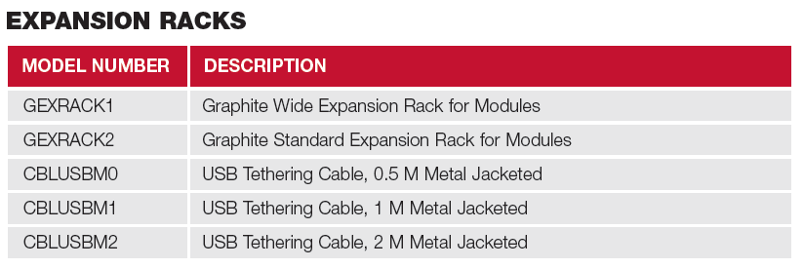
Model Numbers

Slide 25
Where to Sell?

Slide 26
Where to Sell?
Graphite® HMI customers that use a third-party controllers
  Already know Crimson software
  Only one software package reduces cost and complexity
  Easily deploy Crimson software on as many computers as needed without costly licenses
  One stop for technical support for control, networking and data visualization
Applications in harsh environments
  Graphite Core Controller has wide temperature specs that may
  support unventilated or smaller enclosures, resulting in cost savings

Slide 27
Where to Sell?
Customers looking for industry-standard IEC 61131 programming languages
  Eliminates the need to learn special codes and addressing
  schemes
Available as an all-in-one package
  Combines control, HMI and protocol conversion functionality into one all-in-one package
  Reduces wiring complexity and eliminates multiple programming
  or configuration and costly gateways

Slide 28
Where to Sell?
Application Examples:
  Factory Automation: mixers, ovens, dryers, boilers, plastics and test equipment
  Oil & Gas: tank batteries, salt water disposal, separators and pipeline monitoring
  Power & Utilities: solar or wind farm balance of plant, gas compressors and sub-station monitoring
  Water/Waste Water: lift stations, pump controls and aeration tanks
  Industrial Internet of Things (IIoT): remote monitoring of pressures, flows and temperatures with edge control

Slide 29
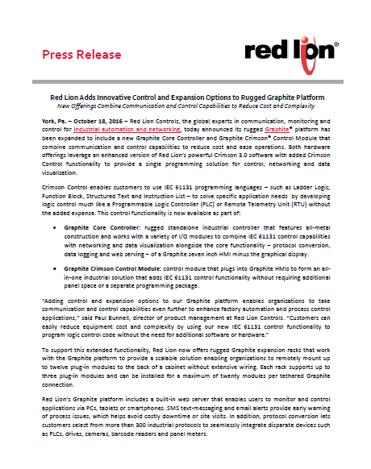
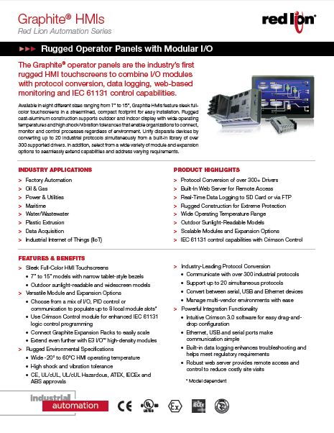
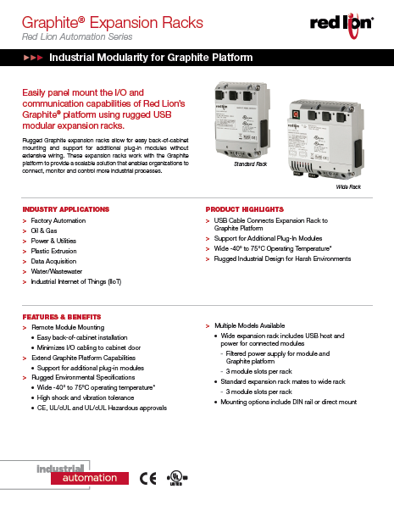
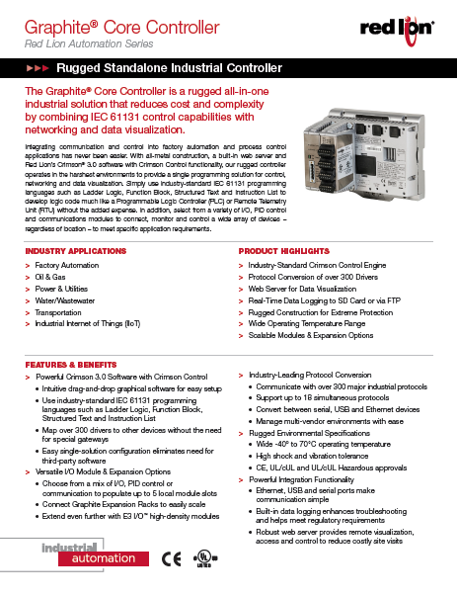
Launch Information – October 18, 2016
Promotional Materials
www.redlion.net/Graphite
  Press Release
  Data Sheets
  Launch Email
Distributor Portal
  Sales Primer
  Product Briefing
  High-Res images
Events
  IAS Shanghai
  PACK Expo in US
  SPS in Germany

