Slide 1

HMI Operator Panels
Name
Title
Date

Slide 2

Red lion and HMS networks join forces
Effective April 2024
We are thrilled to welcome all new employees & valued customers of Red Lion to the HMS Networks family, marking an exciting new chapter in our journey. As we now jointly initiate the integration process, we look forward to leveraging our combined strengths, shared values, and commitment to delivering exceptional customer value. Over the next few quarters, our focus will be on ensuring a seamless integration & actively pursuing synergies between our companies. Together, we look forward to accelerating our position in the North American market.”
- Staffan Dahlström, President and CEO of HMS

Slide 3

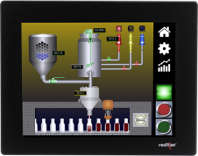
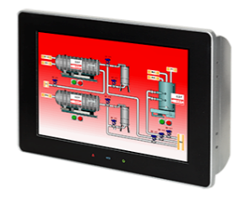
HMI Operator Panels
Data Insights Through Visualization
Our solutions help customers optimize performance, even in the most challenging environments
Red Lion’s industry leading Operator Interfaces empower customers to:
  Acquire
  Manage
  Interact, With their data on-site or virtually.

Slide 4
Red Lion HMI’s

Slide 5
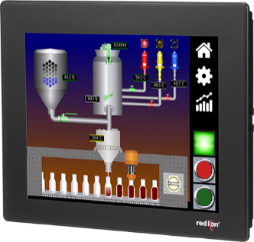
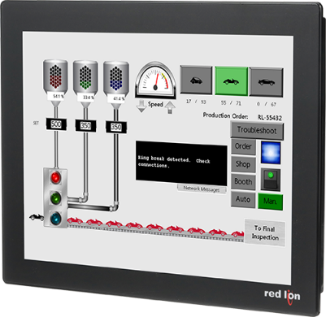

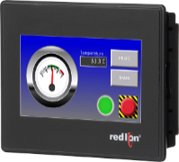

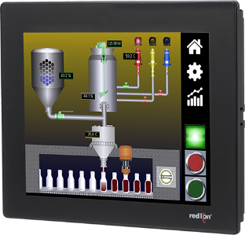
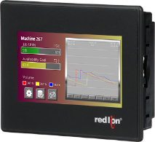
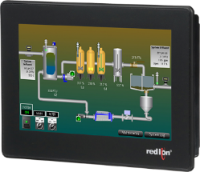
HMI families
Just easy to use!
 | Entry Level -Indoor only | Advanced Features | Ruggedized W/Advanced Features
Features | CR1000 | CR3000 | Graphite HMIs
Sizes | 4", 7", 10" Indoor Only | 4", 7", 10", 15" Indoor Only | Indoor 7", 9", 10", 12", 15" Outdoor 7", 10", 12"
Serial Ports | Up to 2 | Up to 4 | Up to 4
Ethernet | 1 | Up to 2 | Up to 2
USB Host | No | Up to 2 | 2
Programmed with Crimson 3.1 | Yes | Yes | Yes
C-Type User Programming | Yes | Yes | Yes
Crimson Control | No | No | Yes
MQTT Cloud Hooks | No | Yes | Yes
OPC-UA Client / Server/ HA | No | Yes | Yes
Protocol Converter | Yes | Yes | Yes
Simultaneous Conversions (max) | 6 | 15 | 20
Web Server, FTP, Data Logging | No | Yes | Yes
Expansion Ports | No | 1 | Up to 8
Temperature Range | - 10 deg to 50 deg * C | - 10 deg to 50 deg * C | - 20 deg to 60 deg * C

Slide 6
CR1000 HMI

Slide 7
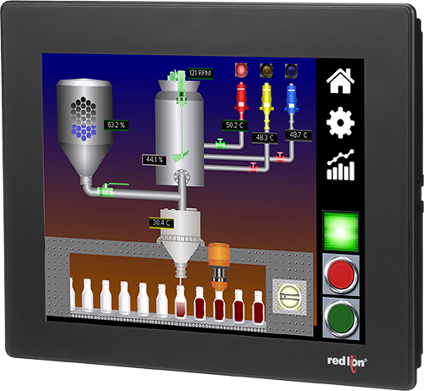
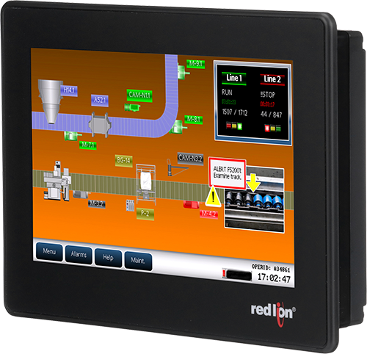
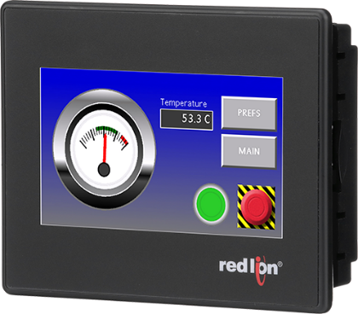
CR1000 HMI’s
Entry Level – Indoor Only
  Display options
  4.3 inch
  7 inch
  10.4 inch
  Up to 800x600 resolution
  Increased connectivity
  1 10/100 Ethernet port
  1 RS-232 serial port
  1 RS-232 / RS-485 serial port
  1 USB device port for upload/download
  Industrial reliability
  Polycarbonate housing rugged IP66, NEMA 4X front panel
  Real Time Clock with battery back up
  24 vdc PS
  Performance without compromise
  Powerful ARM9 CPU
  SD card for database upload/download
  Configured using Crimson® 3.2 software

Slide 8
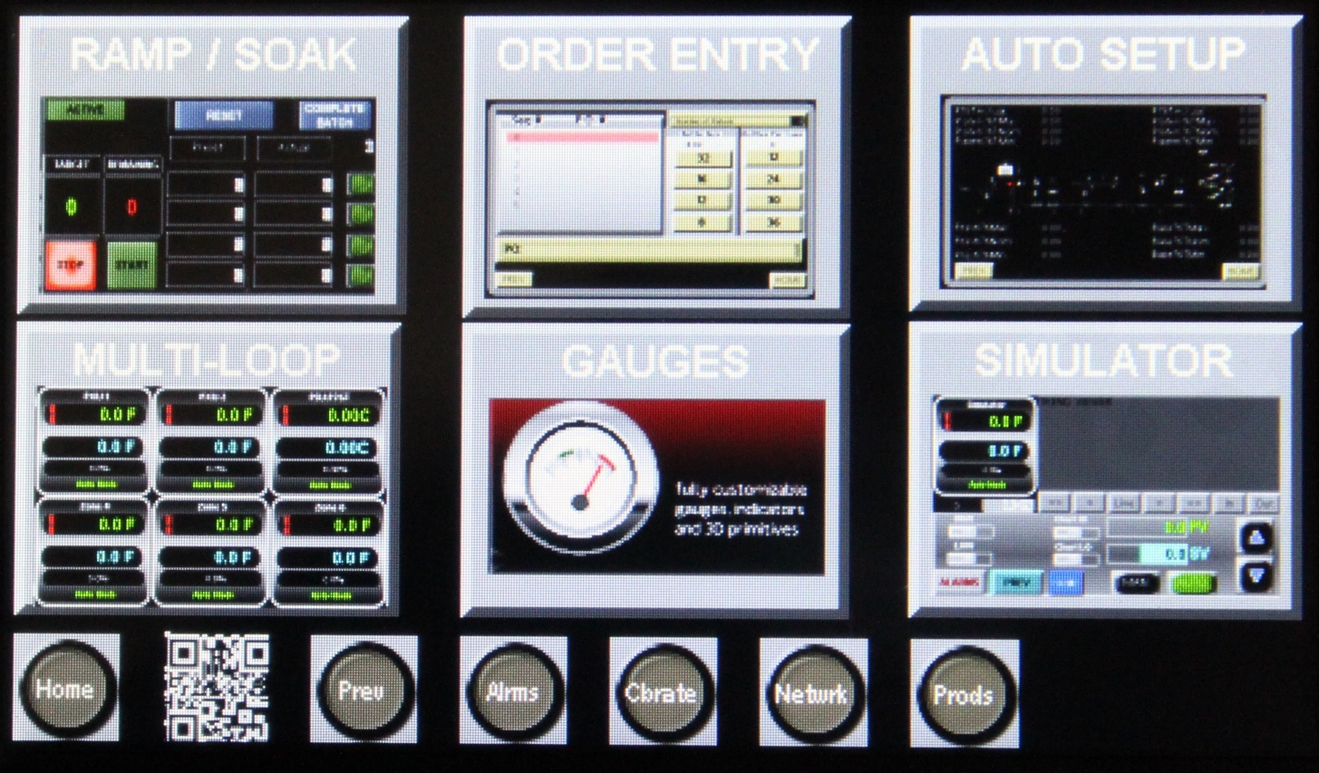
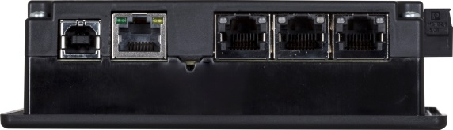
CR1000
Features
Graphical Interface with:
Multiple PLC connections
Protocol Conversion (6)
Visualization
Scripting
CR3000 sizes and attributes
Model Number | Size | PIXALS | Serial | Ethernet | USB Host | Data Logger | Web Server | Scripting | OPC-UA
CR1000-04000-00210 | 4.3“ wide | 480X272 | 2 | 1 | 0 | NO | NO | YES | NO
CR1000-07000-00210 | 7“ wide | 800X480 | 2 | 1 | 0 | NO | NO | YES | NO
CR1000-10000-00210 | 10.4“ wide | 800X600 | 2 | 1 | 0 | NO | NO | YES | NO

Slide 9
CR1000
Features CR1000 | 4.3" | 7" | 10"
Operating Temperature C | -10-50° | -10-50° | -10-50°
Brightness in NITS | 500 | 430 | 430
Vibration per/G | 2 | 2 | 2
Shock per/G | 30 | 30 | 30
Ethernet Ports | 1 | 1 | 1
Serial Ports | 2 | 2 | 2
Colors per Million | 16 | 16 | 16
Certifications UL,CUL, CE | 3 | 3 | 3
NEMA 4X/IP66 Bezel | 2 | 2 | 2
WEB Server | 0 | 0 | 0
Protocols | 6 | 6 | 6
Notes:
SD Card only for trend viewer

Slide 10
CR3000 HMI

Slide 11
CR1000 Vs. 3000
 | Entry Level -Indoor only | Advanced Features
Features | CR1000 | CR3000
Sizes | 4", 7", 10" Indoor Only | 4", 7", 10", 15" Indoor Only
Serial Ports | Up to 2 | Up to 4
Ethernet | 1 | Up to 2
USB Host | No | Up to 2
Programmed with Crimson 3.1 | Yes | Yes
C-Type User Programming | Yes | Yes
Crimson Control | No | No
MQTT Cloud Hooks | No | Yes
OPC-UA Client / Server/ HA | No | Yes
Protocol Converter | Yes | Yes
Simultaneous Conversions (max) | 6 | 15
Web Server, FTP, Data Logging | No | Yes
Expansion Ports | No | 1
Temperature Range | - 10 deg to 50 deg * C | - 10 deg to 50 deg * C

Slide 12

CR3000
Advanced Feature Set
CR3000 advanced features
DATA Collection
USB Host Ports
OPC-UA Client Server & HA
Cloud Connectors
FTP Client/Server
SQL SYNC/SQL Queries
Mail
Web Server
Remote Access
Custom WEB Pages
Class 1 Div. 2 Groups A, B, C, and D T4
Expansion Communication Module
CR3000

Slide 13
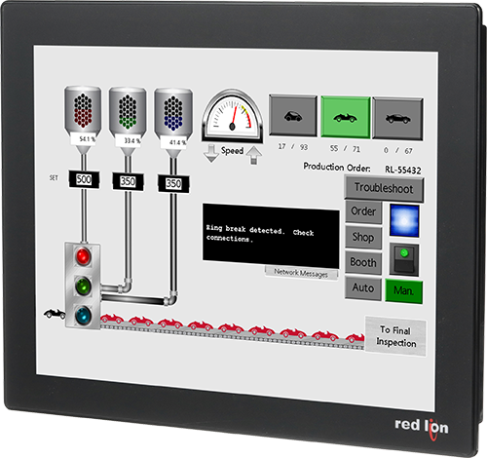
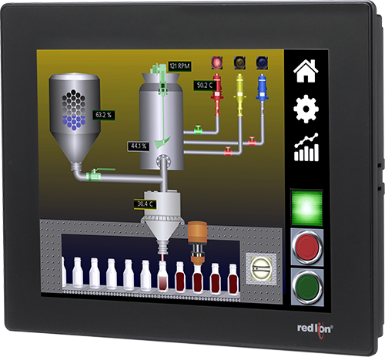
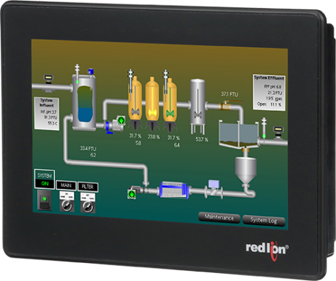
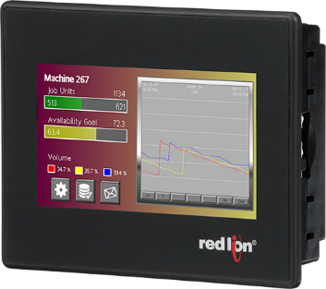
CR3000
Advanced Feature Set
Wider range of display options
  4.3 inch
  7 inch
  10.4 inch
  15 inch
Up to 1024x768 resolution
Indoor only
Industrial reliability
Polycarbonate housing with rugged IP66, NEMA 4X front panel
Real Time Clock with battery back up
10-30vdc PS
Class I Div II
Expandable connectivity
2 10/100 Ethernet ports*
2 RS-232 serial ports
2 USB host ports
2 RS-232 / RS-485 serial ports*
1 USB port upload/download
Expansion port 1 module
Added performance and features
Powerful ARM9 CPU
Web server
SD card for data logging and database upload/download
Configured using Crimson® 3.1 software

Slide 14






CR3000
Vertical markets
Automotive
Oil & Gas, W/WW
Material Handling
Agriculture
Pulp & Paper
General Machine Building

Slide 15
CR3000 sizes and attributes
CR3000 sizes and attributes
Model Number | Size | PIXALS | Serial | Ethernet | USB Host | Data Logger | Web Server | Scripting | OPC-UA | MQTT | ATEX, Class 1 Div 2
CR3000-04000-00310 | 4.3“ wide | 480X272 | 3 | 1 | 1 | YES | YES | YES | YES | YES | YES
CR3000-07000-00420 | 7“ wide | 800X480 | 4 | 2 | 2 | YES | YES | YES | YES | YES | YES
CR3000-10000-00420 | 10.4“ wide | 800X600 | 4 | 2 | 2 | YES | YES | YES | YES | YES | YES
CR3000-10000-00420 | 15“ wide | 1024X768 | 4 | 2 | 2 | YES | YES | YES | YES | YES | YES

Slide 16
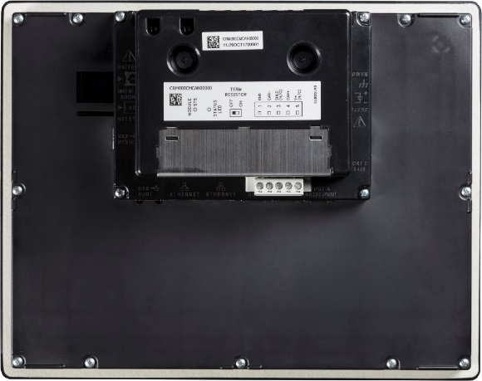
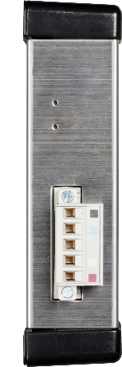
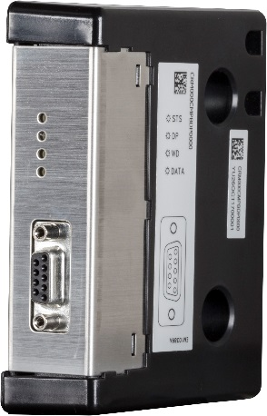
CR3000
Accessories
Protective film
G3FILM4K - G3FILM-Pack of 10 protective films
G0FILM07 - G0FILM- G07 Overlay film (10/PK)
G0FILM10 - G0FILM- G10 Overlay film (10/PK)
G0FILM15 - G0FILM- G15 Overlay film (10/PK)
Modules
CRM000CMCAN00000 - CAN Communication Module
CRM000CMDN000000 - DeviceNet Communication Module
CRM000CMJ1939000 - J1939 Communication Module
CRM000CMPBDP0000 - PROFIBUS DP Communication Module

Slide 17
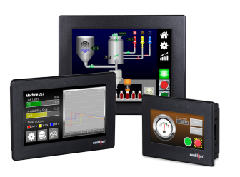

Factory floor/OEM
Just easy to use!
CR Series
Powered by
Industry applications
Factory automation
OEM machine builders
Automotive
Food & beverage
Water/wastewater
Product highlights
NEMA 4X, IP66 Front Panel Rating
Industrial Environmental Specifications
Wide operating temperature
High shock and vibration tolerance
CE, UL/cUL, UL/cUL Hazardous
Supports over 300 Industrial Drivers
SD Card for database upload/download
Built-In Web Server for Remote Access*
Real-Time Data Logging*
Features & benefits
Full-color HMI touchscreen
A variety of 4.3" to 15" models with widescreen (model dependent) ensures the right fit for virtually any application
16M colors
Industry-leading protocol conversion
Communicate with over 300 protocols
Easily convert between serial, USB and Ethernet devices
Convert up to 6 protocols simultaneously with CR1000 and up to 15 with CR3000
Manage multi-vendor environments with ease
Powerful Integration Capabilities
  Crimson 3.2 software enables point-and-click configuration
  Updated 3D symbols and primitives create a modern operator experience
  Ethernet, USB and serial ports make communication simple
  Robust web server* provides remote access and control to reduce costly site visits
  Send email and/or SMS notifications on alarm conditions*
  Built-in data logging enhances troubleshooting and helps meet regulatory requirements
  Automate population of data values using SQL Queries feature" *

Slide 18
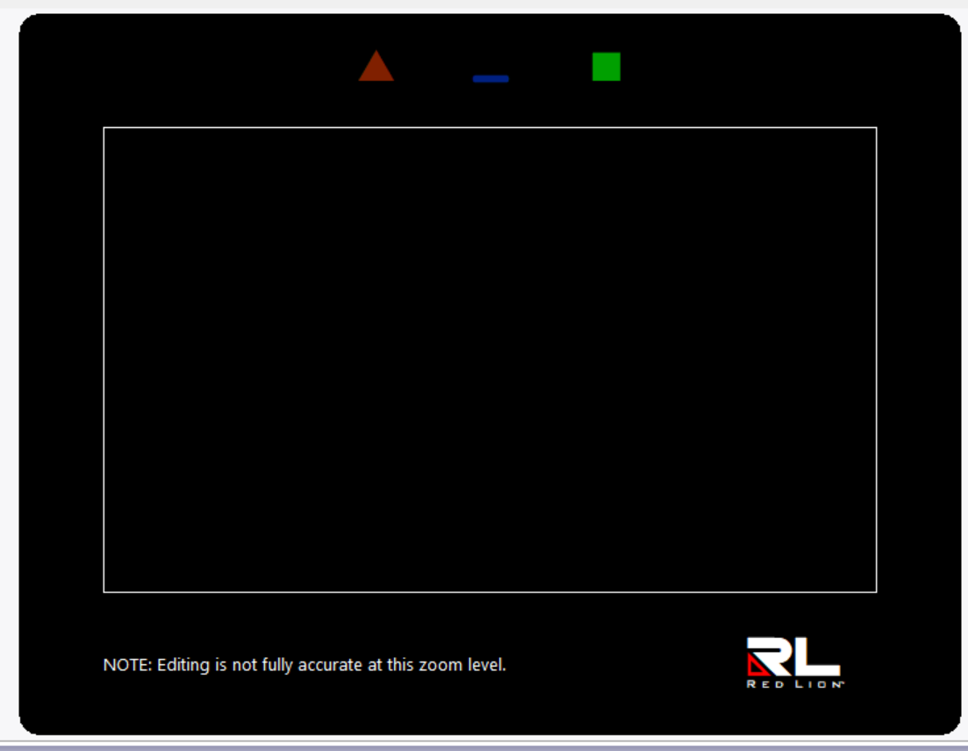
CR1000 & 3000
Screen Status Light
FRONT PANEL LEDS
There are three front panel LEDs that can be configured using Crimson.
  GREEN (■)
  BLUE (▬)
  RED (▲)
Shown below is the default status of the LEDs.
CR1000/CR3000
LED | INDICATION
GREEN (■)
STEADY | Unit is powered
BLUE (▬)
FLASHING | Unit is in the boot loader
OFF | No SD card is present
STEADY | Valid SD card present
FLASHING RAPIDLY | SD card being checked
FLICKERING | SD card accessed
FLASHING SLOWLY | Incorrectly formatted SD card present
RED (▲)
FLASHING | Data tag is in an alarm active state
STEADY | Data tag is in an alarm accepted state

Slide 19
Graphite HMI

Slide 20
Graphite HMI’s
 | Advanced Features | Ruggedized W/Advanced Features
Features | CR3000 | Graphite HMIs
Sizes | 4", 7", 10", 15" Indoor Only | Indoor 7", 9", 10", 12", 15" Outdoor 7", 10", 12"
Enclosure | Polycarbonate | Cast Aluminium
Serial Ports | Up to 4 | Up to 4
Ethernet | Up to 2 | Up to 2
USB Host | Up to 2 | 2
Programmed with Crimson 3.1 | Yes | Yes
C-Type User Programming | Yes | Yes
Crimson Control | No | Yes
MQTT Cloud Hooks | Yes | Yes
OPC-UA Client / Server/ HA | Yes | Yes
Protocol Converter | Yes | Yes
Simultaneous Conversions (max) | 15 | 20
Web Server, FTP, Data Logging | Yes | Yes
Expansion Ports | 1 | Up to 8
Temperature Range | - 10 deg to 50 deg * C | - 20 deg to 60 deg * C

Slide 21
Graphite HMI’s
CR3000 vs. Graphite
Graphite series additional features
Extended Temperature Range
ABS
Plug in I/O modules
Expansion Rack
Crimson Control-IEC61131
Cast Aluminum Housing
Outdoor Rated Screens
Additional Simultaneous Conversations
Additional Sizes
Expanded Shock and Vibration Rating
Class II, Division 2, Groups F and G
Class III, Division 2

Slide 22
HMI families
Just easy to use!
Vertical Markets
Automotive
Oil & Gas, Power & Utilities, W/WW
Material Handling
Agriculture, Food & BEV
Pulp & Paper
General Machine Building, Heat Treat/ Furnace, Steel/Metal Forming, Plastic Extrusion, Maritime

Slide 23
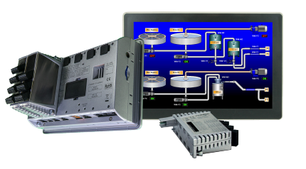
HMI families
Just easy to use!
Graphite HMI (Indoor) Sizes and Attributes
Model No | Size | PIXALS | NIT Value | Serial | E-Net | USB Host | Size ATEX, Class 1 Div 2 | 1/O Modules
G07C0000 | 7 in Wide | 800 X 480 WVGA | 500 cd/m2 | 3 | 1 | 2 | YES | 5
G09C0000 | 9 in Wide | 800 X 480 WVGA | 400 cd/m2 | 3 | 1 | 2 | YES | 6
G09C1000 | 9 in Wide | 800 X 480 WVGA | 400 cd/m2 | 3 | 2 | 2 | YES | 6
G10C0000 | 10 in | 640 X 480 VGA | 450 cd/m2 | 3 | 1 | 2 | YES | 7
G10C1000 | 10 in | 640 X 480 VGA | 450 cd/m2 | 3 | 2 | 2 | YES | 7
G10R0000 | 10 in SVGA | 800 X 600 SVGA | 400 cd/m2 | 3 | 1 | 2 | YES | 7
G10R1000 | 10 in SVGA | 800 X 600 SVGA | 400 cd/m2 | 3 | 2 | 2 | YES | 7
G12C0000 | 12 in SVGA | 1280 X 800 SVGA | 400 cd/m2 | 3 | 1 | 2 | YES | 8
G12C1100 | 12 in SVGA | 1280 X 800 SVGA | 400 cd/m2 | 4 | 2 | 2 | YES | 8
G15C0000 | 15 in | 1024 X 768 XGA | 400 cd/m2 | 3 | 1 | 2 | YES | 8
G15C1100 | 15 in | 1024 X 768 XGA | 400 cd/m2 | 4 | 2 | 2 | YES | 8

Slide 24
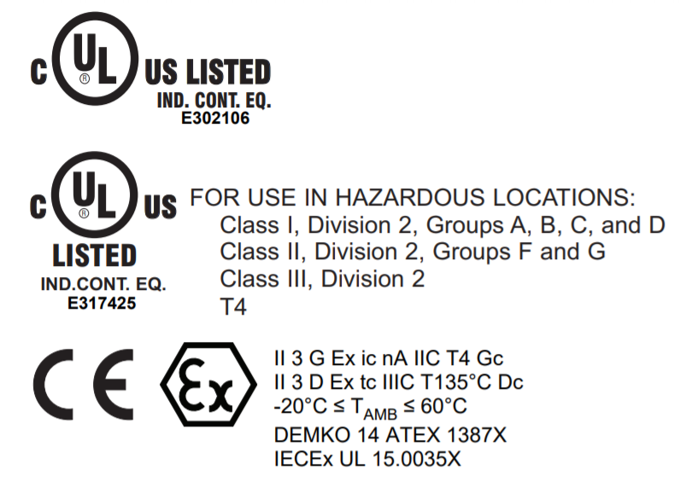


Graphite HMI’s
Rugged!
Wider range of display options
7 in indoor & outdoor
9 inch
10 inch indoor & outdoor
12 inch indoor & outdoor
15 inch
Up to 1024x768 resolution
Industrial reliability
Rugged Aluminum housing with rugged IP66, NEMA 4X front panel
Real Time Clock with battery back up
Expandable connectivity
2 10/100 Ethernet ports*
2 RS-232 serial ports
2 USB host ports
2 RS-232 / RS-485 serial ports*
1 USB device port for upload/download
8* Expansion port for select add-on network modules
Extended I/O Rack
Added performance and features
Powerful ARM9 CPU
Web server
SD card for data logging and database upload/download
Crimson Control*
I/O Expansion
Configured using Crimson® 3.2 software

Slide 25
Indoor/Outdoor HMI’s
Graphite HMI Series
Powered by
Industry applications
Factory Automation
Oil & Gas
Power & Utilities
Maritime
Water/Wastewater
Plastic Extrusion
Data Acquisition
    Industrial Internet of Things (IoT)
Product highlights
Protocol Conversion of over 300+ Drivers
Built-In Web Server for Remote Access
Real-Time Data Logging to SD Card or via FTP
Rugged Construction for Extreme Protection
Wide Operating Temperature Range
Outdoor Sunlight-Readable Models
Scalable Modules and Expansion Options IEC 61131 control capabilities with Crimson Control
Features & benefits
Sleek Full-Color HMI Touchscreens
7" to 15" models with narrow tablet-style bezels
Outdoor sunlight-readable and widescreen models
Versatile Module and Expansion Options
Choose from a mix of I/O, PID control or communication to populate up to 8 local module slots"
Use Crimson Control module for enhanced IEC 61131 logic control programming
Connect Graphite Expansion Racks to easily scale
Extend even further with E3 I/O™ high-density modules
Rugged Environmental Specifications
Wide -20° to 60°C HMI operating temperature
High shock and vibration tolerance
CE, UL/cUL, UL/cUL Hazardous, ATEX, IECEx and ABS approvals
Powerful integration capabilities
  Industry-Leading Protocol Conversion Communicate with over 300 industrial protocols
  Support up to 20 simultaneous protocols
  Convert between serial, USB and Ethernet devices Manage multi-vendor environments with ease
  Powerful Integration Functionality
  Intuitive Crimson 3.0 software for easy drag-and-drop configuration
  Ethernet, USB and serial ports make communication simple
  Built-in data logging enhances troubleshooting and helps meet regulatory requirements
  Robust web server provides remote access and control to reduce costly site visits

Slide 26
Options with Exceptional Visibility
Graphite OUTDOOR HMI
FEATURES | G10S000 | G10S1000 | G12S1100
Operating Temperature C | -20°-60° | -20°-60° | -20°-60°
Brightness in NITS | 2500 | 2500 | 1600
Vibration per G | 4 | 4 | 4
Shock per G | 40 | 40 | 40
Ethernet Ports | 1 | 2 | 2
Serial Ports | 4 | 4 | 4
USB A,B | 2 | 2 | 2
Colors 1 pt. per M | 16 | 16 | 16
Certifications UL,CUL, CE,CSA | 4 | 4 | 4
ABS | 1 | 1 | 1
NEMA 4X/IP66 Bezel | 2 | 2 | 2
ATEX, UL Class 1,2,3, Div 2, A,B,C,D, T4 | 15 | 15 | 15
SD card Expandable memory per GB | 256 | 256 | 256
Simultaneous Protocols | 20 | 20 | 20
IEC61131 Capable | 1 | 1 | 1
Expandable Modules -On Unit | 7 | 7 | 8

Slide 27
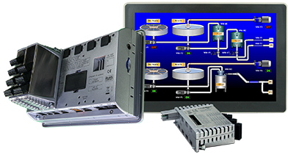
Graphite I/O Modules
Digital input/output combo modules
GMDIOR00 - 8 Inputs, 6 Relay Outputs
GMDIOS00 - I/O, 8 Inputs, 6 Solid State Outputs
Analog modules
GMINI800 - 8 DC Current Inputs
GMINV800 - 8 DC Voltage Inputs
GMUIN400 - 4 Universal Inputs
GMOUT400 - 4 Analog Outputs
TC and RTD Inputs
GMTC8000 - 8 Thermocouple Inputs
GMRTD600 - 6 RTD Inputs
Single Loop PID
GMP1RA00 - Single PID, Relay, Analog Outputs
GMP1RM00 - Single PID, Relay, HCM
GMP1SA00 - Single PID, SSR, Analog Outputs
GMP1SM00 - Single PID, SSR Outputs, HCM
DUAL Loop PID
GMP2R000 - Dual PID, Relay Outputs
GMP2RM00 - Dual PID, Relay, HCM Outputs
GMP2S000 - Dual PID, SSR Outputs
GMP2SM00 - Dual PID, SSR, HCM Outputs
Strain Guage Options
Comms Module – Options
Crimson Control
Graphite Module Overview
Temperature – -40 to 75˚ C
Control modules run independent of HMI
Universal module is completely isolated (inputs, power and core)
PID modules have universal inputs:
  TCs, RTDs, 0 – 10 VDC and process signals
Notes:
Note: modules are not hot-swappable

Slide 28


Questions?

