Slide 1
Industrial RTU and I/O Modules
Product Presentation

Slide 2
RTU and I/O

Slide 3
RTU and I/O
Industry Landscape
Oil & Gas
Compressor Stations
Wellhead Monitoring & Control
Drilling & Fracturing
Offshore Platforms
Shipboard Monitoring
Power & Energy
Generator Control
Load Management
Transmission & Distribution
Solar Tracking
Water, Wastewater
Water Treatment
Well, Lift Station, Pump & Tank Control
Chemical Injection
Process Control
Pollution Control
Boiler Control
Metal Refining
Paper Mills
Cooling Towers

Slide 4
Product Line

Slide 5
RTU and I/O
Product Line
ST-IPm-8460
VersaTRAK® RTUs
VT-mIPm-138\248-D
Red Lion Workbench
EtherTRAK® -2
Programmable RTU
New Programmable RTU
IEC 61131-3 Programming Workbench
Dual Ethernet I/O Module
Rugged (High Temp; Haz Loc)
Programmable
Redundant Operation
Datalogging
Rugged (High Temp; Haz Loc)
Programmable
Onboard I/O
Datalogging
5 Languages
Protocols
Redundancy
Two variable database or one variable database
Rugged (High Temp; Haz Loc)
Three Network Modes
Up 34 I/O
17 different models

Slide 6
RTU and I/O
Product Line
ST-IPm-8460
VersaTRAK® RTUs
VT-mIPm-138\248-D
Red Lion Workbench
EtherTRAK® -2
Programmable RTU
New Programmable RTU
IEC 61131-3 Programming Workbench
Dual Ethernet I/O Module
Rugged (High Temp; Haz Loc)
Programmable
Redundant Operation
Datalogging
Rugged (High Temp; Haz Loc)
Programmable
Onboard I/O
Datalogging
5 Languages
Protocols
Redundancy
Two variable database or one variable database
Rugged (High Temp; Haz Loc)
Three Network Modes
Up 34 I/O
17 different models

Slide 7
ST-IPm-8460
Programmable Controller
10x faster performance
4x more NVRAM
4x more FLASH
8x more RAM
Isolated RS232 and RS485 ports
1 additional Ethernet Port
Red Lion Workbench (IEC61131-3 programming)
ISaGRAF Compatible (backward compatibility)

Slide 8
ST-IPm-8460
Hardware Features
Ethernet 1
Ethernet 2
Rugged dependability in extreme environments
Extreme temperature rating -40 to +70◦C
High mean-time between failure (MTBF)
Redundancy
Redundant Controller
Dual Power Input
Many communication ports and protocols
3x RS232, 1x RS485, 6x Ethernet
Certified for hazardous environments
USB Device
Diagnostics only
RS232
RS232
Dual Power
RS485
RS232

Slide 9
ST-IPm-8460
Software Features
Flexible open architecture
Linux operating system
Security
User Authentication
Advanced firewalls
Datalogging configuration
Programmable with IEC61131-3 and C
Red Lion Controls Workbench
ISaGRAF (backward compatibility)

Slide 10
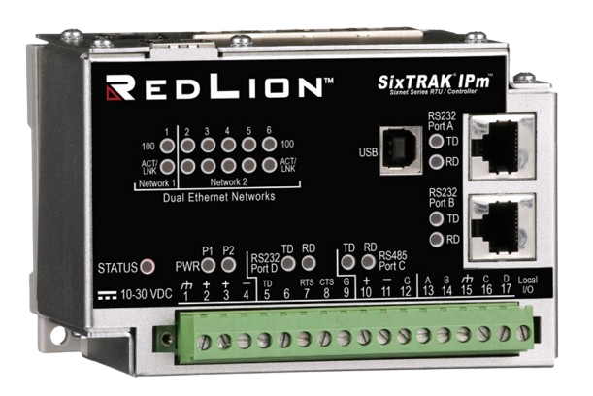
ST-IPm-8460
Order Guide
 | PORTS |  |  | MEMORY
Part Number | Eth | 232 | 485 | NVRAM | FLASH | DRAM
ST-IPm-8460 | 6 | 3 | 1 | 8M | 512M | 512M

Slide 11
ST-IPm-8460
Cross Reference Guide
 | PORTS |  |  | MEMORY
Part Number | Eth | 232 | 485 | NVRAM | FLASH | DRAM
ST-IPm-8460 | 6 | 3 | 1 | 8M | 512M | 512M
ST-IPm-6350 | 5 | 3 | 1 | 2M | 128M | 64M
ST-IPm-2350\1350 | 5 | 3 | 1 | 2M\512K | 16M | 16M
VT-IPm-1410 | 1 | 3 | 1 | 512K | 16M | 16M
VT-IPm-2410 | 1 | 3 | 1 | 2M | 16M | 16M
ET-GT-ST-1 | 2 | 1
ST-GT-1210 | 1 | 1 | 1 | 512K | 16M | 16M

Slide 12
RTU and I/O
Product Line
ST-IPm-8460
VersaTRAK® RTUs
VT-mIPm-138\248-D
Red Lion Workbench
EtherTRAK® -2
Programmable RTU
New Programmable RTU
IEC 61131-3 Programming Workbench
Dual Ethernet I/O Module
Rugged (High Temp; Haz Loc)
Programmable
Redundant Operation
Datalogging
Rugged (High Temp; Haz Loc)
Programmable
Onboard I/O
Datalogging
5 Languages
Protocols
Redundancy
Two variable database or one variable database
Rugged (High Temp; Haz Loc)
Three Network Modes
Up 34 I/O
17 different models

Slide 13
VersaTRAK® RTUs
Hardware Features
On-board I/O
Mixture of DI, DO, AI, AO
Ethernet, RS232 and RS485 Port
Certified for rugged and hazardous environments

Slide 14
VersaTRAK® RTUs
Software Features
Linux OS
Open programming
IEC61131-3 programming via Red Lion Workbench
ISaGRAF is supported for backward compatibility
Datalogging
Security with advanced firewall

Slide 15
VersaTRAK® RTUs
Order Guide
 | PORTS |  |  | ON-BOARD I/O |  |  |  | MEMORY
Part Number | Eth | 232 | 485 | DI | DO | AI | AO | NVRAM | FLASH | DRAM
VT-MIPM-248-D | 1 | 2 | 2 | 12 | 4 | 8 | 2 | 8M | 512M | 512M
VT-MIPM-138-D | 1 | 2 | 1 | 12 | 8 | 6 |  | 8M | 512M | 512M

Slide 16
VT-mIPm-248-D
Cross Reference Guide VT-mIPm-248-D is a suitable upgrade to the parts below
 | PORTS |  |  | ON-BOARD I/O |  |  |  | MEMORY
Part Number | Eth | 232 | 485 | DI | DO | AI | AO | NVRAM | FLASH | DRAM
VT-MIPM-248-D | 1 | 2 | 2 | 12 | 4 | 8 | 2 | 8M | 512M | 512M
VT-MIPM-241-D | 1 | 2 | 2 | 12 | 4 | 8 | 2 | 512K | 16M | 16M
VT-MIPM-245-D | 1 | 2 | 2 | 12 | 4 | 8 | 2 | 512K | 64M | 32M
VT-IPM2M-113-D | 1 | 1 | 1 | 12 | 4 | 8 |  | 512K | 32M | 32M
VT-IPM2M-213-D | 1 | 1 | 1 | 12 | 4 | 8 | 2 | 512K | 32M | 32M
VT-UIPM-431-H | 1 | 2 | 1 | 8 | 4 | 2 |  | 512K | 16M | 16M

Slide 17
VT-mIPm-138-D
Cross Reference Guide VT-mIPm-138-D is a suitable upgrade to the parts below
 | PORTS |  |  | ON-BOARD I/O |  |  |  | MEMORY
Part Number | Eth | 232 | 485 | DI | DO | AI | AO | NVRAM | FLASH | DRAM
VT-MIPM-138-D | 1 | 2 | 1 | 12 | 8 | 6 |  | 8M | 512M | 512M
VT-MIPM-131-D | 1 | 2 | 1 | 12 | 8 | 6 |  | 512K | 16M | 16M
VT-MIPM-135-D | 1 | 2 | 1 | 12 | 8 | 6 |  | 512K | 64M | 32M
VT-UIPM-431-H | 1 | 2 | 1 | 8 | 4 | 2 |  | 512K | 16M | 16M

Slide 18
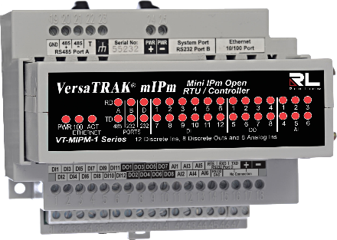
VT-mIPm-248-D, Graphite HMI
Natural Gas Monitoring and Control
Storage
City Gate
Home

Slide 19
RTU and I/O
Product Line
ST-IPm-8460
VersaTRAK® RTUs
VT-mIPm-138\248-D
Red Lion Workbench
EtherTRAK® -2
Programmable RTU
New Programmable RTU
Programming IEC 61131-3 Workbench
Dual Ethernet I/O Module
Rugged (High Temp; Haz Loc)
Programmable
Redundant Operation
Datalogging
Rugged (High Temp; Haz Loc)
Programmable
Onboard I/O
Datalogging
5 Languages
Protocols
Redundancy
Two variable database or one variable database
Rugged (High Temp; Haz Loc)
Three Network Modes
Up 34 I/O
17 different models

Slide 20
Red Lion Workbench
IEC61131-3 Programming
5 Programming Languages
ST, SFC/CFC, IL, FBD, LD
Many Protocols Supported
Modbus Included
DNP3 (Future)
IEC60870 (Future)
IEC61850 (Future)
Ethernet/IP (Future)
Controller Redundancy
Bump less transfer
Fast Switchover
Primary
Secondary

Slide 21
Tool Kit and Red Lion Workbench
Separate Variable Databases
Tool Kit
RL Workbench
When ever there is a change you must resync
Data Types Supported
Boolean
Integer
Long
Float
Data Types Supported
Boolean
REAL
LREAL
SINT
USINT
BYTE
INT
UINT
WORD
DINT
DWORD
LINT
ULINT
LWORD
TIME
STRING
ST-IPm-8460
VT-mIPm-138-D
VT-mIPm-248-D
Tool Kit
I/O Database
Red Lion Runtime

Slide 22
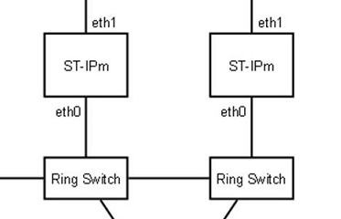
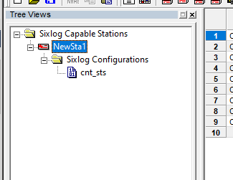
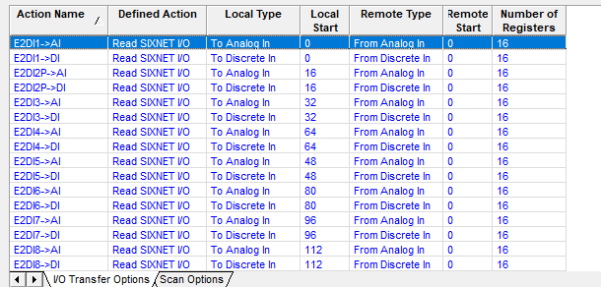
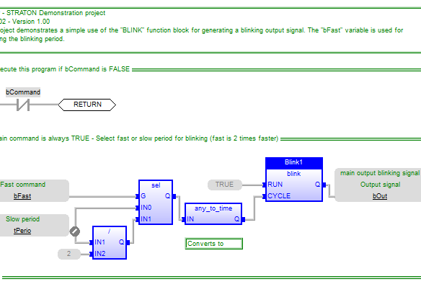
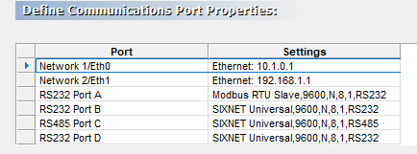
Tool Kit and Red Lion Workbench
Separate Variable Databases
Tool Kit
RL Workbench
Redundancy
Datalog
Data Types Supported
Boolean
Integer
Long
Float
ST-IPm-8460
VT-mIPm-138-D
VT-mIPm-248-D
I/O Transfers
Tool Kit
I/O Database
Red Lion Runtime
SCADA
Program

Slide 23
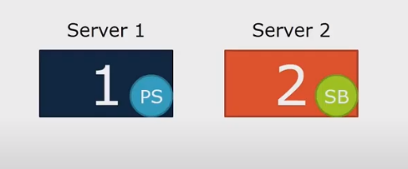
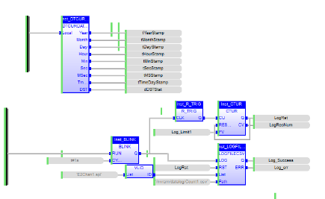
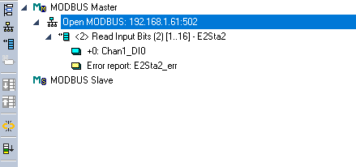
Red Lion Workbench
One Variable Database
Redundancy
Tool Kit
RL Workbench
Configuration Only
IP address
User Authentication
Firewall
Program
Data Types Supported
Boolean
REAL
LREAL
SINT
USINT
BYTE
INT
UINT
WORD
DINT
DWORD
LINT
ULINT
LWORD
TIME
STRING
ST-IPm-8460
VT-mIPm-138-D
VT-mIPm-248-D
Red Lion Runtime
Datalog
I/O Transfers
SCADA

Slide 24
RTU and I/O
Product Line
ST-IPm-8460
VersaTRAK® RTUs
VT-mIPm-138\248-D
Red Lion Workbench
EtherTRAK® -2
New Programmable RTU
New Programmable RTU
IEC 61131-3 Programming Workbench
Dual Ethernet I/O Module
Rugged (High Temp; Haz Loc)
Programmable
Redundant Operation
Datalogging
Rugged (High Temp; Haz Loc)
Programmable
Onboard I/O
Datalogging
5 Languages
Protocols
Redundancy
Two variable database or one variable database
Rugged (High Temp; Haz Loc)
Three Network Modes
Up 34 I/O
17 different models

Slide 25
EtherTRAK® -2
Hardware Features
17 I/O Module Models
Redundancy
Redundant Ethernet Ports
Dual power input and communication ports
RS485 Communication to field devices
Certified for rugged and hazardous environments

Slide 26
EtherTRAK® -2
1
Dual Ethernet ports
Real-Time Ring™ switch redundancy
Switch “passthru” elimination
Dual independent networks
USB port for local interface
Redundant power inputs
RS-485 port
Independent watchdog output
Up to 34 high-density I/O
2
3
4
5
6

Slide 27
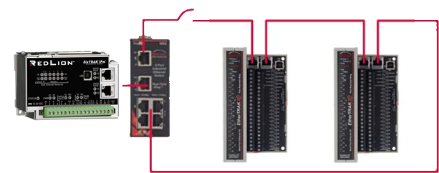
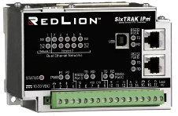
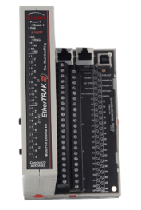
EtherTRAK®-2 Networking Options
Real-Time Ring Mode Create redundant Ethernet reliability without additional costly equipment
Switch Elimination Mode Daisy-chain modules – without the need for external switches – saves money and reduces complexity
Two Networks Mode Each Ethernet port has a unique MAC and IP address for connecting two independent physical networks

Slide 28
EtherTRAK®-2
Software Features
Ethernet Flexibility – 2 Port Switch
Fast I/O Operation
Peer-to-peer transfers and Ethernet to RS485 Passthru
Security
Limit access to specific devices
Advanced Diagnostics
Watchdogs
Module and network health

Slide 29
EtherTRAK®-2 Order Guide
EtherTRAK-2 Ethernet I/O |  | I/O Count
Part Number | Description | DI | AI | DO | AO
E2-MIX20884-D | 32 channel Combination I/O with 4 isolated high-speed counters and 4 analog outputs | 20 | 8 | 8 | 4
E2 or EB-MIX24880-D | 32 channel combination I/O with one isolated input counter | 24 | 8 | 8 | -
E2 or EB-MIX24882-D | 34 channel combination I/O with two analog outputs | 24 | 8 | 8 | 2
E2 or EB-32DI24-D | 32 discrete inputs (10-30 VDC) including 16 multifunction counters | 32 | - | - | -
E2 or EB-16DI24-D | 16 individually isolated discrete inputs (10-30 VDC) with counters | 16 | - | - | -
E2-16DIAC-D | 16 individually isolated discrete inputs (120 VAC nominal, 10-30VDC) with counters | 16 | - | - | -
E2 or EB-32DO24-D | 32 discrete outputs (10-30VDC) 0.5 Amp each, 8 Amps total | - | - | 32 | -
E2 or EB-16DO24-D | 16 individually isolated discrete outputs (10-30VDC ) 1 Amp outputs, 16 Amps total | - | - | 16 | -
E2 or EB-16DORLY-D | 16 individually isolated discrete outputs (10-30VDC/VAC Relay) 1 Amp outputs, 16 Amps total
E2 or EB-32AI20M-D | 32 analog inputs (4-20mA)16-bit accuracy | - | 32 | - | -
E2 or EB-32AI10V-D | 32 analog inputs (0-10VDC) | - | 32 | - | -
E2 or EB-16AI20M-D | 16 analog inputs (4-20 mA) | - | 16 | - | -
E2 or EB-8AO20M-D | 8 analog outputs (4-20 mA) | - | - | - | 8
E2 or EB-16AI-8AO-D | 24 channel combination, 16 analog inputs 4-20 mA and 8 analog outputs (4-20 mA) | - | 16 | - | -
E2 or EB-16ISO20M-D | 16 individually isolated analog inputs (4-20 mA) | - | 16 | - | -
E2 or EB-16ISOTC-D | 16 individually isolated analog inputs (thermocouple and +/-250mV ) with J, K, E, R, T, C, N, S | - | 16TC | - | -
E2 or EB-10RTD-D | 10 analog inputs (100 Ohm platinum RTD), range is -200 to 850o C | - | 10RTD | - | -

Slide 30
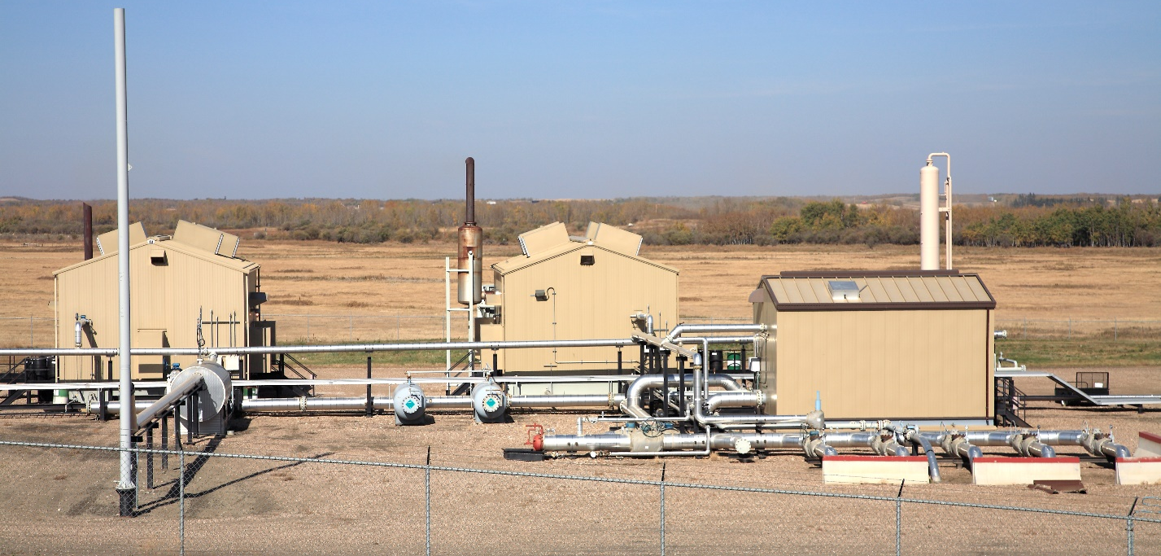
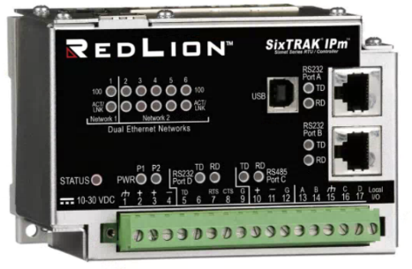
ST-IPm-8460, EtherTRAK-2 I/O, Graphite
Gas Compression Operation

