Slide 1
PAX®2C Advanced PID Controller

Slide 2
Agenda
Industry Challenges
Optimizing capital investment
Lowering total cost of ownership
PAX®2C PID Controller
New: Ramp/Soak functionality
Summary
The Red Lion difference

Slide 3
Solving the Challenges of Industry
Optimizing Capital Investment
How can I cost effectively plan for future line reconfiguration or feature upgrades without scrapping existing equipment?
In a market of ever-changing customer requirements and increasing rates of innovation, the need for production equipment that can adapt to meet these needs is important.
Notes:
http://www.bottling-world.com/future-proofing-production-2/

Slide 4
Solving the Challenges of Industry
Lowering Total Cost of Ownership
Is it possible to reduce downtime while also shrinking spare part inventory costs?
Because minutes of lost production time can have potentially significant financial consequences, companies often increase on-hand spare part inventory.

Slide 5
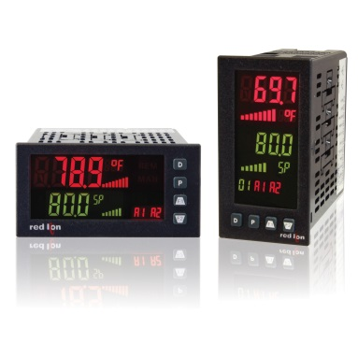
PAX®2C PID Controller Features
Universal capability
Inputs: DC current/voltage, process signals, thermocouples, RTDs and Resistive
Power: AC or DC
Ramp/Soak functionality (New)
Create up to 16 Profiles
Each profile can contain 1 to 20 segments
Orderable Part Numbers
PX2CHZ00
PX2CVR00

Slide 6
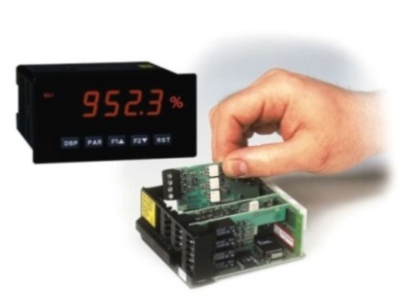
PAX®2C PID Controller Features
Standard PAX® option cards
Set-points: relays, triacs, or solid state
Retransmitted analog: 0 to 10 VDC or 4 to 20 mA
Communication: RS232, RS485, DeviceNet, Modbus, and Profibus
Flex Card option cards
Process input/Remote set-point/PID Control
Heater current monitor

Slide 7
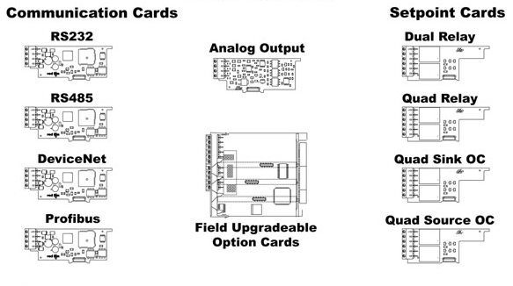
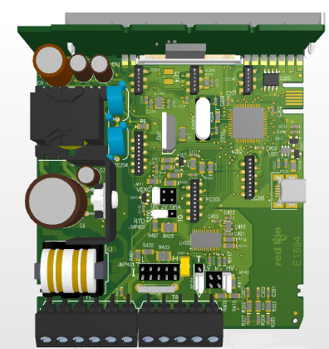
PAX®2C Plug-in Option Cards
Simple plug and play functionality

Slide 8
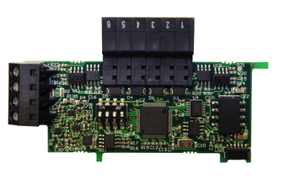
PAX®2C Plug-in Flex Cards
Flex Cards for controller applications are capable of plugging into any Flex Card slot
Heater Current Monitor
Process Input
2nd Analog Input
2nd PID Controller
Flex Card connectors

Slide 9
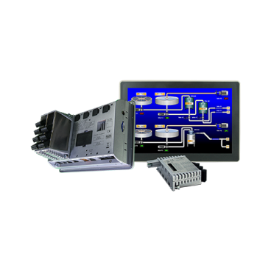
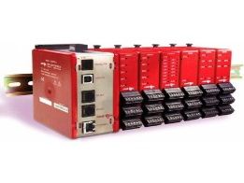
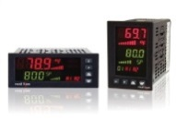
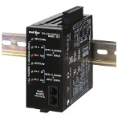
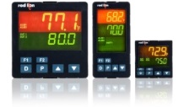
PID Controller Portfolio
PRICE
Graphite HMI with PID module
Modular Controller with PID module
PAX®2C
Dual Loop Controller
PXU
PERFORMANCE

Slide 10
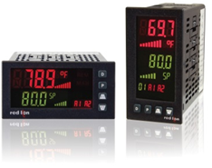
Summary
Red Lion’s advanced PID Controller, the PAX®2C, offers many universal capabilities as well as plug-in option cards - providing the most flexible PID controller available. The unit includes On/Off, Full PID Control and Ramp/Soak functionality. Users can select a horizontal or vertical mount version to fit any application requirement.
Challenge | Capability | The Red Lion Difference
Reduce downtime while also reducing spare part inventory complexity & costs | Universal power& input Option cards | With universal flexibility, customers can avoid having to stock and manage multiple controller SKUs to ensure spares coverage. The space and carrying costs associated with stocking option cards for swap out is a fraction of what would be needed to keep a variety of controller variants on hand. In addition, the time to replace a relay card, for example, is far shorter than to power down, remove a PID controller and replace it.
Reduce the costs associated with line reconfiguration or upgrade | Universal input Option cards Crimson® 2.0 programming software | Universal input accepts DC current/voltage, process, RTDs, thermocouple, resistive inputs, meaning as your equipment changes you don’t need to change out your PAX®2C. Field installable option cards allow unit configuration as needed, rather than having to redesign and change out the controller entirely. With our easy-to-use Crimson® 2.0 software, included when you buy a PAX®2C, programming time is greatly reduced.

Slide 12
Backup Slides

Slide 13
Sales Training Information
What is PID Control?
Ramp/Soak Key Terms
Target Applications & Use Cases
Food & Beverage
Heat Treating & Industrial Ovens
Packaging
Plastics
Life Science & Healthcare

Slide 14
What is PID Control?
The best example of PID Control is to think of the cruise control in your car
The goal is to maintain a constant speed, regardless of outside forces that may be acting on the vehicle, like wind, incline, etc.

Slide 15
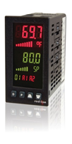
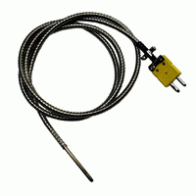
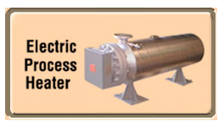
What is PID Control?
PID Control is similar except it maintains a constant process flow or temperature exactly the same way
PID Controller
Temperature sensor or process signal

Slide 16
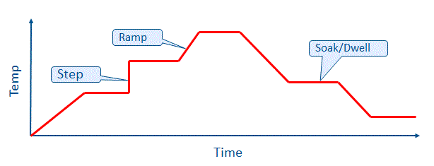
Ramp/Soak Key Terms
Ramp
A defined change (+/-) over time, or at a specific rate, between two setpoints (also called set values)
Soak (Dwell)
The defined time to stay at a setpoint
Step
Increases the setpoint value instantaneously
Segment
One action in a Ramp/Soak profile
NOTE: may also be called a step
Profile
A chain of segments (steps)

Slide 17
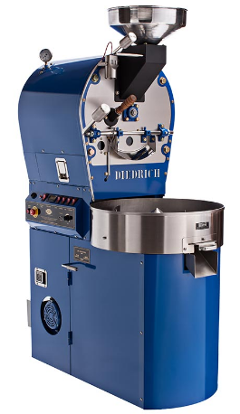
Food & Beverage
Applications
Brewing
Blending
Sterilization
Ovens
Fryers
Food warmers
Refrigeration
Coffee roasting
Example Uses
Controllers regulate temperature and/or process time to ensure optimum performance and a quality product.
Temperature patterns of heat treatment change depending on the food product. Programmable ramp/soak makes it easy to change between processes.

Slide 18
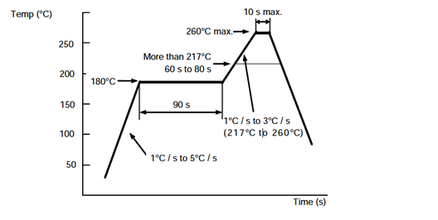
Heat Treating & Industrial Ovens
Equipment Examples
Rubber curing ovens
Industrial furnaces
Metal annealing
Brazing
Reflow equipment
Example Applications
Automotive
Parts manufacturing
Interior lamination
Aerospace
Forging
Semiconductor manufacturing
Solar panel manufacturing
Example reflow profile

Slide 19
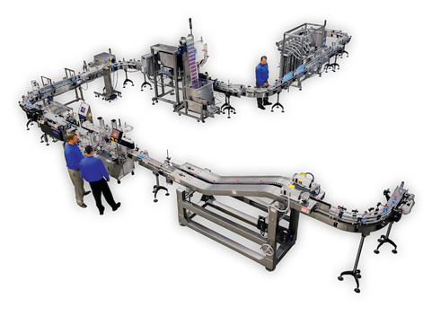
Packaging
Functional Examples
Seal bars
Glue applicators
Hot melt functions
Shrink wrap tunnels
Label applicators
Any features in packaging equipment that must operate at designated temperatures and process time lengths are a potential target for ramp/soak.

Slide 20
Plastics
Example Equipment
Portable chillers
Hoppers
Dryers
Molding equipment
Extruders
Functional drivers
Plastic production relies on precisely-monitored temperatures at various points in the process
In extruding equipment, temperature controllers are used to monitor and control temperatures at different critical points in the production process.

Slide 21
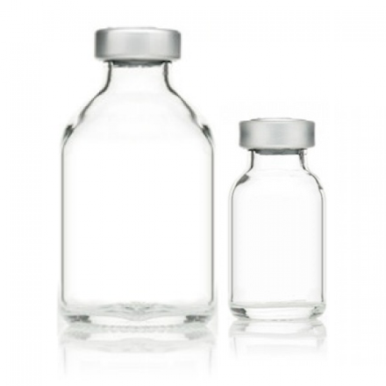
Life Science and Healthcare
Equipment Examples
Autoclaves
Incubators
Refrigeration
Test equipment
Typical Applications
Production of glass syringes
Sterilization of glass bottles

