Slide 1
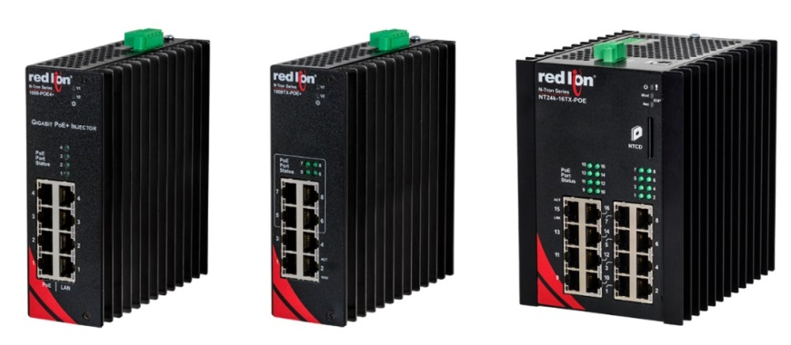
NT24k® & 1000 PoE+ Offerings
October 2016

Slide 2

NT24K® & 1000 PoE+ Offerings
Introduction
Features & Benefits
  1000-POE4+
  1008TX-POE+
  NT24k-16TX-POE
Model Numbers
Where to Sell

Slide 3
NT24K® & 1000 PoE Switches & Injectors
What: new network offerings
  1000-POE4+
  1008TX-POE+
  NT24k-16TX-POE
When: October 25, 2016
Why: extends Gigabit PoE+ product portfolio to drive operational efficiencies by addressing industry demands with
  a multi-port PoE+ injector
  our first unmanaged Gigabit PoE+ switch
  a 16-port Gigabit PoE+ switch with PoE management features
New PoE Offerings Launch Tuesday, October 25, 2016

Slide 4
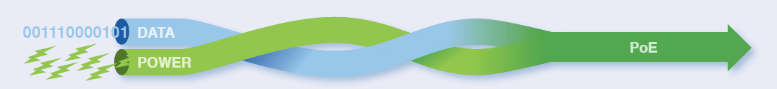
What is Power over Ethernet (PoE)?
PoE (Power Over Ethernet) is a method to transmit data and power, up to 100 meters, over a single CAT5E/CAT6/CAT6a Ethernet cable
The benefits of PoE include:
  Eliminates the need for separate power cabling
  Reduced wiring and installation costs
  No need for special electrical permits
  Greater installation flexibility as devices no longer have to be located near power outlets

Slide 5
Power over Ethernet – Two Standards
 | PoE (IEEE 802.3af) | PoE+ (IEEE 802.3at)
Max power delivered by PSE | 15.40 W | 34.20 W
Power available at PD | 12.95 W | 25.5 W
Voltage range (at PSE) | 44-57 VDC | 50-57 VDC
Maximum current | 350 mA | 600 mA
Power management | Three levels | Four levels
IEEE 802.3at (POE+) provides more power
for devices like Pan, Tilt and Zoom Cameras

Slide 6
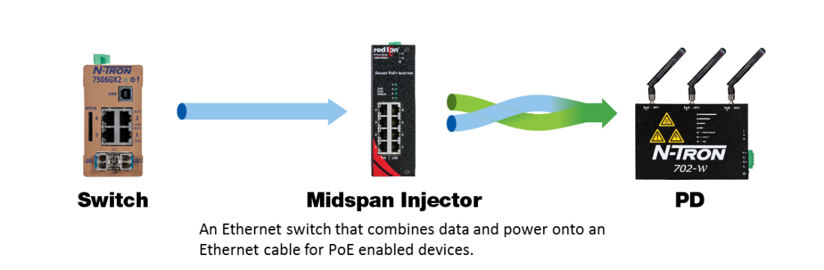
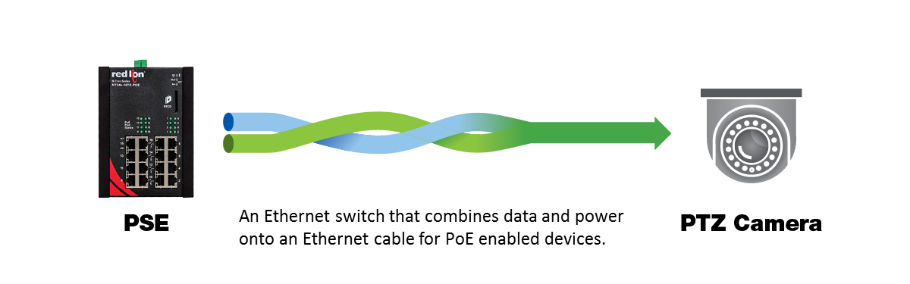
PoE Terminology
PSE (Power Sourcing Equipment) is a device that injects power onto a copper Ethernet cable
  Midspan injector, like the 1000-POE4+, is an intermediary device that injects PoE power onto an Ethernet cable to power a PoE powered device
  An Endspan switch, like the 1008TX-POE+ or NT24k-16TX-POE, combines data and power onto an Ethernet cable to power a device that can accept PoE power (PD)

Slide 7
PoE Terminology, cont.
PD (Powered Device) is a device is capable of being powered by PoE
  IP Cameras
  VoiP Phones
  Wireless Access Points
  Network Audio
  WiMax Access Points
  PTZ Cameras
  Remote Computer Terminals

Slide 8
1000-POE4+ Midspan Injector

Slide 9
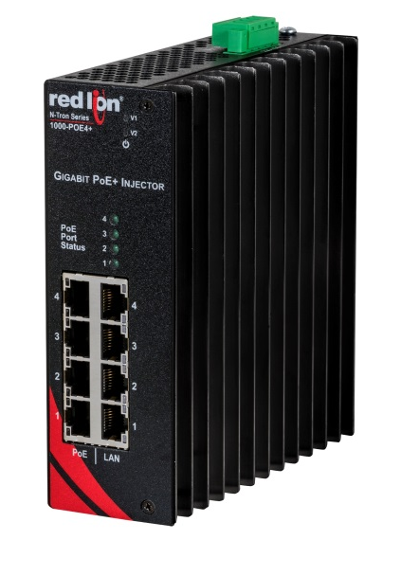
1000-POE4+ Midspan Injector
1000-POE4+
  Unmanaged 4-port Gigabit mid-span POE+ injector
  IEEE 802.3af/at compliant
  4 10/100/1000Base-T(X) RJ-45 ports (data in)
  4 10/100/1000Base-T(X) RJ-45 POE+ ports (data and power out)
  Supports 30 Watts per port (25.5 Watts at the PD)
  Power status LED
  PoE status indication LED
  Hardened metal DIN-rail mountable enclosure
  Built-in PoE power boost circuit
  22-49 VDC input voltage
  -40 to 85°C Operating temperature range
  MTBF: > 2 million hours

Slide 10
1008TX-POE+ & NT24k-16TX-POE Switches

Slide 11
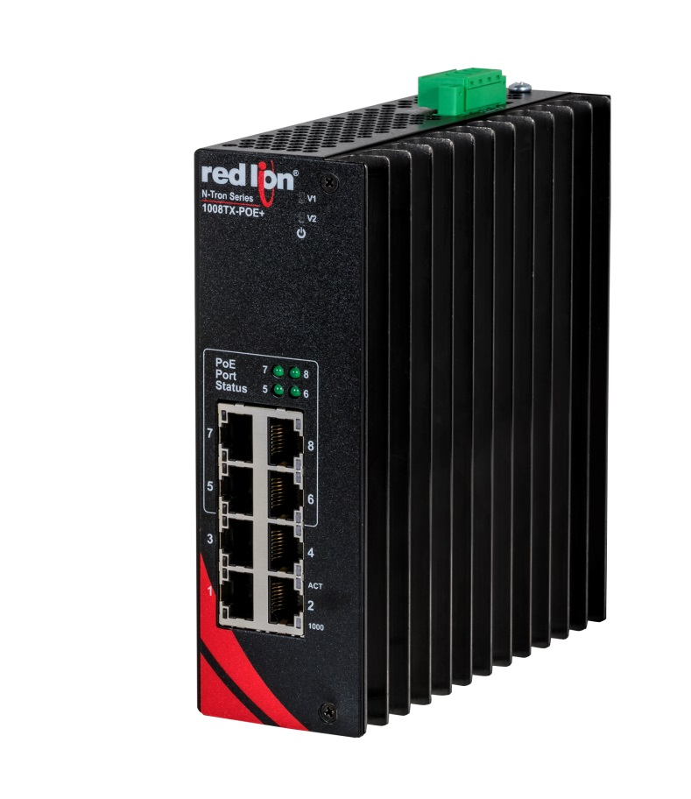
1008TX-POE+ Unmanaged Switch
1008TX-POE+
  8 10/100/1000Base-T(X) ports
  POE+ on 4 ports (25.5 Watts at the PD)
  Built-in PoE power-boost circuit
  22-49VDC input voltage
  Jumbo frame support
  Up to 16.0 Gb/s maximum throughput
  LED link/activity status indication
  Hardened metal DIN-Rail enclosure
  -40 to 80°C operating temperature
  MTBF: > 2 million hours

Slide 12
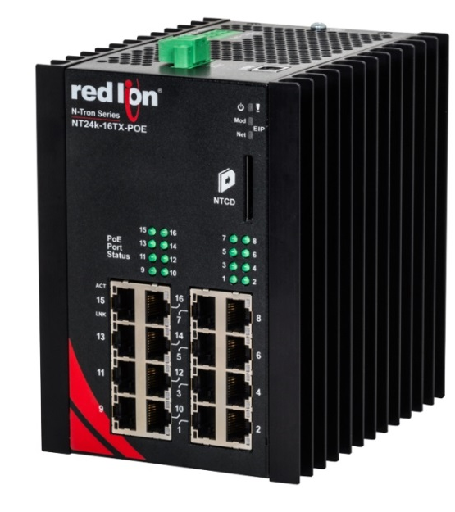
NT24k®-16TX-POE
Layer 2 managed Gigabit switch
16 10/100/1000BaseT(X) RJ45 ports
Managed PoE
  IEEE 802.3af/at
  240 Watt power budget
Redundant power inputs 22-49 VDC
  Boosts power to meet PoE output requirements
-40°C to 80°C operating temperature
200g shock, 50g vibration tolerance

Slide 13
NT24k® Feature Highlights
Advanced PoE management
  Quick and easy allocation of the switch’s 240 Watt PoE power budget to any of its 16 ports (up to 30 Watts per port)
Comprehensive networking functionality
  Auto IGMP configuration
  N-Link™ and N-Ring™ technology
  RSTP
  N-View™ monitoring
  CIP messaging
  Event logging
  IEEE 802.1x with RADIUS remote server authentication
  SNTP (Simple Network Time Protocol)

Slide 14
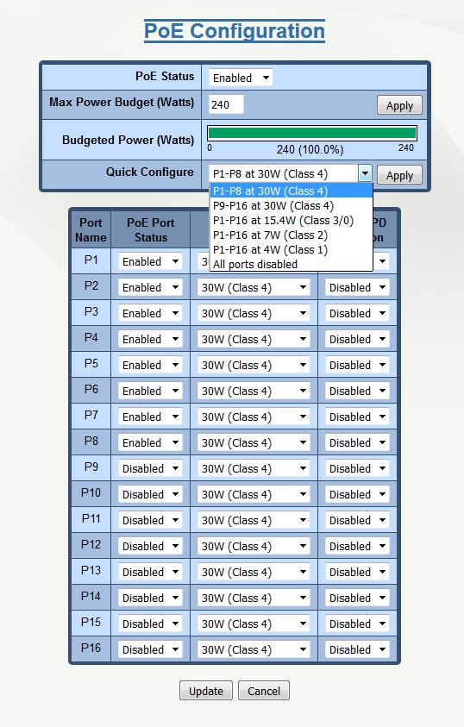
PoE Port Assignment
240 Watt PoE power budget can be assigned to any of the 16 ports
Quick configuration option allows allocation of the power budget across multiple ports in one step
For example:
  Allocate 30 Watts to ports 1-8
  Allocate 15.4 Watts to ports 1-16

Slide 15
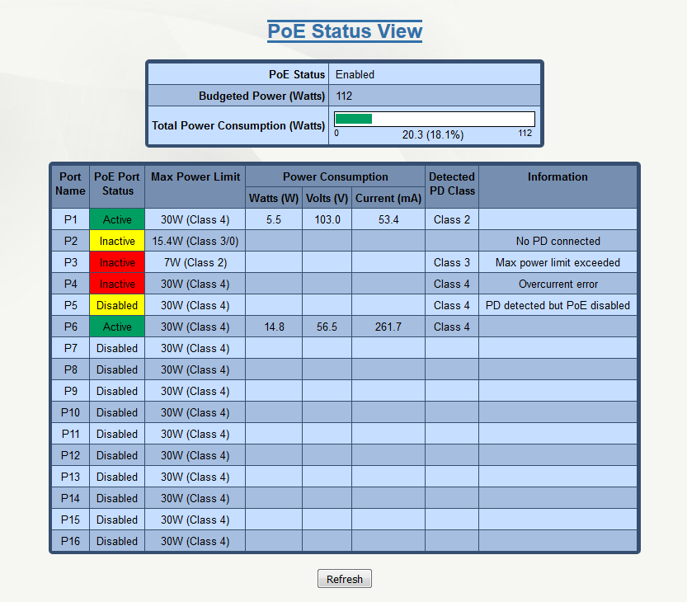
PoE Port Status
Web browser displays PoE status and power consumption by port

Slide 16
NT24k®-16TX-POE
240 Watt PoE power budget
  Can be assigned to any of the 16 ports
Quick PoE configuration allocates
Graphical “gas gauge” representation of budgeted power and actual power consumption

Slide 17

Model Numbers

Slide 18
Model Numbers
Model Number | Description
1000-POE4+ | 4-Port Industrial Gigabit PoE+ Mid-Span Injector (4 10/100/1000Base-T Ports Data In, 4 10/100/1000Base-T Data/PoE+ Out)
1008TX-POE+ | 8-Port Industrial Unmanaged Gigabit PoE+ Switch (4 10/100/1000Base-T ports, 4 10/100/1000Base-T with PoE+ ports)
NTPS-24-10 | DIN-Rail Power Supply 10 Amp @ 24 VDC
1K26-PMK | Panel Mount Kit, 1000 Series

Slide 19
NT24K®-16TX-POE Model Numbers
Model Number | Description
NT24K-16TX-POE | 16-Port 10/100/1000BaseT Managed PoE+ Industrial Ethernet Switch
NTCD-CFG | NT24k Configuration Recovery Device
NTPS-24-20 | DIN-Rail Power Supply 20 Amp @ 24 VDC
NTPS-48-10 | DIN-Rail Power Supply 10 Amp @ 48 VDC
NT24K-NM-PMK | NT24k Non-Modular Panel Mount Kit

Slide 20
Where to Sell?

Slide 21
Targeted Applications
Security & Surveillance
Oil & Gas
Utilities
Alternative Energy
Transportation
Utilities
Factory Automation

Slide 22
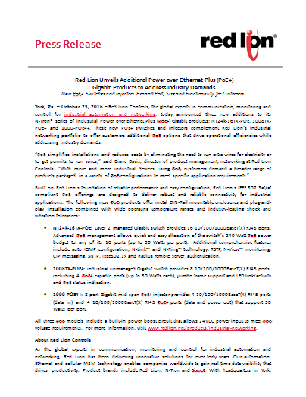
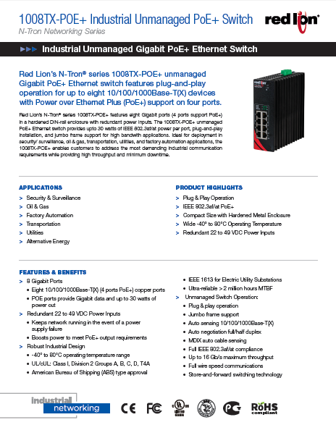

Launch Information – October 25, 2016
Promotional Materials
www.redlion.net/products/industrial-networking
  Press Release
  Data Sheets
  Launch Email
Distributor Portal
  Product Notice
  Product Briefing
  High-Res images
Events
  IAS Shanghai
  SPS in Germany

Slide 23
