Slide 1
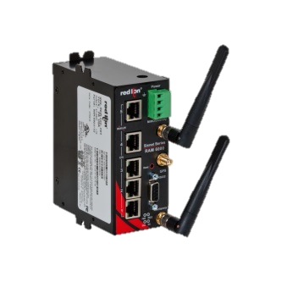
Success Story | Water/Waste Water
Situation
Solution
Value
Faced with a legacy SCADA communication network and needing to scale for changing requirements, a county municipality serving over 1M people across roughly 39,000 acres needed to upgrade their data collection and management equipment for over 300 lift stations.
Red Lion recommended a
RAM-6921 cellular RTU for each lift station. Featuring a web-based event engine that can trigger built-in I/O or send SMS text messages based on real-time operational data, it can perform advanced control & communications for remote assets in extreme conditions.
With native support for Modbus and DNP3, and able to communicate directly with the existing PLC and RTU infrastructure, Red Lion’s RAM® cellular RTUs eased the transition to 4G LTE and significantly reduced system
upgrade costs.

