Slide 1
ST-IPm-8460 and Red Lion Workbench
Product Introduction

Slide 2
ST-IPm-8460 and Red Lion Workbench
New Product Introduction
ST-IPm-8460
Red Lion Workbench
New Programmable RTU
New IEC61131-3 Programming Workbench
Rugged (High Temp; Haz Loc)
Programmable
Redundant Operation
Datalogging
5 Languages
Protocols
Redundancy
Two variable database or one variable database

Slide 3
ST-IPm-8460
10x faster performance
4x more NVRAM
4x more FLASH
8x more RAM
Isolated RS232 and RS485 ports
1 additional Ethernet Port
ISaGRAF Compatible (backward compatibility)
New Red Lion Workbench (IEC61131-3 programming)
Programmable Controller

Slide 4
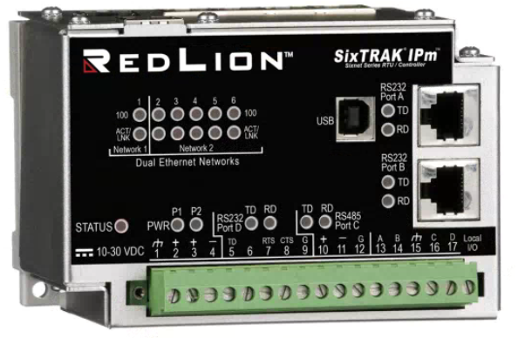
ST-IPm-8460
Rugged dependability in extreme environments
Extreme temperature rating -40 to +70◦C
High mean-time between failure (MTBF)
Redundancy
Redundant Controller
Dual Power Input
Many communication ports and protocols
- 3x RS232, 1x RS485, 6x Ethernet
Certified for hazardous environments
Hardware Features
Ethernet 1
Ethernet 2
USB Device
(Future)
RS232
RS232
Dual Power
RS485
RS232
Notes:
Rugged dependability in extreme environments
Extreme temperature rating -40 to +70◦C
High mean-time between failure (MTBF)
Comprehensive flexibility meets varying requirements
Combines datalogging and control in one device
Simplifies remote monitoring and control needs
Open design future proofs investment
Based on industry standards and open Linux operating system
Critical application redundancy
Built-in option for redundant control
Dual power input and communication ports
Certified for hazardous environments
UL, CSA, CE and ABS Marine rated
Class I, Division 2 and Zone 2
Many communication ports and protocols
All RTUs have Ethernet and multiple serial ports

Slide 5
ST-IPm-8460
Software Features
Flexible open architecture
Linux operating system
Security
User Authentication
Advanced firewalls
Datalogging configuration
Programmable with IEC61131-3 and C
Red Lion Controls Workbench
ISaGRAF (backward compatibility)
5

Slide 6
ST-IPm-8460
Order Guide
 | PORTS |  |  | MEMORY
Part Number | Eth | 232 | 485 | NVRAM | FLASH | DRAM
ST-IPm-8460 | 6 | 3 | 1 | 8M | 512M | 512M
6
Notes:
6

Slide 7
ST-IPm-8460 and Red Lion Workbench
New Product Introduction
ST-IPm-8460
Red Lion Workbench
New Programmable RTU
New IEC61131-3 Programming Workbench
Rugged (High Temp; Haz Loc)
Programmable
Redundant Operation
Datalogging
5 Languages
Protocols
Redundancy
Two variable database or one variable database

Slide 8
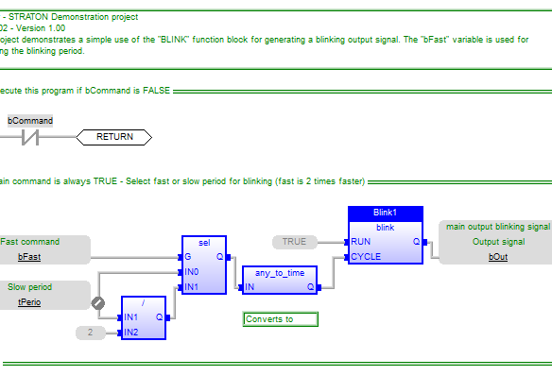
Red Lion Workbench
IEC61131-3 Programming
5 Programming Languages
ST, SFC/CFC, IL, FBD, LD
Many Protocols Supported
Modbus Included
DNP3 (Future)
IEC60870 (Future)
IEC61850 (Future)
Ethernet/IP (Future)
Controller Redundancy
Bumpless transfer
No License Required
Primary
Secondary
Notes:
5 Languages: 2 textual programming languages
ST – Structured Text
IL – Instruction List
Graphical languages
SPC/CPC – Sequential Function Charts / CPC (Colour Personal Computer) OLD
FBD – Function Block Diagram
LD – Ladder Diagram
Protocols
Modbus
DNP3 – Distributed Network Protocol

Slide 9
Tool Kit and Red Lion Workbench
Separate Variable Databases
Tool Kit
RL Workbench
When ever there is a change you must resync
Data Types Supported
Boolean
Integer
Long
Float
Data Types Supported
Boolean
REAL
LREAL
SINT
USINT
BYTE
INT
UINT
WORD
DINT
DWORD
LINT
ULINT
LWORD
TIME
STRING
ST-IPm-8460
Tool Kit
I/O Database
Red Lion Runtime

Slide 10
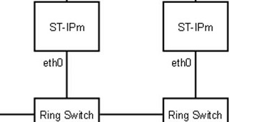
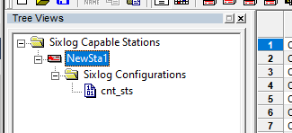
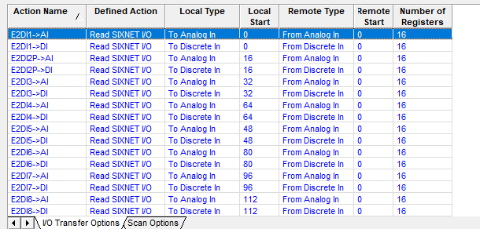
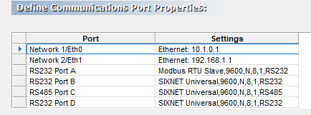
Tool Kit and Red Lion Workbench
Separate Variable Databases
Tool Kit
RL Workbench
Redundancy
Datalog
Data Types Supported
Boolean
Integer
Long
Float
Program
ST-IPm-8460
I/O Transfers
Tool Kit
I/O Database
Red Lion Runtime
SCADA

Slide 11
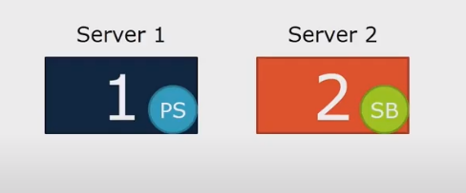
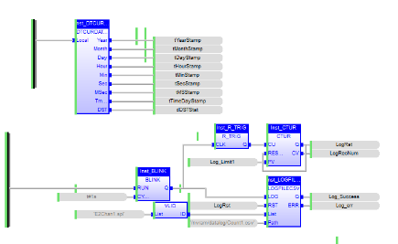
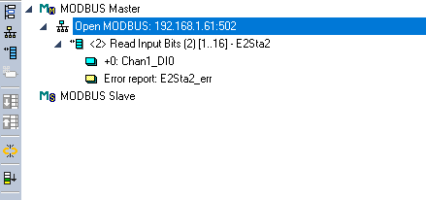
Red Lion Workbench
One Variable Database
Redundancy
Tool Kit
RL Workbench
Program
Configuration Only
IP address
User Authentication
Firewall
Datalog
Data Types Supported
Boolean
REAL
LREAL
SINT
USINT
BYTE
INT
UINT
WORD
DINT
DWORD
LINT
ULINT
LWORD
TIME
STRING
ST-IPm-8460
Red Lion Runtime
I/O Transfers
SCADA

Slide 12
Red Lion Workbench
1
2
3
1
Multiple Projects Each Project List
Main Window Editor
Global/Local Variable List
Watchlist
List of Functions
Build status output
2
3
4
4
5
5
6
6
Full Featured Editor

Slide 13
Red Lion Workbench
1
1
Select the timestamp format
Use the Log File function block
Define log trigger
Create log records with spylists
Log to RTU directory
Log all data types including messages and time
3
2
3
2
4
4
5
5
6
6
Datalogging
Notes:
5 Languages: 2 textual programming languages
ST – Structured Text
IL – Instruction List
Graphical languages
SPC/CPC – Sequential Function Charts / CPC (Colour Personal Computer) OLD
FBD – Function Block Diagram
LD – Ladder Diagram
Protocols
Modbus
DNP3 – Distributed Network Protocol

Slide 14
Red Lion Workbench
1
2
1
Configure slave device and registers to read/write
Variables for program are automatically created
2
Fieldbus
Notes:
5 Languages: 2 textual programming languages
ST – Structured Text
IL – Instruction List
Graphical languages
SPC/CPC – Sequential Function Charts / CPC (Colour Personal Computer) OLD
FBD – Function Block Diagram
LD – Ladder Diagram
Protocols
Modbus
DNP3 – Distributed Network Protocol

Slide 15
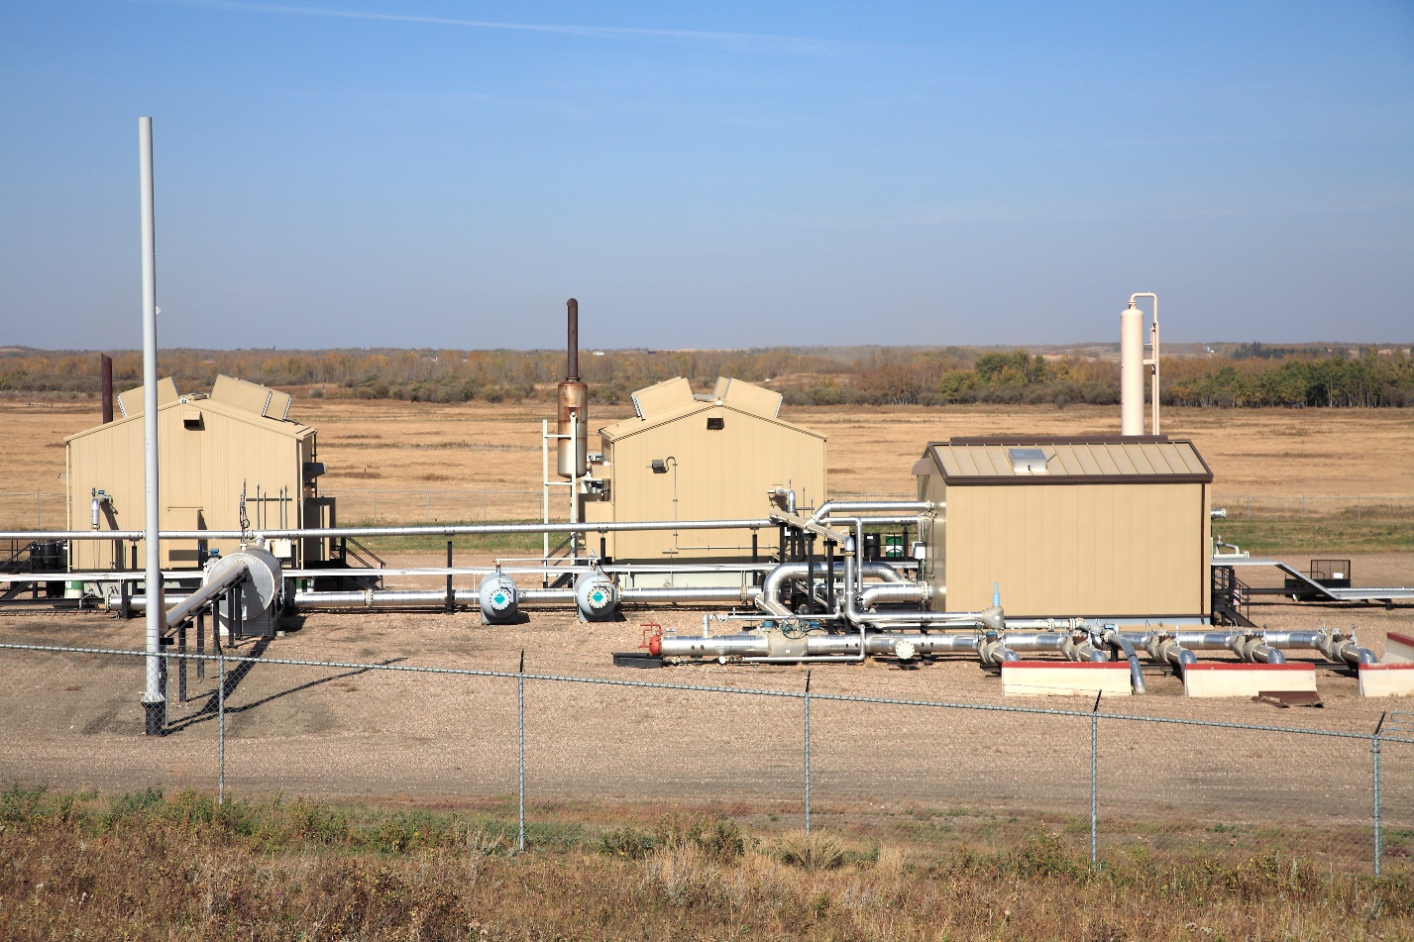
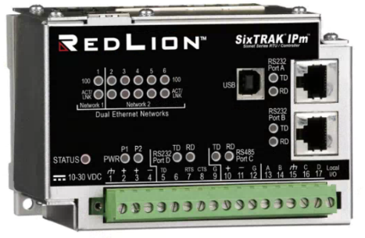
ST-IPm-8460, EtherTRAK-2 I/O, Graphite
Gas Compression Operation

Slide 16
ST-IPm-8460 and Red Lion Workbench
Powerful Combination
ST-IPm-8460 and Red Lion Workbench
New Programmable RTU with fully featured workbench
Rugged (High Temp; Haz Loc)
Programmable
Redundant Operation
Datalogging
Red Lion Workbench
New IEC61131-3 Programming Workbench
5 Languages
Protocols
Redundancy
Two variable database or one variable database
Red Lion Workbench Inside

Slide 17
support.redlion.net
jacob.colegrove@redlion.net

